Slide 1
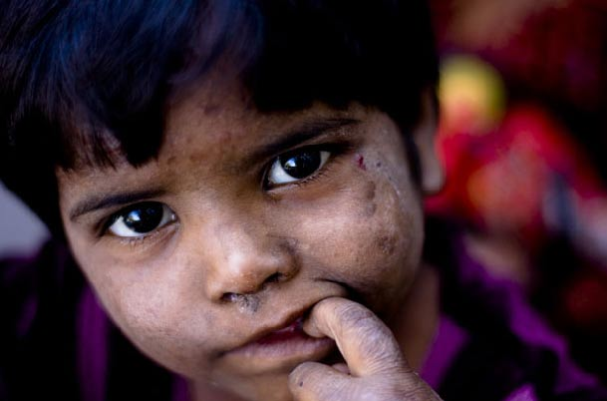
Children At Risk
Adventist say NO to child abuse

Slide 2
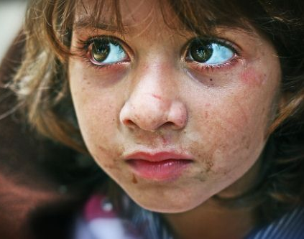
Child Abuse Definition from WHO
Abuse or negligence of children under 18 years of age that can harm their health, development or dignity, or put their survival at risk.

Slide 3
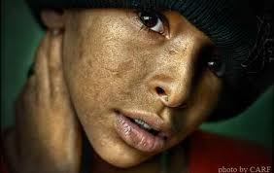
Types of Abuse
Negligence
Psychological
Physical
Sexual

Slide 4
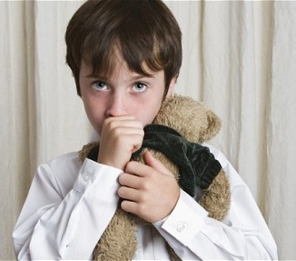
1. Abuse by Neglect
Failure to provide the basic needs of a child by his parents or people in charge of his care

Slide 5
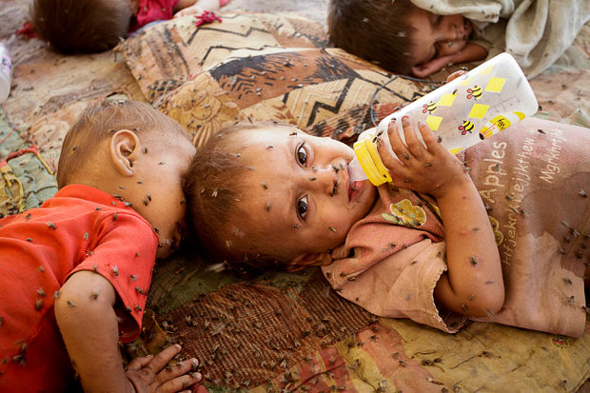
Types of Negligent Abuse
Physical:
Lack of food and shelter
Lack of adequate supervision.

Slide 6
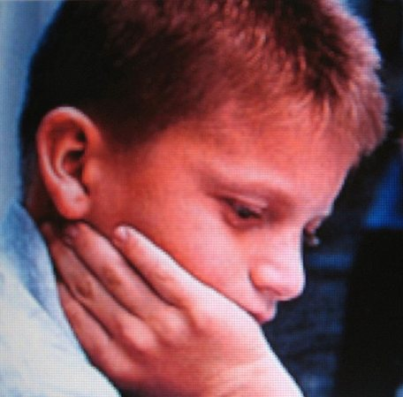
Types of Negligent Abuse
Medical:
Lack of medical attention, immunization and mental health.

Slide 7
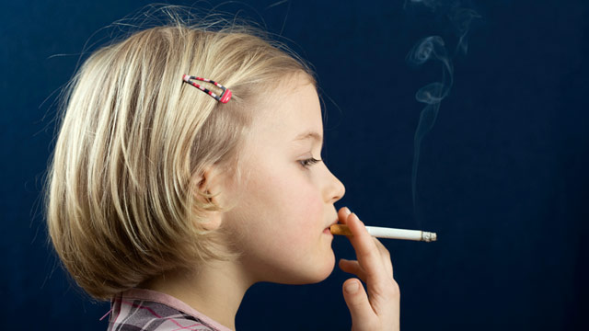
Types of Negligent Abuse
Psychological:
Absence of affection, freedom to use alcohol and drugs.

Slide 8
Types of Negligent Abuse
Educational:
Lack of proper instruction.
Frequent absence from school.

Slide 9
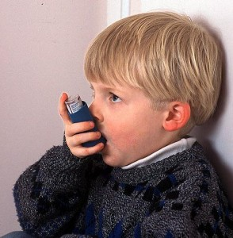
2. Psychological Abuse
Occurs when children are permitted to witness acts of violence or severe abuse among parents or adults.
Child is ignored, insulted or threatened with violence.

Slide 10
Psychological abuse
Child is not provided with a secure environment for their emotional support by the adults. There is an obvious neglect of the child’s well-being.

Slide 11
Psychological Abuse
The child is treated with disregard and there is no affection provided.

Slide 12
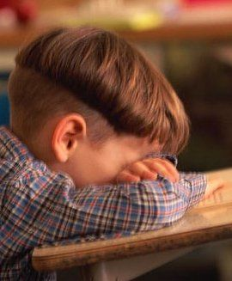
Symptoms of Psychological abuse
Difficulties at school
Changes in eating habits that leads to weight loss or deficient weight gain.

Slide 13
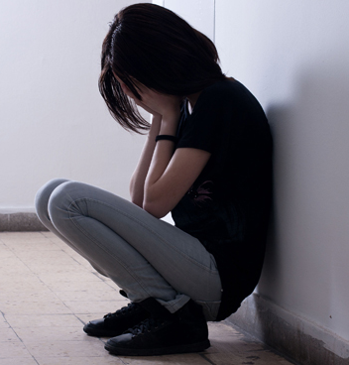
Symptoms of Psychological abuse
Anxiety, depression and low self –esteem
Rebellious behavior
Sleep disorders

Slide 14
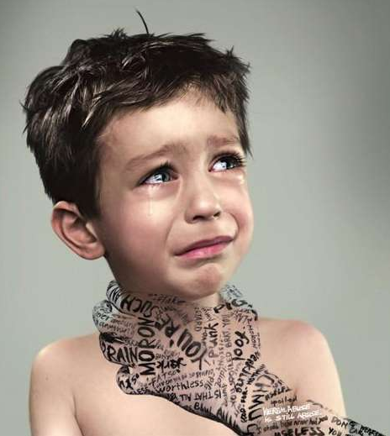
3. Physical Abuse
It is also known as non-accidental trauma.
It also refers to fractures and other signs of lesions that occur when a child is spanked with anger.

Slide 15
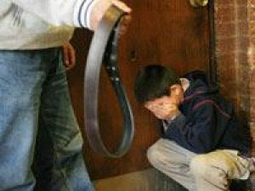
Physical Abuse
Physical abuse tend to occur in moments of great stress.
Many physical abusers were also victims of abuse in their childhood.

Slide 16
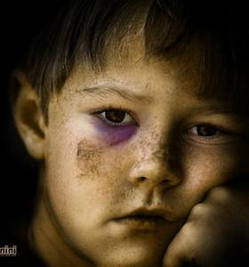
Symptoms of Physical abuse
Blackened eyes or blood in the posterior part of the eye. This occurs when the child is jolted or hit on the head.

Slide 17
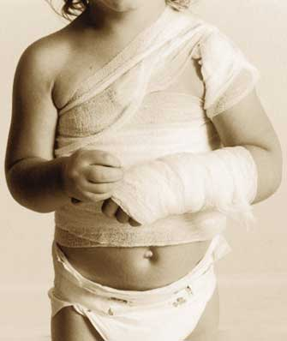
Symptoms of Physical Abuse
Unexplained fractures or any other types of fractures in a child too small to crawl or walk. Fractures of the head.

Slide 18
Symptoms of Physical Abuse
Damage of internal organs or internal bleeding caused by heavy blows.

Slide 19
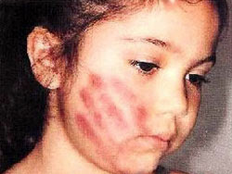
Symptoms of Physical Abuse
Bruise marks in the forms of hands, fingers or other objects such as belts.

Slide 20
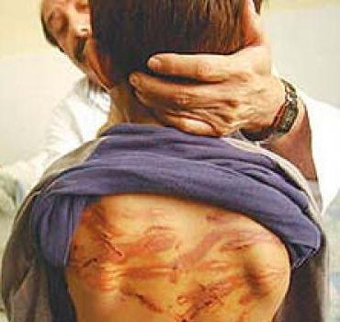
Symptoms of Physical Abuse
Bruises on areas of the body that normal activity of the infant would not create these types of lesions.

Slide 21
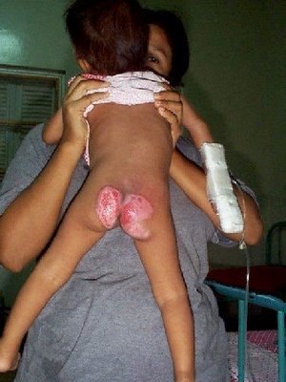
Symptoms of Physical Abuse
Burns
Strangulation marks around the neck
Rope or string marks resulting from tying up

Slide 22
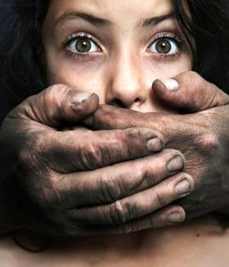
4. Sexual Abuse
A traumatic experience that affects both the physical and psychological integrity of the child

Slide 23
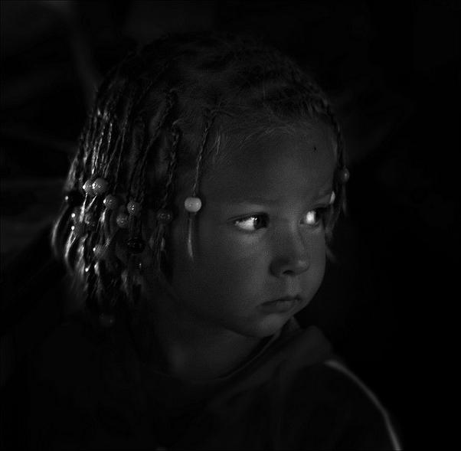
Phases of Sexual Abuse
Seduction:
Manipulation of the child’s confidence and reliance in order to prepare the place and time for the abuse to occur.

Slide 24
Phases of Sexual Abuse
Abusive sexual interaction:
A process that could include exhibitionist behavior, caresses with erotic intentions, masturbation and other lascivious acts.

Slide 25
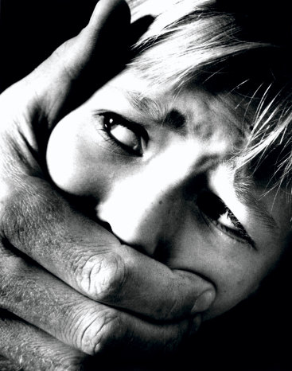
Phases of Sexual Abuse
Establishing the secrecy:
The minor is threatened to keep silent to what is happening.

Slide 26
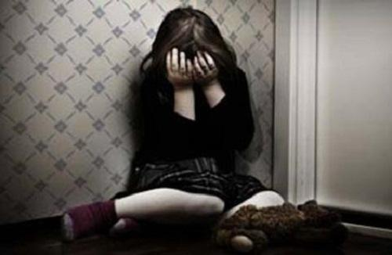
Phases of Sexual Abuse
Telling:
Quite often this phase does not occur.
Accidentally can be expressed in puberty or before

Slide 27
Phases of Sexual Abuse
Repression:
After the occurrence usually the family will try to establish some equilibrium

Slide 28
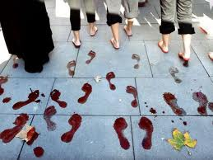
Consequences of Abuse
Can commit acts of violence
Can repeat the scheme of the abuser
Become the victim of a relationship.

Slide 29
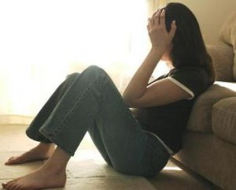
Consequences of Abuse
Depressed, consuming alcohol or drugs
Develops eating disorders
Develops high risk sexual behaviors.

Slide 30
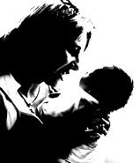
Risk Factors for a child
Younger than 4years of age and/or puberty
Unwanted pregnancy
Children who do not meet their parents expectations
Have special needs, cry a lot or have abnormal physical characteristics.

Slide 31
Risk Factors associated with parents or guardians
Difficulty to establish affection with the new born
Parents who do not take care of their children or spend too little time with them.

Slide 32
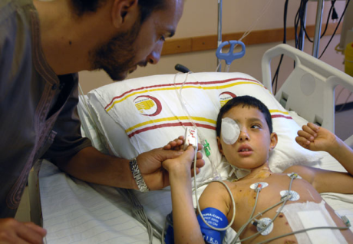
Risk Factors associated with parents or guardians
Personal background of child abuse
Lack of understanding of child development

Slide 33
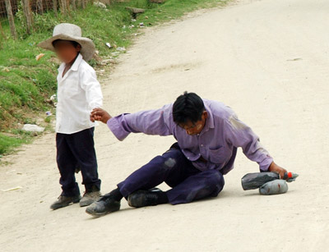
Risk Factors associated with parents or guardians
Improper use of alcohol and drugs especially during pregnancy
Participating in unlawful activities
Financial difficulties

Slide 34
Risk Factors associated with family dynamics
Physical, mental or developmental problems of a family member
Problematic divorces
Violence among other family members

Slide 35
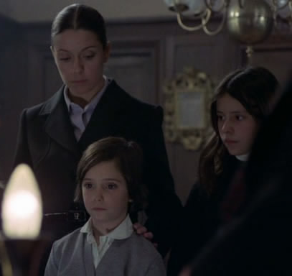
Risk Factors by parents or guardians
Isolated from the community
Lack of support in the extended family to help raise the child.
Social and community factors

Slide 36
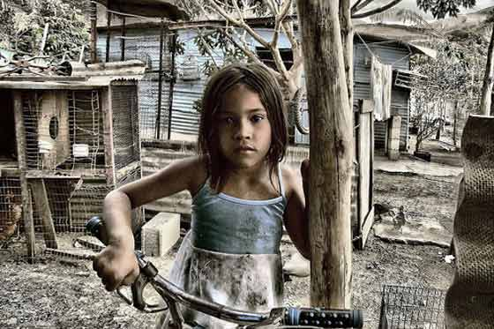
Risk Factors associated with the community
Lack of adequate housing or support services for families and institutions
Social and gender inequalities
Easy access to alcohol and drugs

Slide 37
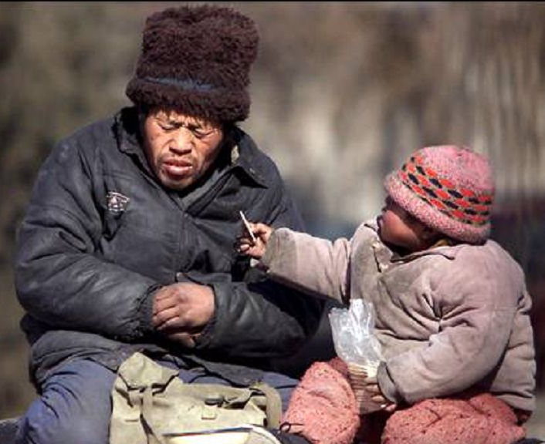
Risk Factors associated with the community
Easy access to alcohol or drugs
Unemployment and poverty at higher levels
Lack of adequate programs to prevent child abuse

Slide 38
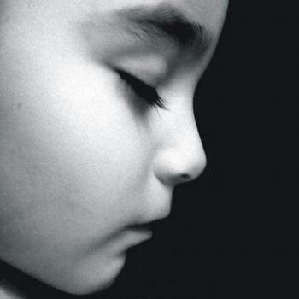
Risk Factors associated with the community
Proliferation of pornography, prostitution and child labor
Loose principles at home, disregard to violence, physical abuse and inflexible roles of each gender.

Slide 39
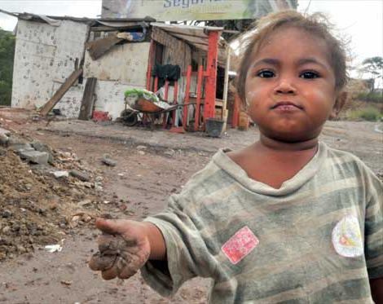
Risk Factors associated with the community
Social, economical,
health and educa-tional policies that generate terrible life conditions.

Slide 40
Primary Prevention
Provide training and awareness for the community
Intervention in psycho- prophylactic deliveries
Create schools for parents

Slide 41
Primary Prevention
Prevent unwanted pregnancies
A systematic search for risk factors in the community.

Slide 42
Primary Prevention
Discuss alternative disciplinary methods
Identify positive strengths of the parents.

Slide 43
Primary Prevention
Teach the children to take care of their bodies
Teach parent the dangers of shaking or jolting their children.
Teach children to say NO.

Slide 44
Secondary Prevention
Recognize abuse by neglect
Develop strategies against negligent behavior
Evaluate the reasons behind neglect and abandonment

Slide 45
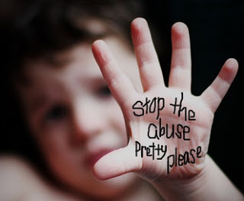
Secondary Prevention
Recognize situations that lead to domestic violence
Recognize inappro-priate disciplinary measures used by parents such as threats, blows, jolting, among others.

Slide 46
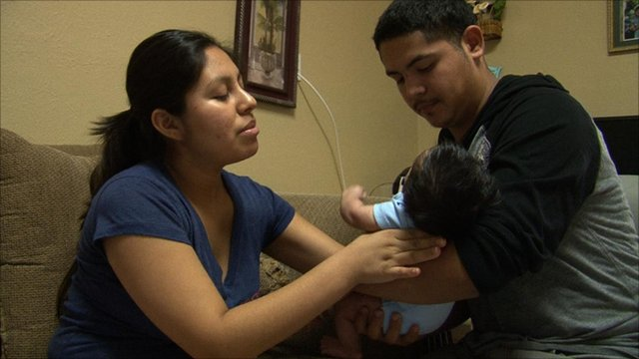
Secondary Prevention
Educate parents on alternative discip-linary measures
Refer parents to anger control groups
Refer alcoholic parents to mental health centers

Slide 47
Secondary Prevention
Provide psychological, social economic and employment support as needed.
Coordinate house visits. Teach parents behavior modification.

