Slide 1
CHRIST’S AMAZING LOVE MOVES ME
By Heather-Dawn Small
General Conference
2020 Women’s Emphasis Day
Notes:
CHRIST’S AMAZING LOVE MOVES ME
By Heather-Dawn Small
Christ’s love has moved me” (2 Corinthians 5:14, MSG)
(Note for the speaker: When you pray just before you preach, ask God to send His Holy Spirit to move the hearts and minds of all who are listening. It is the Holy Spirit who brings change and healing to each person. This message is calling for change.)
Scripture passage: 1 John 4:7-12, NKJV

Slide 2
How has knowing Christ made a difference in your life?
Are you any different this year than last year?
Has the love of Christ for you changed you?
If I were to ask the people closest to you, your family, what would they say?
Notes:
INTRODUCTION
Let me begin this message by asking you a few questions? (Pause a few seconds after reading each question.)
How has knowing Christ made a difference in your life?
Are you any different this year than last year?
Has the love of Christ for you changed you?
If I were to ask the people closest to you, your family, what would they say?

Slide 3
These are uncomfortable questions, but they are questions we need to answer. So, let me repeat them one more time.
How has knowing Christ made a difference in your life?
Are you any different this year than last year?
Has the love of Christ for you changed you?
If I were to ask the people closest to you, your family, what would they say?
Notes:
These are uncomfortable questions, but they are questions we need to answer. So, let me repeat them one more time.
How has knowing Christ made a difference in your life?
Are you any different this year than last year?
Has the love of Christ for you changed you?
If I were to ask the people closest to you, your family, what would they say?

Slide 4
For the love of Christ compels us...” ( New King James Version)
“For the love of Christ controls us...” ( English Standard Version)
“For the love of Christ controls and urges and impels us...” (Amplified Version)
The Message translation says, “Christ's love has moved me...” (The Message)
Notes:
Paul writes in 2 Corinthians 5:14, “For the love of Christ constraineth us…” (KJV)
Let me share a few other versions of this same verse.
“For the love of Christ compels us...” (NKJV – New King James Version)
“For the love of Christ controls us...” (ESV - English Standard Version)
“For the love of Christ controls and urges and impels us...” (AMP – Amplified Version)
The Message translation says, “Christ's love has moved me...” (MSG)
Each of these versions or translations use a number of different words to translate “constraineth” — words such as “compels,” “controls,” “urges,” “impels,” and “move.”
Strong words which carry strong meaning. What does it mean for something to constrain us, to compel us, to control us, or to move us to action? What kind of love is this? Let me share a story with you.

Slide 5
Susan’s Story
Notes:
Thirty-four-year-old Susan had been blind for a year. Due to a medical misdiagnosis she had been rendered sightless. Suddenly she could no longer see, not even the dear and loving face of her husband Mark. How this could have happened to her was her daily question. She was depressed and had every right to her bitter with feelings of regret and loss.
Mark felt his wife’s pain and was deeply saddened at her loss and her struggle to come to terms with her situation. What could he do? Susan was too frightened to move around by herself, so Mark went everywhere with her including taking the bus with her to work each day. But he could not keep it up. It was costly and hectic. Once he dropped her off, he had to take another bus to his job.
Finally, one day Mark told Susan that she would have to start taking the bus by herself. She was angry and stunned to think that she would have to ride that bus alone. “I’m blind,” she screamed at him. “How am I supposed to know where I am going? I feel like you are abandoning me.” Mark’s heart broke to hear these words, but he knew it had to be done. He knew that in time Susan would become accustomed to the bus ride and she would become more confident. But she would never reach that place if he kept on doing it with her. So for the next few trips he talked to her about everything he did and then had her try it on her own. He even helped her make friends with the bus driver.
Finally, the day came when Susan believed she could take the bus on her own. Mark would take a taxi to his office as he used to before her blindness. On that first Monday morning she hugged her husband as though she did not want to let him go. But then she released him, carefully climbed into the bus and was on her way. Each day she did this—Monday, Tuesday, Wednesday, Thursday. Each day she felt more confident about her ability to travel to work on her own.

Slide 6
That’s Amazing Love!
Notes:
One morning as she was paying for her fare to exit the bus, the driver said, “I sure envy you.”
Susan wasn’t sure if the bus driver was speaking to her or not. After all, who on earth would envy a blind woman? Curious she asked the bus driver, “Why do you say that you envy me?”
The driver responded, “It must feel so good to be taken care of and protected like you are.”
Susan had no idea what the driver was talking about and asked, “What do you mean?”
The driver answered, “You know, every morning for the past week a fine-looking gentleman has been standing across the corner watching you when you get off the bus. He makes sure you cross the street safely and he watches you until you enter your office building. Then he blows you a kiss and walks away. You are one lucky lady.”
Tears of joy poured down Susan’s cheeks. For although she couldn’t physically see him, she had always felt Mark’s presence. She was lucky, so lucky for he had given her a gift more powerful than sight—the gift of love. Amazing love.
What kind of love would compel a man, urge him and constrain him to look after his wife in such a manner? Only the love of God. That’s amazing love!

Slide 7
GOD’S LOVE FOR ME
⁷Beloved, let us love one another, for love is of God; and everyone who loves is born of God and knows God. ⁸He who does not love does not know God, for God is love. ⁹In this the love of God was manifested toward us, that God has sent His only begotten Son into the world, that we might live through Him.
¹⁰In this is love, not that we loved God, but that He loved us and sent His Son to be the propitiation for our sins. ¹¹Beloved, if God so loved us, we also ought to love one another.¹²No one has seen God at any time. If we love one another, God abides in us, and His love has been perfected in us.
1 John 4:7-12. (NKJV)
Notes:
GOD’S LOVE FOR ME
But God’s love for us is even more amazing than Mark’s love for Susan. God’s love caused Him to send His only Son to this earth to die for us so that we can have life eternal.
John, the beloved disciple, writes about God’s love in his first epistle. He describes the effect God’s love has in our lives in 1 John 4:7-12. We are reading this passage today in New King James Version.
⁷Beloved, let us love one another, for love is of God; and everyone who loves is born of God and knows God.
⁸He who does not love does not know God, for God is love.
⁹In this the love of God was manifested toward us, that God has sent His only begotten Son into the world, that we might live through Him.
¹⁰In this is love, not that we loved God, but that He loved us and sent His Son to be the propitiation for our sins.
¹¹Beloved, if God so loved us, we also ought to love one another.
¹²No one has seen God at any time. If we love one another, God abides in us, and His love has been perfected in us.

Slide 8
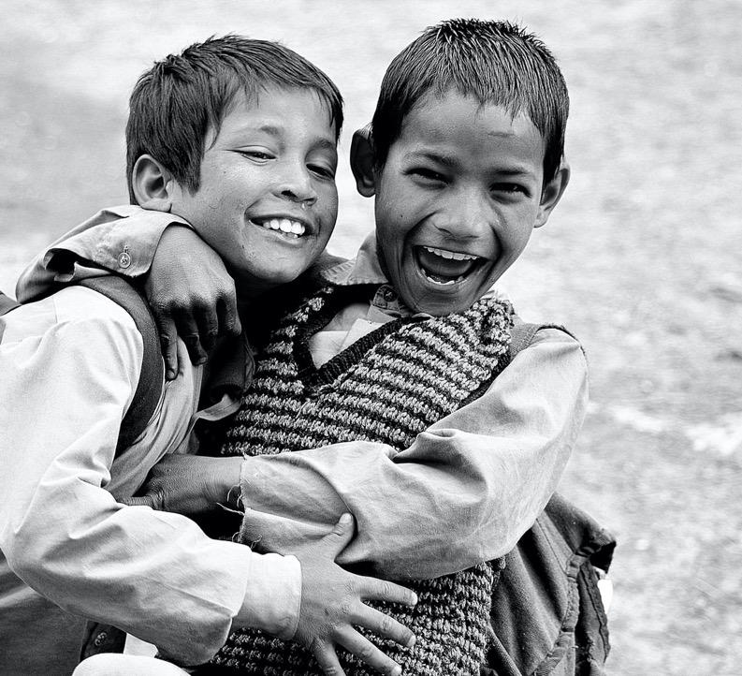
suffers long
kind
does not envy
bears all things
never fails
Notes:
God has called each one of us to share His love with the world. In Women’s Ministries we say, “Touch a Heart, Reach My World.” That word “touch” means to touch those with needs with God’s caring love. Because of challenges and trials that we face in our lives, because of struggles with self and others, we may not have that love to share with others. But if God lives in us on a daily basis, we will have that love.
We read in verse 7 that “love is of God.” God is the source of love. Any other love is not true love. 1 Corinthians 13 gives us a clear description of what true love is and how it behaves. Some of the phrases Paul uses to describe true love are:
- suffers long
- kind
- does not envy
- bears all things
- never fails
I know by now some of you are thinking, “Who can love like this?” The answer is, God can. And we can, too, if He lives in us.

Slide 9
I have loved you with an everlasting love; Therefore with lovingkindness I have drawn you”
(Jeremiah 31:3, NKJV).
Notes:
I know by now some of you are thinking, “Who can love like this?” The answer is, God can. And we can, too, if He lives in us.
We know God can love like this because He says, “I have loved you with an everlasting love; Therefore with lovingkindness I have drawn you” (Jeremiah 31:3, NKJV). Regardless of our past or present, our daily struggles with sin, or the many times we fail our God, He still loves us. He does not give up loving us or in drawing us to Himself. Having a daily relationship with God is vital for us to love others as God loves.
All who have been born into the heavenly family are in a special sense the brethren of our Lord. The love of Christ binds together the members of His family. Wherever that love is made manifest, the divine relationship is revealed. 1 John 4:7 says, “Everyone who loves is born of God and knows God” (emphasis added).
Listen to how these two short quotes from the Spirit of Prophecy support John’s message.
It is not pleasing to God to see man looking only upon his own things, closing his eyes to the interests of others. (emphasis added)
The love of God in the heart is the only spring of love toward our neighbor. (emphasis added)
E.G. White, Counsels on Health (Mountain View, CA: Pacific Press Publishing Association, 1923), 309.
Ibid., The Desire of Ages (Mountain View, CA: Pacific Press Publishing Association, 1898), 505.

Slide 10
MY LOVE FOR GOD
John is straightforward in writing 1 John 4. He counsels us in verse 7 to love one another and then explains that the ability to love as God does comes from knowing God. He states this again in verse 8 but in the negative form so that we pay attention. “He who does not love, does not know God”.
Notes:
MY LOVE FOR GOD
John is straightforward in writing 1 John 4. He counsels us in verse 7 to love one another and then explains that the ability to love as God does comes from knowing God. He states this again in verse 8 but in the negative form so that we pay attention. “He who does not love, does not know God”. Finally, he challenges us in verse 11 to show God’s love to one another.
It is clear from scripture that if we do not love others, we do not truly know God. If others around me—my family, friends, members in the church, co-workers, strangers—do not see Christ’s pure and true love in my life then I do not know God.
You may be coming to church each Sabbath and even during the week. You may be paying a faithful tithe. You may be giving of your time, talent, and means to the church, but if God’s love is not seen in your life then you do not know God. And that translates to being lost. Imagine doing all those things and still being lost? No one wants to be lost! Yet, we are all lost without the love of God in our hearts. I ask you to honestly evaluate your heart at this moment and plead with God to bring change to your heart right now.

Slide 11
GOD’S AMAZING LOVE
For God so loved the world that He gave His only begotten Son, that whoever believes in Him should not perish but have everlasting life (John 3:16, NKJV).
Notes:
GOD’S AMAZING LOVE
What proof do we have of God’s love? Let’s read 1 John 4:9.
⁹In this the love of God was manifested toward us, that God has sent His only begotten Son into the world, that we might live through Him.
John reinforces the same thought even more clearly in his gospel.
For God so loved the world that He gave His only begotten Son, that whoever believes in Him should not perish but have everlasting life (John 3:16, NKJV).
God’s love for us is so limitless that it compelled Him, urged Him, and constrained Him to make that great sacrifice for you and me. That sacrificial love is amazing love!
Paul tells us that God “chose us in Him before the foundation of the world” (Ephesians 1:4, NKJV). Think of it! Before we were conceived, even before time began, God thought of you and me. God’s love for us began even before the first sin was committed because a plan was already in place to save us. That infinite love is amazing love!
Ellen White writes, “The one thing essential for us in order that we may receive and impart the forgiving love of God is to know and believe the love that He has to us.” That forgiving love is amazing love!
Because of God’s amazing, forgiving love for us, we are expected as believers to show love to others. John reminds us in 1 John 4:11, “Beloved, if God so loved us we also ought to love one another” (emphasis added).
Ibid., Prayer (Nampa, ID: Pacific Press Publishing Association, 2002), 298, 299.

Slide 12
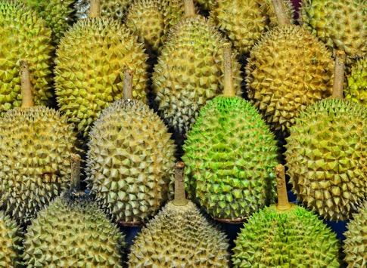
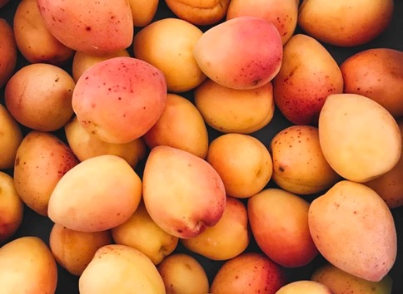
MY LOVE FOR OTHERS
What is your daily prayer? Is it Lord change the other person? Or is it Lord change me? When others look at us, do they see a love that amazes them? Do they see Jesus? They should see a love that compels, urges, controls, and constrains us to love them, whether they are mangoes or durian.
Notes:
Certain fruits are favored by different people and each favorite fruit is called “the best.” Mangoes (or substitute mangoes with a beloved fruit from your country) are sweet and juicy. Lovely to the eyes and so tempting! Another fruit found in Southeast Asia is loved by many people. It’s called durian. However, the smell of the fruit is strong and most unpleasant. Many people won’t even try it because the smell is so strong. It is so unpleasant that hotels will not serve this fruit, nor can passengers take it onboard a plane because of the offensive smell. Yet people claim the taste is sweet and heavenly.
When we think of loving others we are faced with many challenges. Some people are like mangoes (or your chosen fruit). We love them at first sight. We find them a delight have around us. However, some people are more like durian. Often, they have offensive habits. It’s hard to get to know them and sometimes we run the other way when we meet such people. Yet once we persist, we find good things about them. God can use your influence to soften their hearts.
What is your daily prayer? Is it Lord change the other person? Or is it Lord change me? When others look at us, do they see a love that amazes them? Do they see Jesus? They should see a love that compels, urges, controls, and constrains us to love them, whether they are mangoes or durian.

Slide 13
CHRIST’S LOVE IN ME
Paul writes in 2 Corinthians 5:17,
Therefore, if any man be in Christ, he [or she] is a new creature: old things are passed away;
behold, all things are become new.
Notes:
CHRIST’S LOVE IN ME
My friends, be encouraged! If we are like durian, malodorous and smelly to others, God can change our hearts and make us new creatures in Christ.
Paul writes in 2 Corinthians 5:17,
Therefore, if any man be in Christ, he [or she] is a new creature: old things are passed away; behold, all things are become new.
We need to be IN CHRIST. Why IN CHRIST? Because IN CHRIST we have righteousness, forgiveness of sins, life eternal, joy everlasting. IN CHRIST we are new creatures.
What is a new creature? Does this mean our faces will change? Is this an external change? The answer is that it is both internal and external. Externally, people will see it in the change in our behavior and the joy on our faces. Internally, it is a change of the heart and mind. When we are in Christ and He is in us He changes our character. As a result of the change inside, our behavior is changed on the outside. That is what others should see.
Old things are passed away. Old habits, behaviors, attitudes, all those things are fading away. Oh yes, they may surface from time to time when we look to self instead of Jesus. But when we seek our Savior each day, we will see a change in the way we treat others and they will see it too. Having a relationship with Christ means that we are recipients of His love being poured into us. That regenerating love is amazing love!
The old heart—you know, the heart of the woman fussing with her family over little things, the woman constantly criticizing and complaining, the woman sometimes revealing a mean and short-tempered attitude, yes, that woman’s heart—is subdued by the indwelling of the Holy Spirit. Our families, our friends, our co-workers, and our neighbors will see in us the amazing love of Jesus.

Slide 14
SHARING GOD’S LOVE
Our duty is to live in the atmosphere of Christ’s love, to breathe His love deeply, and to reflect its warmth around us. Oh, what a sphere of influence is open before us! How carefully we should cultivate the garden of the soul, so that it may bring forth only pure, sweet, fragrant flowers! Words of love, tenderness, and charity sanctify our influence over others.
E.G. White, Our Higher Calling,175.
Notes:
SHARING GOD’S LOVE
Yet, it’s not enough to receive God’s love. We also need to pass that love on to others. The love that God bestows on us affirms that we are loved, that we are precious in God’s eyes. As we pass that love to others, they too will know that God loves them and sees them as precious. What a difference that can make in the life of someone who is drowning in guilt, regrets, sadness, anger, loneliness, hopelessness, and unforgiveness. To know that God loves them just as they are and died to save them will make the difference between a life of pain or a life or joy. And we are the joy-givers whom God chooses to bring His love to His children in need. That life-changing love is truly amazing love!
Ellen White writes eloquently of the amazing, life-changing love that moves our hearts.
When the heavenly principle of eternal love fills the heart, it will flow out to others, not merely because favors are received of them, but because love is the principle of action, and modifies the character, governs the impulses, controls the passions, subdues enmity, and elevates the affections. This love is not contracted, so as merely to include “me and mine,” but is as broad as the world and as high as heaven. It is in harmony with that of the angel workers. This love, cherished in the soul, sweetens the entire life, and sheds a refining influence on all around. Possessing it, we cannot but be happy, let fortune smile or frown. And if we love God with all the heart, we must love His children also. This love is the spirit of God. It is the heavenly adorning that gives true nobility and dignity to the soul….
Our duty is to live in the atmosphere of Christ’s love, to breathe His love deeply, and to reflect its warmth around us. Oh, what a sphere of influence is open before us! How carefully we should cultivate the garden of the soul, so that it may bring forth only pure, sweet, fragrant flowers! Words of love, tenderness, and charity sanctify our influence over others.
E.G. White, Our Higher Calling (Washington, D.C.: Review and Herald Publishing Association, 1961), 175.

Slide 15
¹⁰In this is love, not that we loved God, but that He loved us and sent His Son to be the propitiation for our sins.¹¹Beloved, if God so loved us, we also ought to love one another. ¹²No one has seen God at any time. If we love one another, God abides in us, and His love has been perfected in us.
1 John 4:10-12.
Notes:
Let’s read 1 John 4:10-12.
¹⁰In this is love, not that we loved God, but that He loved us and sent His Son to be the propitiation for our sins.
¹¹Beloved, if God so loved us, we also ought to love one another.
¹²No one has seen God at any time. If we love one another, God abides in us, and His love has been perfected in us.

Slide 16
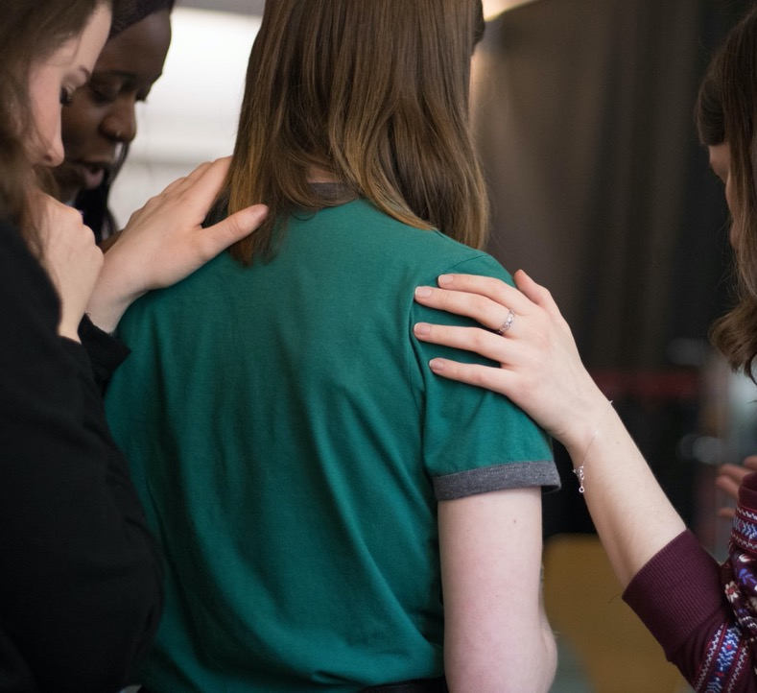
God needs women
Women who are fully surrendered to Him each day.
Women who love Him and are willing to give their lives as a sacrifice of praise to God.
Women who will put Him first in their lives, and that means before husband, children, family, friends, job, everything. God first.
Women who are studying God’s Word and are led by the Holy Spirit.
And women who are willing to serve others.
Notes:
APPEAL
God calls each of us to salvation through His Son, Jesus Christ.
He calls us to surrender our lives to Him so He can live in our lives.
He calls us spend time with Him each day and receive the Holy Spirit and the gifts He brings.
God’s love compels, controls, urges, and constrains us. His love moves us to desire the change we need to become new creatures.
He calls us also to be one with Him and His church as we reach out to those we meet, those who need a touch of God’s love in their lives.
Yes, my sisters, God calls us each day to receive His love and to give His love to those we meet. And so, God needs women—
Women who are fully surrendered to Him each day.
Women who love Him and are willing to give their lives as a sacrifice of praise to God.
Women who will put Him first in their lives, and that means before husband, children, family, friends, job, everything. God first.
Women who are studying God’s Word and are led by the Holy Spirit.
And women who are willing to serve others.
If you want to be such a woman, moved by God’s amazing love, please join me in standing and allowing all present to see that God has an army of women who are ready and willing to love the world for Him.

