Slide 1
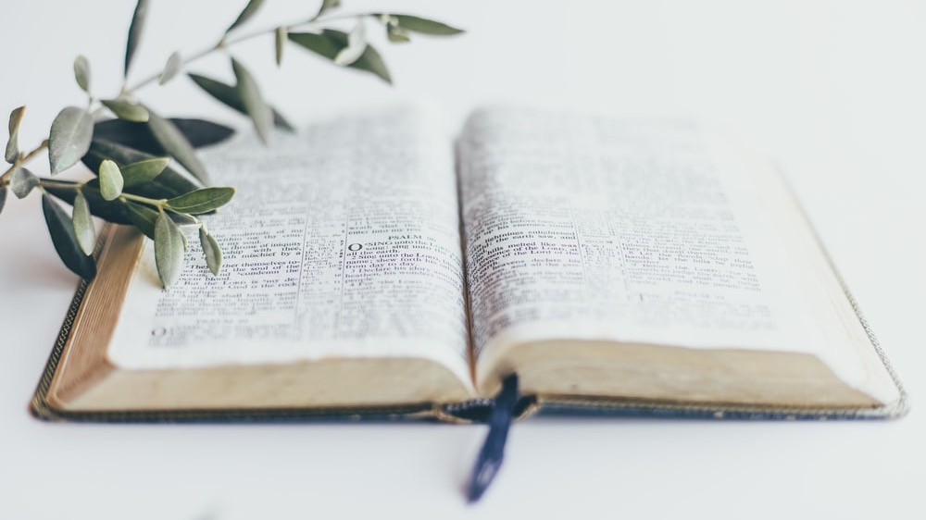
HEROINES OF FAITHFULNESS
SERMON PREPARED BY
OMOBONIKE ADEOLA SESSOU
WEST CENTRAL AFRICA DIVISION WM DIRECTOR
Notes:
Heroines of Faithfulness
By Omobonike Adeola Sessou
Women’s Ministries director of West-Central Africa Division

Slide 2
CAMBRIDGE DICTIONARY
A HEROINE IS “A WOMAN WHO IS ADMIRED FOR HAVING DONE SOMETHING VERY BRAVE OR HAVING ACHIEVED SOMETHING GREAT.”
Notes:
“We ought to obey God rather than men” (Acts 5:29, NKJV).
INTRODUCTION
According to Cambridge Dictionary, a heroine is “a woman who is admired for having done something very brave or having achieved something great.”
The Bible presents many women who are well known for their courage and faith. They are heroines of the ages, who have inspired thousands in their pilgrimage to heaven; women like Deborah, Esther, Sara, Hannah, and Mary, just to mention a few. But we also find some less commonly mentioned women who nevertheless demonstrated their strong faith in God and left us with lessons of faithfulness to God. Today we will study the story of two less well-known women.
https://dictionary.cambridge.org/dictionary/english/heroine

Slide 3
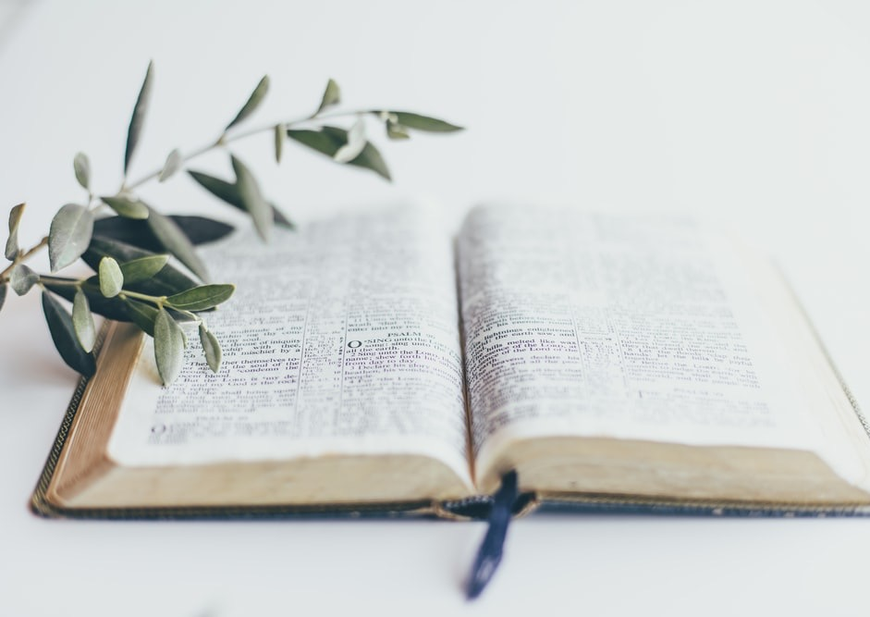
What happens when your profession gives you the unique opportunity to do an extraordinary assignment, whether for good or for bad?
What happens when obedience to God conflicts with obedience to man, and you are faced with life-threatening consequences?
Notes:
What happens when your profession gives you the unique opportunity to do an extraordinary assignment, whether for good or for bad?
What happens when obedience to God conflicts with obedience to man, and you are faced with life-threatening consequences?

Slide 4
What happens when you can simply rationalize being on the side of the multitude who prefer receiving the favor of men, but conscience calls for better choice?
What happens when standing for the right is the only test of faith?
Notes:
What happens when you can simply rationalize being on the side of the multitude who prefer receiving the favor of men, but conscience calls for better choice?
What happens when standing for the right is the only test of faith?

Slide 5
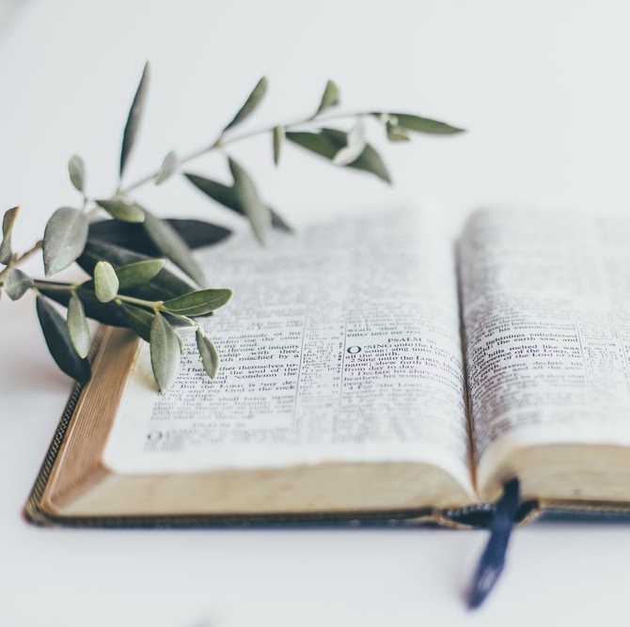
OUR PRAYER
“Father teach me your ways of righteousness and cause your spirit to open my eyes that I may understand your will for my life in Jesus’ name. Amen.”
Notes:
In our study we will learn practical lessons of courage, faithfulness, and love for God through the action of Shiphrah and Puah that will help us as women to fulfill our God-given purpose in life.
Say this prayer with me as we learn from Shiphrah and Puah:
“Father, teach me your ways of righteousness and cause your spirit to open my eyes that I may understand your will for my life in Jesus’ name. Amen.”
SLAVES IN EGYPT
Joseph had died and the children of Israel who were still living in Egypt continued to multiply. The new Pharaoh chose to forget all the good deeds of Joseph who preserved the land of Egypt during a destructive famine. Instead, he planned to curb the exponential growth of the Israelites. They weren’t even Egyptians! He forced them into harsh slavery thinking that hard labor and suffering would diminish their fruitfulness. To his amazement, the more the Israelites suffered, the more fertile they became—because God was blessing them.
Here is good lesson for us all: the enemy cannot stop the blessing of God upon His people, so long as they remain faithful to Him. When the first plan failed, Pharaoh decided to try another strategy to achieve his baleful, death-bringing plan.

Slide 6
“Then the king of Egypt spoke to the Hebrew midwives, of whom one was named Shiphrah and the name of the other Puah; and he said, ‘When you do the duties of a midwife for the Hebrew women, and see them on the birth stools, if it is a son, then you shall kill him; but if it is a daughter, then she shall live’“
Exodus 1:15, 16: (NKJV).
Notes:
PHARAOH’S POPULATION CONTROL STRATEGY
The king’s strategy involved the service of midwives whom he expected to apply the birth control technique of exterminating male children as they were born. The plan would kill all the Hebrew boys and destroy any possibility of their growing up to become rebellious warriors and overthrowing Pharaoh and overrunning Egypt. We read Pharaoh’s strategy in Exodus 1:15, 16: “Then the king of Egypt spoke to the Hebrew midwives, of whom one was named Shiphrah and the name of the other Puah; and he said, ‘When you do the duties of a midwife for the Hebrew women, and see them on the birth stools, if it is a son, then you shall kill him; but if it is a daughter, then she shall live’" (NKJV).
This was a serious and urgent task given to midwives whose profession gave them the unique opportunity to carry out the mandate of the king. What was their reaction to Pharaoh’s order?

Slide 7
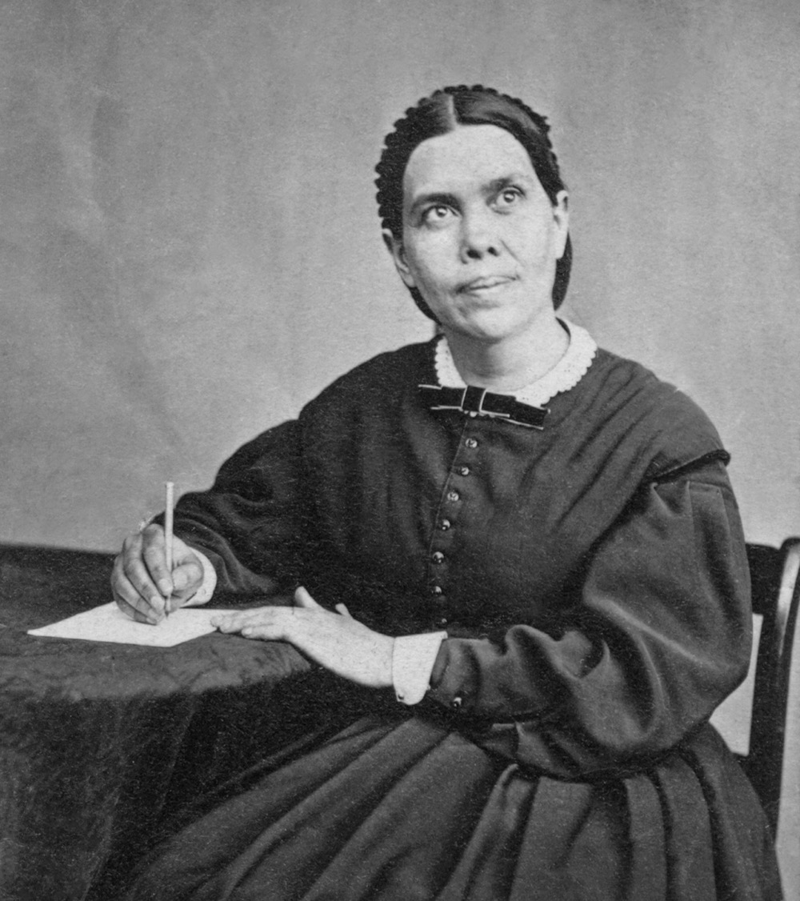
“Satan was the mover in this matter. He knew that a deliverer was to be raised up among the Israelites; and by leading the king to destroy their children he hoped to defeat the divine purpose”
(Patriarchs and Prophets, 242.1).
Notes:
It is important to note here that the plan to exterminate the male babies was not merely a cruel plan of a tyrannical king but rather it came from the greatest mastermind, Satan himself, who is engaged in the great controversy with God. Ellen G. White writes, “Satan was the mover in this matter. He knew that a deliverer was to be raised up among the Israelites; and by leading the king to destroy their children he hoped to defeat the divine purpose” (Patriarchs and Prophets, 242.1). A spiritual battle was raging, and God needed faithful warriors to stand against the enemy, to defeat his purpose, and to honor Him through their faithfulness. Shiphrah and Puah, two midwives, took up the challenge.
THE MIDWIVES’ DILEMMA
Shiphrah and Puah obviously were not the only midwives working in Egypt but why were they specially addressed by the king? Maybe they served directly under the king as leaders of all the midwives to the Hebrew women. Perhaps by giving them this mandate, Pharaoh was sure his order would be carried out as they instructed and supervised other midwives. Whatever the case, these women of value were entrusted with a personal assignment from the Egyptian king.
Apparently, the king never considered the possibility the midwives might not obey him. An Egyptian Pharaoh reigned as a son of the gods. Through his divine right as king, his command must be obeyed without hesitation. By obeying Pharaoh, the midwives might even gain the favor of their monarch, even receive promotions, gifts, and popularity in his court.
Disobedience to a royal decree meant death. Shiphrah and Puah faced the real consequence of losing their heads if they did not obey Pharaoh. The midwives might have reasoned that they had no other choice but to carry out the merciless dictates of the king. Many reasons could be given to obey this royal decree of killing baby boys, but they chose to do otherwise. Why? We can learn the following lessons from their story.

Slide 8
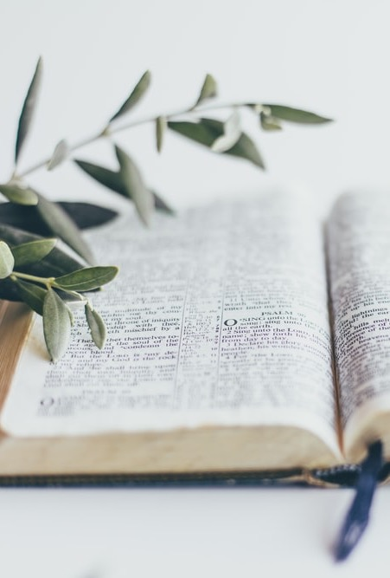
1. THEY FEARED THE LORD
“But the midwives feared God, and did not do as the king of Egypt commanded them, but saved the male children alive”
Exodus 1:17, AKJV.
Notes:
LESSONS FROM THEIR STORY
1. THEY FEARED THE LORD
The Bible clearly reveals the underlying factor influencing Shiphrah and Puah’s decision was the fear of God. “But the midwives feared God, and did not do as the king of Egypt commanded them, but saved the male children alive” Exodus 1:17, AKJV).
The fear of God is the only motivating factor that can make someone reject evil despite the consequences. The fear of God leads one to choose to glorify God, even with the cost and sacrifice of suffering. The fear of God is the only reason why one can say ‘no’ to what is wrong and ‘yes’ to what is right. The fear of God is a virtue shining forth amidst the darkness of this world.

Slide 9
Proverbs 8:13 tells us, “The fear of the Lord is to hate evil; Pride and arrogancy and the evil way. And the perverse mouth I hate” (NKJV).
“Charm is deceitful, and beauty is vain, but a woman who fears the Lord shall be praised.” Proverbs 31:30 (ESV)
Notes:
Proverbs 8:13 tells us, “The fear of the Lord is to hate evil;/ Pride and arrogancy and the evil way/ And the perverse mouth I hate” (NKJV).
A woman who fears God is a power for good. Proverbs 31:30 reveals the true beauty of a woman: “Charm is deceitful, and beauty is vain, but a woman who fears the Lord shall be praised” (ESV). Beauty without the fear of God is a disaster. To fear God means to acknowledge God as Supreme Being and Lord of our lives who alone is worthy of our allegiance, obedience, and worship.

Slide 10
2. THEY HANDLED THE SITUATION WITH WISDOM
And the king of Egypt called for the midwives, and said unto them, Why have ye done this thing, and have saved the men children alive? And the midwives said unto Pharaoh, Because the Hebrew women are not as the Egyptian women; for they are lively, and are delivered ere the midwives come in unto them.”
Exodus 1:18.19 (KJV)
Notes:
2. THEY HANDLED THE SITUATION WITH WISDOM
The midwives resolved to keep alive both the male and female Hebrew children, but they needed to find the best means of accomplishing this resolution. They expected the monarch would ask for an explanation if they didn’t carry out the order. And that is exactly what he did! “And the king of Egypt called for the midwives, and said unto them, ‘Why have ye done this thing, and have saved the male children alive?’” (Exodus 1:18, AKJV).
The next verse reveals Shiphrah and Puah’s secret plan. “The midwives said to Pharaoh, ‘Because the Hebrew women are not like the Egyptian women, for they are vigorous and give birth before the midwife comes to them’” (Exodus 1:19, ESV).
So, it may have been possible that through the wisdom of God these midwives decided to delay their intervention for delivering Israelite women, allowing them to give birth before their arrival, thereby avoiding the killing of babies. The killing instructions specified the time was to be done during the delivery, while still sitting on the birthing stools.
Proverbs 9:10 says, “The fear of the Lord is the beginning of wisdom: and the knowledge of the Holy One is understanding” (NKJV). God blessed Shiphrah and Puah with the best solution for obeying the Lord. The king could not contradict their response, and they could not be accused of disobedience. How did the midwives gain this wisdom? Perhaps as they sought to honor God, He communicated this plan to them.
Is wisdom available for us?

Slide 11
“THE FEAR OF THE LORD IS THE BEGINNING OF WISDOM: AND THE KNOWLEDGE OF THE HOLY ONE IS UNDERSTANDING”
PROVERBS 9:10 (NKJV).
Notes:
Proverbs 9:10 says, “The fear of the Lord is the beginning of wisdom: and the knowledge of the Holy One is understanding” (NKJV). God blessed Shiphrah and Puah with the best solution for obeying the Lord. The king could not contradict their response, and they could not be accused of disobedience. How did the midwives gain this wisdom? Perhaps as they sought to honor God, He communicated this plan to them.
Is wisdom ava
“For the Lord gives wisdom” (Proverbs 2:6, NIV).
“Wisdom is enshrined in the hearts of men [and women] of common sense” (Proverbs 14:33, TLB).
“The fear of the Lord—that is wisdom, and to shun evil is understanding” (Job 28:28, NIV).
ilable for us?

Slide 12
When daughters of God choose to honor Him with their obedience, God blesses them with wisdom in handling complex situations. God promises to help us in all circumstances especially in the time of trouble like this one.
Notes:
When daughters of God choose to honor Him with their obedience, God blesses them with wisdom in handling complex situations. God promises to help us in all circumstances especially in the time of trouble like this one. Psalms 50:15 declares, “And call upon me in the day of trouble: I will deliver you, and you shall glorify me” (KJV). Psalms 32:8 promises, “I will instruct you and teach you in the way which you should go; I will guide you with My eye” (NKJV). Wisdom for finding our way through the labyrinth of life’s difficulties comes through the help and wisdom of God who is willing to communicate to all who seek him.

Slide 13
3. THEY CHOSE TO OBEY GOD RATHER THAN MAN
“He who has God’s law written in the heart will obey God rather than men, and will sooner disobey all men than deviate in the least from the commandment of God.
God’s people, taught by the inspiration of truth, and led by a good conscience to live by every word of God, will take His law, written in their hearts, as the only authority which they can acknowledge or consent to obey. The wisdom and authority of the divine law are supreme”
(Counsels for the Church, 314.3).
Notes:
3. THEY CHOSE TO OBEY GOD RATHER THAN MAN (HUMANS)
Although simply choosing to obey the king was expected, although the command to kill came from the greatest king in history to that time, although the disobedience to the king’s orders meant death, Shiphrah and Puah chose to obey God rather than to obey Pharaoh. Their actions demonstrate that in life a choice can be made in every circumstance. It is incorrect to think we have no choice of our own, to assume that whatever is imposed on us, be it good or bad, leaves us with no choice. Life is all about making choices, and we are responsible for our own choices.
Ellen G. White states that “He who has God’s law written in the heart will obey God rather than men, and will sooner disobey all men than deviate in the least from the commandment of God. God’s people, taught by the inspiration of truth, and led by a good conscience to live by every word of God, will take His law, written in their hearts, as the only authority which they can acknowledge or consent to obey. The wisdom and authority of the divine law are supreme” (Counsels for the Church, 314.3).
The midwives refused to take the life of a human being, choosing instead to obey the Life Giver Himself. God’s law of life on earth was first seen when He breathed on Adam the breath of life. To take the life of another person, even a fetus, is to take away the gift of God’s breath of life. It is the privilege of every child of God to give the Life Giver glory through obedience to His law of life.

Slide 14
4. THEY STOOD AGAINST INJUSTICE AND DEFENDED THE HELPLESS
“Speak up for those who cannot speak for themselves; Defend the rights of all those who have nothing”
Proverbs 31:8 (NCV).
Notes:
4. THEY STOOD AGAINST INJUSTICE AND DEFENDED THE HELPLESS
It is an act of injustice for anyone to seek to eliminate the life of another. It is our responsibility to defend those who are helpless and cannot do so for themselves. “Speak up for those who cannot speak for themselves; Defend the rights of all those who have nothing” (Proverbs 31:8, NCV).
Shiphrah and Puah decided to stand against injustice done to the Hebrews by refusing to carry out the king’s order. They refused to kill the defenseless and saw it as their moral right to defend the helpless, preserving the lives of the innocents.

Slide 15
People who love God, especially women of God, must stand up like Shiphrah and Puah and with God’s wisdom protect the lives of the helpless and defend those who cannot defend themselves.
Notes:
People who love God, especially women of God, must stand up like Shiphrah and Puah and with God’s wisdom protect the lives of the helpless and defend those who cannot defend themselves. This is true whether it concerns abortion, infanticide, child abuse, domestic violence, the way the disabled or the elderly are treated, etc. God longs for His people to be the voice for those who cannot speak, for them to defend the helpless in both private and public sectors.

Slide 16
5. THEIR FAITHFULNESS SAVED THE ENTIRE RACE OF HEBREWS
Can God count on you and me when He needs us to serve Him through our faithfulness in our professions and in the daily routines of life?
Notes:
5. THEIR FAITHFULNESS SAVED THE ENTIRE RACE OF HEBREWS
Little did the two midwives realize the extent to which their faithfulness would work out the fulfilment of God’s purpose and defeat Satan’s plan. Moses, who was used by God to deliver His people from their bondage, surely was saved by the midwives from death at his birth. Thus, Satan’s plan was defeated. God’s plan to raise up a deliverer from the slavery of Egypt flourished. The children of Israel multiplied and became numerous enough to form their own nation. Praise God that Shiphrah and Puah were at the right place at the right time. God could count on them to save His people. What a blessing to have such women in a time of crisis!
Can God count on you and me when He needs us to serve Him through our faithfulness in our professions and in the daily routines of life? Yes, we can be faithful in exercising our daily activities whether at home, in the church, in the community, or anywhere we are called to serve.

Slide 17
“Woman in her home, doing the simple duties of life that must be done, can and should exhibit faithfulness, obedience, and love, as sincere as angels in their sphere. Conformity to the will of God makes any work honorable that must be done”
(Adventist Home, 24.2).
Notes:
Ellen G. White writes, “Woman in her home, doing the simple duties of life that must be done, can and should exhibit faithfulness, obedience, and love, as sincere as angels in their sphere. Conformity to the will of God makes any work honorable that must be done” (Adventist Home, 24.2).

Slide 18
6. GOD REWARDED THEIR FAITHFULNESS
Good News Translation: “Because the midwives were God-fearing, God was good to them and gave them families of their own. And the Israelites continued to increase and become strong.”
Exodus 1:20
Notes:
GOD REWARDED THEIR FAITHFULNESS
God approved the action of the faithful midwives and blessed them for honoring Him. Exodus 1:20 records, “Therefore God dealt well with the midwives, and the people multiplied and grew very mighty.” That was read from the New King James Version.
Other versions throw more light on the phrase “God dealt well with [them].”
Good News Translation: “Because the midwives were God-fearing, God was good to them and gave them families of their own. And the Israelites continued to increase and become strong.”

Slide 19
New American Standard Bible: “So God was good to the midwives, and the people multiplied, and became very mighty.” Exodus 1:20
New International Version: “So God was kind to the midwives and the people increased and became even more numerous.” Exodus 1:20
Notes:
New American Standard Bible: “So God was good to the midwives, and the people multiplied, and became very mighty.”
New International Version: “So God was kind to the midwives and the people increased and became even more numerous.”
The different translations give us a picture of the depth of the blessings that God showered upon the faithful midwives who dared to honor Him at this time of crisis for God’s people. God’s kindness was extended to their families and, surely, they became living testimonies of God’s goodness.
As daughters of God, we may not see the instant results of being faithful to Him in the world full of injustice. We may wonder if we are doing any good by staying faithful in the world full of praise for wickedness. Paul encourages us in Galatians 6:9-10, “And let us not be weary in well doing: for in due season we shall reap, if we faint not. As we have therefore opportunity, let us do good unto all men, especially unto them who are of the household of faith” (AKJV) He also gives counsel in 2 Thessalonians 3:13, “But ye, brethren, be not weary in well doing” (AKJV)

Slide 20
We learned from these humble women that the fear of God is the most important virtue, one which also beautifies the daughters of God.
We learned that God grants us wisdom needed to tackle every situation when we choose to do His will.
We learned that in every circumstance we always have a choice to obey God rather than Satan and his agents.
Notes:
CONCLUSION
Women can exert a positive influence for God in our little corners that will thwart Satan’s purpose and bless the world. Although Shiphrah and Puah have a short appearance in the Bible, just few verses of Exodus 1:15-21, they left a legacy of faithfulness and blessing to us all in the sacred pages. Let’s review what we’ve learned from them.
We learned from these humble women that the fear of God is the most important virtue, one which also beautifies the daughters of God.
We learned that God grants us wisdom needed to tackle every situation when we choose to do His will.
We learned that in every circumstance we always have a choice to obey God rather than Satan and his agents.
We learned to stand up against injustice wherever we are, to defend the helpless, and to offer whatever help is necessary to save lives.
We learned that when we remain faithful in obedience to God, He is faithful in blessing us.
After examining the great lessons from this life-changing story, we can safely call Shiphrah and Puah “Heroines of Faithfulness.”

Slide 21
We learned to stand up against injustice wherever we are, to defend the helpless, and to offer whatever help is necessary to save lives.
We learned that when we remain faithful in obedience to God, He is faithful in blessing us.
Notes:
We learned to stand up against injustice wherever we are, to defend the helpless, and to offer whatever help is necessary to save lives.
We learned that when we remain faithful in obedience to God, He is faithful in blessing us.
After examining the great lessons from this life-changing story, we can safely call Shiphrah and Puah “Heroines of Faithfulness.”
God is calling each one of us to be Shiphrahs and Puahs standing against evil. In the world in which we live, we will be tempted to make compromises to our faith to please others. It could even be a situation in which we are asked to do something that is ethically wrong, but we fear losing our job or relationship if we do not conform. We have learned from this story today that God protects those who stand for what is right. God also blesses those who stand for what is right.

Slide 22
“FATHER TEACH ME YOUR WAYS OF RIGHTEOUSNESS AND CAUSE YOUR SPIRIT TO OPEN MY EYES THAT I MAY UNDERSTAND YOUR WILL FOR MY LIFE AND GO IN JESUS’ NAME.
AMEN.”
Notes:
Today, we each have a choice. Shall we conform or compromise our beliefs? Or shall we stand firm? I pray that with God’s help you will decide to stand firm on the Rock, never turning to the left or the right, but always keeping our eyes on Jesus.
Is that your decision today? If so, will you stand with me to show our Father—stand to affirm visibly—that we choose to stand with Him always.
Let’s pray.

