Slide 1

MENTAL WELLNESS STRATEGY
SUPPORTING CHURCHES IN RAISING MENTAL HEALTH AWARENESS AND ENCOURAGING EMOTIONAL HEALING
© SHARON PLATT-MCDONALD, BRITISH UNION CONFERENCE DIRECTOR,
HEALTH MINISTRIES/WOMEN MINISTRIES AND DISABILITY AWARENESS
© Sharon Platt-McDonald
Notes:
Slide 1:
Recognizing the need to address the issue of Mental Health; the Seventh-day Adventist church in the UK has taken decisive action in order to raise awareness among the membership. The British Union Conference Health Ministries department (under the leadership of Sharon Platt-McDonald) launched a Mental Wellness Strategy in March 2009. This was followed by a series of training events to brief ministerial staff, departmental leaders, and health professionals on how to minister to members experiencing mental health challenges.

Slide 2
MIND – BODY CONNECTION
“The mind controls the whole man. All our actions, good or bad, have their source in the mind. It is the mind that worships God and allies us to heavenly beings....All the physical organs are the servants of the mind, and the nerves are the messengers that transmit its orders to every part of the body, guiding the motions of the living machinery.
Mind, Character, and Personality, vol. 2, p. 396
© Sharon Platt-McDonald
Notes:
Slide 2:
Ellen G. White made some insightful statements on the power of the mind and its impact on our wellbeing. Here is one of her key quotes.

Slide 3
© Sharon Platt-McDonald
Notes:
Slide 3:
A key part of the British Union Conference Mental Wellness Strategy is the production of a handbook which is currently being printed for each church in the British Isles titled: ‘Mental Wellness Handbook – Supporting Churches In Raising Mental Health Awareness and Encouraging Emotional Healing and Wellbeing’.
This comprehensive manual aims to deliver the following:
Provide insight into how improved mental health awareness can enhance greater understanding and support for individuals with mental health challenges.
Assist churches to better embrace individuals with mental health challenges and assimilate them into the church family.
Highlight some key aspects of mental wellbeing and the factors that impact it.
Provide a foundation on which to undertake future workshops to enable learning about the mind/body/spirit connection and how it relates to general wellbeing.
Encourage the church to be more sensitive in its outreach and provision of services that are accessible to all.
Author Platt-McDonald states: “Because the area of mental health is not readily discussed and adequately addressed in our churches, I felt that we needed to open the dialogue with a range of products to assist in raising the awareness of mental health issues and attempt to break down barriers which exist in this area. The manual will seek to do this. Additionally, it aims to equip members with some basic skills in reaching out to individuals in a caring and sensitive way in order to meet their needs.”

Slide 4
MENTAL WELLNESS STRATEGY
THREE SECTIONS MENTAL WELLNESS HANDBOOK:
PART 1 – ADDRESSING MENTAL HEALTH AND MENTAL ILLNESS
PART 2 – ENCOURAGING EMOTIONAL HEALING
PART 3 - MAINTAINING MENTAL WELLNESS
Appendix ( comprehensive resource list and specialist agencies)
© Sharon Platt-McDonald
Notes:
Slide 4:
The Mental Wellness Handbook is compiled in three sections:
PART ONE – Addressing Mental Health and Mental Illness: highlights some statistics, major mental health issues, and prevalent mental illnesses that exist.
PART TWO – Encouraging Emotional Healing: identifies some major emotional issues individuals face and coping strategies to help them. Key professionals share from their work, cases of intervention, in these areas and offer expertise on counseling individuals facing such challenges. Useful quotes are cited from the complied books, “Mind, Character and Personality,” by Ellen G White.
PART THREE - Fostering Emotional Wellbeing: offers practical advice for maintaining emotional health and identifying interventions which enable emotional growth and wellbeing. Also included is information on C.A.R.E., the British Union Conference emotional wellbeing website. A ‘Word from the Lord’ in relevant bible texts finishes this section.
APPENDIX – The Glossary gives a brief explanation of technical terms. Useful Resources identifies publications addressing the issues discussed in the handbook. Used with the handbook, the appendix will bring greater clarity to a specific subject or encourage further reading and training in this area.

Slide 5
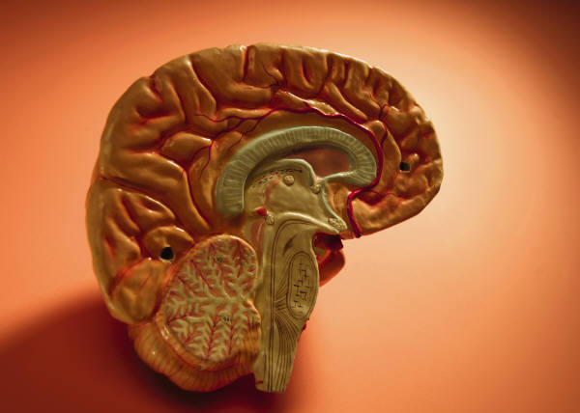
AIMS & OBJECTIVES
RAISE AWARENESS
REDRESS IMBALANCE
DESTIGMATIZE
ADDRESS MENTAL
WELLBEING AND
FACTORS THAT
IMPACT IT
FOSTER EMOTIONAL
HEALING
PROMOTE MENTAL
WELLBEING THROUGH
HEALTH ENHANCING
ACTIVITIES
ASSIST CHURCHES TO BETTER SUPPORT INDIVIDUALS WITH MENTAL HEALTH CHALLENGES
ENCOURAGE CHURCHES TO BE MORE SENSITIVE IN IT’S OUTREACH PROGRAMS
© Sharon Platt-McDonald
Notes:
Slide 5:
Realizing the emotional, mental, spiritual, and social repercussions that can arise from trauma or challenging-life situations, we must educate our members to respond appropriately to the people who are hurting.
If we are to help heal hearts and restore minds, we need to deal with the stigma of mental illness. When a church member has a physical illness, we fill the hospital wards to visit and give them support on Sabbath. However, in comparison, the number of church members taking time on Sabbath to visit a mental health institution to offer support to a member who has succumbed to mental illness are very low.
The Aims and Objectives for developing a Mental Wellness Strategy are as follows:
(read slide)

Slide 6
© Sharon Platt-McDonald
Notes:
Slide 6:
The British Union Conference Health Ministries Department compiled a leaflet titled, “Brain in Crisis,” to assist and train members in offering support to someone in a mental health crisis or whom they suspect is close to having a mental breakdown. It also promotes the Mental Health First Aid course which teaches participants to care for someone in an emergency situation (mental health crisis). Copies of this leaflet can be acquired through the Health Ministries Department of the British Union Conference.

Slide 7
ENCOURAGING EMOTIONAL HEALING
HOW SENSITIVE ARE YOU TO PEOPLE WHO ARE EXPERIENCING EMOTIONAL PAIN?
HOW EFFECTIVE IS YOUR CHURCH AT DEALING WITH THE EMOTIONALLY WOUNDED?
DO YOU KNOW WHICH REFERAL AGENCIES TO REFER PEOPLE TO WHEN THEY COME TO YOU FOR HELP?
WHAT HEALING STEPS WOULD YOU ADVISE FOR SOMEONE COMING THROUGH TRAUMA?
© Sharon Platt-McDonald
Notes:
Slide 7:
Take a few moments to discuss and answer the following 4 questions in relation to your congregation and community. Grade yourself and your church on a scale of 1-10 (1 being the lowest and 10 being the highest) in terms of how you respond.

Slide 8
C.A.R.E
Compassionate Action for the Restoration
and Encouragement of Individuals
(C.A.R.E. is a network organization established by the British Union Conference Health Ministries department of the Seventh-day Adventist Church.)
© Sharon Platt-McDonald
Notes:
Slide 8:
C.A.R.E is an acronym for: Compassionate Action for the Restoration and Encouragement of individuals. Recognising the need to address emotional wellbeing as a key aspect of our journey through life, CARE exists both as a supportive outlet for challenging times and a tool for encouragement. It is a network ministry which seeks to harness the support, understanding, and skills of individuals and other agencies to assist those who are facing crisis and life challenges.
As part of the Mental Wellness Strategy recently launched by the British Union Conference Health Ministries department, Sharon Platt-McDonald, union director, developed the C.A.R.E network as a practical tool to aid individuals in offering a range of options and resources to enhance emotional and spiritual wellbeing.
C.A.R.E can be accessed via the BUC Health Ministries page of the BUC website or via C-A-R-E-adventist.org.uk.
Three key aspects to C.A.R.E :
* prayer ministry (including prayer requests and testimonies to answered prayer)
* support ministry (including resources, and details of relevant referral agencies)
* affirmation cards (a range of inspirational cards to encourage and affirm individuals)

Slide 9

AFFIRMATION CARDS
This entails an exclusive range of affirmation
postcards, with 12 assorted scenes and text,
designed to encourage and
affirm members, family and friends.
Do you know someone who is in need of
encouragement or who would value being
appreciated? Here is an opportunity
to send them an uplifting message set against a
vibrant background.
Under the categories of encouragement and
support are the following 7 cards:
‘Missed you at Church'; ‘Thinking of You’;
‘Praying for your healing’; ‘Trust God’;
‘For Such a Time as This’; ‘Are You Discouraged?’;
‘Remembering’.
Under the category of acknowledgement are the
following 5 cards:
‘Thanksgiving’; ‘Appreciation’; ‘A friend like you’;
‘Friends’; ‘Happy Anniversary’
© Sharon Platt-McDonald
Notes:
Slide 9:
1st Thessalonians 5:11 (NIV) states: “Therefore encourage one another and build each other up.”
In attempting to assist church members and community individuals in addressing life challenges which impact emotional wellbeing, we need to be both sensitive and supportive in our approach demonstrating genuine care and concern.
The Affirmation Cards were created to do just that. Sometimes hurting individuals don’t want to be ‘talked at’ and would rather receive an encouraging word through a card, book, or thoughtful present. By choosing one of the relevant affirmation cards, you have opportunity to minister to an individual’s emotional and spiritual needs.

Slide 10
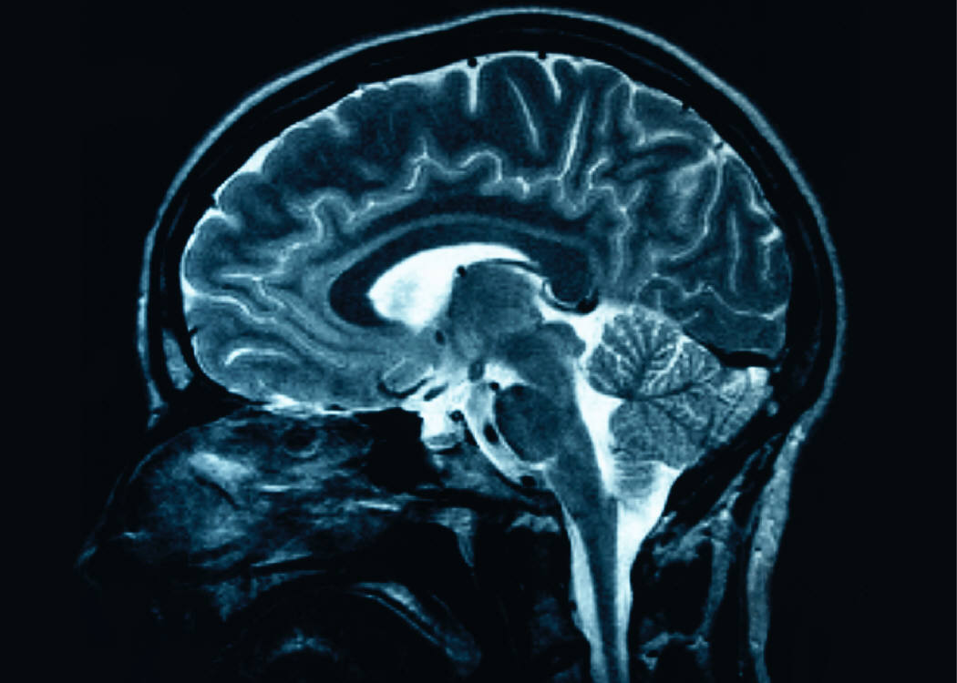
MENTAL HEALTH FACTS
The Mental Health Foundation 2007 edition
www.mentalhealth.org.uk
© Sharon Platt-McDonald
Notes:
Slide 10:
The following slides deal with data on Mental Health issues from the Mental Health Foundation.

Slide 11

DID YOU KNOW?
1 in 4 people will experience some kind of mental health problem in the course of a year.
About 10% of children have a mental health problem at any one time.
(Mental Health Foundation)
© Sharon Platt-McDonald
Notes:
Slide 11:
Take a moment to reflect on the scope of Mental Health challenges and how prevalent it is.

Slide 12
DID YOU KNOW?
Women are more likely to have been treated for a mental health problem than men.
British men are three times as likely as British women to die by suicide.
(Mental Health Foundation)
© Sharon Platt-McDonald
Notes:
Slide 12:
What do you think is the reason for the gender differences expressed in this slide?

Slide 13
GENDER DIFFERENCES
Emotional expression – The deep limbic system is responsible for emotions and bonding and is larger in females than males. As a result, women create bonds easily and are more expressive and in touch with their feelings than men.
© Sharon Platt-McDonald
Notes:
Slide 13:
There are gender differences in the emotional expression of men and women. This slide gives a biological perspective from the deep limbic system of why the brain is different in size and function, depending on whether you are male or female.

Slide 14
GENDER DIFFERENCES
Depression risk –
A larger deep limbic system, however, makes females more susceptible to depression, particularly, at times of significant hormonal changes such as puberty, menstruation, postnatal period, and menopause.
Women attempt suicide three times more than men. However, men kill themselves three times more than women, partly because they become disconnected more easily and use more violent means of dying.
© Sharon Platt-McDonald
Notes:
Slide 14:
A biological gender difference exists in the incidence and expression of depression. Women are at greater risk.

Slide 15
Brain Facts
(From book Brain Health – How to Handle Your Head)
Oxygen plays a key role in brain health. Developing the efficiency and depth of your breathing improves oxygenation to the brain thus enhancing its function.
Adequate water is essential to balancing physiological and biochemical processes in the body, as well as nerve and brain function.
A diet rich in antioxidants may slow the aging process and diseases associated with brain degeneration
Exposure to toxic substances damages the brain, accelerates aging and increases the incidence of memory loss.
© Sharon Platt-McDonald
Notes:
Slide 15:
Here are some key lifestyle practices that enable the brain to function at its optimum and to prevent it from degenerating.

Slide 16
Brain Facts
(From book Brain Health – How to Handle Your Head)
Unstable blood sugar levels damage brain cells and impair brain function
Thyroid dysfunction can impact mood and mental wellbeing.
Exercise increases mental agility and alertness
Nurture your body; nurture your brain and enhance its functional capacity
© Sharon Platt-McDonald
Notes:
Slide 16:
Here are some additional lifestyle factors that enhance brain function.

Slide 17

HEALTH BOOKS
© Sharon Platt-McDonald
Notes:
Slide 17:
Books at the top of the slide give guidance related to mental wellbeing of children and youth, men, women, and seniors.
Books at the bottom of the slide are used to coach individuals facing emotional wellbeing challenges.
These books are available from the British Union Conference Health Ministries Department. In some countries, they are available at local Adventist Book Centers.

Slide 18

E. G. WHITE ON MENTAL HEALTH
“A person whose mind
is quiet and satisfied in
God is in the pathway
to health.”
Mind, Character, and
Personality, vol. 2, p. 403
© Sharon Platt-McDonald
Notes:
Slide 18:
Comment on the following quote by Ellen G White, “A person whose mind is quiet and satisfied in God is in the pathway to health.”

Slide 19
FAITH IMPACT
The Royal College of Psychiatrists discovered that mental health service users identified positive outcomes associated with good quality spiritual care. As a result these service users reported that they experienced improved self-control, higher self-esteem, increased confidence and better relationships. Spirituality and Mental Health (2005)
© Sharon Platt-McDonald
Notes:
Slide 19:
We are all susceptible to mental health challenges. However, science has found that Christians suffering from mental illness have a more positive outcome that those without a faith. This is encouraging!

Slide 20
FAITH IMPACT
The Mental Health Foundation reports (2006) that religious people—in particular, those who believe in a transcendent being or higher power—are more likely to recover from depression.
This is also true of people who belong to a community with others who share their values and offer support.
© Sharon Platt-McDonald
Notes:
Slide 20:
The picture is similar for faith individuals suffering from depression. We should never underestimate the power of our faith to heal.

Slide 21
MAINTAINING MENTAL WELLBEING
WHICH LIFESTYLE FACTORS DO YOU CONSIDER WHEN PROMOTING MENTAL WELLBEING?
WHAT ACTIVITIES DO YOU UNDERTAKE TO ENHANCE YOUR MENTAL WELLBEING?
© Sharon Platt-McDonald
Notes:
Slide 21:
Take a few moments to quickly answer the following two questions.

Slide 22

P.E.A.C.E
P.E.A.C.E. – a recipe for tranquil moments of reflection. (Pause – Platt-McDonald & Boldeau 2006)
P – Pause
E – Environment
A – Attitude
C – Calm
E – Exercise
© Sharon Platt-McDonald
Notes:
Slide 22:
The word PEACE is used as an acronym to highlight various lifestyle factors that enhance emotional wellbeing.

Slide 23

PAUSE
P – Pause.
Stop and be still. Delight in the fact at this moment that you choose to ‘be’ rather than to ‘do.’
Don’t feel guilty about this time of seeming inactivity. Just enjoy it. Learn to relax – it eases tension.
Think of this time as renewal, when your energies are being replenished and you gain new strength to go again.
Schedule ‘me time’ in your calendar on a weekly basis.
© Sharon Platt-McDonald
Notes:
Slide 23:
Here are some tips to help you pause for renewal of body, mind, and spirit.

Slide 24
ENVIRONMENT
E – Environment
Retire to a treasured spot where you can easily unwind.
Ensure that the lighting, the temperature and the furniture is comfortable and enhances a relaxing and reflective mood.
Make this your personal area, a safe haven of
retreat.
You may wish to choose some appropriate music which adds to the ambience and aids your restful mood.
© Sharon Platt-McDonald
Notes:
Slide 24:
Try these environmental tips to enhance your environment to make it more conduce for relaxation.

Slide 25

ATTITUDE
A – Attitude
Detox your mind. Getting rid of negative thoughts helps you to think more clearly and enhances general wellbeing.
With a positive mindset you can face life with all its challenges, conquer the past with its disappointments and embrace the future with hope.
Encourage yourself and others. It lifts your mood and reminds you of what is possible.
© Sharon Platt-McDonald
Notes:
Slide 25:
Attitude is key to emotional wellness. Here is some advice that you may find useful.

Slide 26

CALM
C – Calm
The ability to bring body, mind and spirit into a state of rest.
Prayer is a powerful exercise which releases the pressure and allows you to express hopes, hurts and joys. It enables you to connect with God, reflect, and pace your thinking as you gain strength and wisdom to continue the journey of life.
Contemplate on beauty in nature, listen to relaxing music, read something interesting.
Try a soothing herbal tea like camomile which is known for its calming properties to relax the nerves and induce sleep.
© Sharon Platt-McDonald
Notes:
Slide 26:
Ensuring that we enjoy calm moments in our day is vital for emotional wellbeing and is integral to healing hearts bruised by life trauma and restoring minds that have been broken.

Slide 27

EXERCISE
E – Exercise
Engage in regular exercise; it’s a great stress buster.
Exercise improves the circulation, boosts immunity, and maintains good health both mentally and physically.
It also enhances rest which is crucial for good mental health.
© Sharon Platt-McDonald
Notes:
Slide 27:
Much evidence exists to demonstrate the healing benefits for exercise for both brain and body. When we exercise we release endorphins (also known as happy hormones) which are healing.

Slide 28

FORGIVENESS
Biblical directive
Emotional impact
Health impact
Social impact
© Sharon Platt-McDonald
Notes:
Slide 28:
Forgiveness is not just a biblical spiritual directive. Science has demonstrated the healing benefits of forgiveness for our emotional, physical, and social wellbeing.

Slide 29

UNDERSTANDING PEACE
“Peace I leave with you; my
peace I give you. I do not give
to you as the world gives. Do not
let your hearts be troubled
and do not be afraid.”
John 14:27 (NIV)
© Sharon Platt-McDonald
Notes:
Slide 29:
God’s word is always the best prescription. Recognising that we will encounter challenges in life and may experience trauma, Jesus offers us the true peace that comes only from Him. John 14:27, “Peace I leave with you; my peace I give you. I do not give as the world gives. Do not let your hearts be troubled and do not let it be afraid.”

Slide 30
DIVINE HEALER
© Sharon Platt-McDonald
“Are you tired? Worn out? Burned out on religion? Come to me. Get away with me and you’ll recover your life. I’ll show you how to take a real rest. Walk with me and work with me—watch how I do it. Learn the unforced rhythms of grace. I won’t lay anything heavy or ill-fitting on you. Keep company with me and you’ll learn to live freely and lightly.” (Mathew 11:28-30, The Message)
Notes:
Slide 30:
Jesus, the Divine healer who mends both heart and mind, asks us to come to Him for rest and renewal. Only He can fully restore us.
End the PowerPoint presentation…
with a prayer for healing for those who are experiencing emotional or mental health challenges and for sensitivity of our members to minister to them effectively.

