Slide 1
Enditnow® EFFECTIVELY CONFRONTING THE CHALLENGE OF DOMESTIC VIOLENCE
David R. Williams, PhD, MPH, MDiv
Professor, Harvard University
Associate Director (hon.), Health Ministries,
General Conference of Seventh-day Adventists

Slide 2
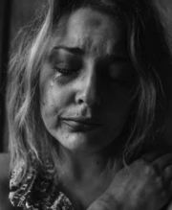
UNITED NATIONS DEFINITION:
OF VIOLENCE AGAINST WOMEN
Any act of gender-based violence that results in, or is likely to result in, physical, sexual or psychological harm or suffering to women, including threats of such acts, coercion or arbitrary deprivation of liberty, whether occurring in public or in private life.

Slide 3
MANY FACES OF
DOMESTIC VIOLENCE
PHYSICAL: shoving, hitting, punching, and the use of dangerous weapons
SEXUAL: demands for unreasonable sexual response, often filled with insane jealousy

Slide 4
ECONOMIC: spouse is deprived of basic needs, or withholding of funds as punishment, or refusing requests for spending money
But domestic violence is ALWAYS PSYCHOLOGICAL: verbal attacks and constant erosion of one’s self image

Slide 5
EXAMPLES OF ABUSE
Constantly checking where spouse is
Telling them they are ugly, too fat/thin, stupid, useless, etc.
Treating them as a servant/slave
Constant putting person down or criticizing (“you’re a bad mother” or “bad wife”)
Shouting, smashing or throwing things, sulking
Hitting, pushing, slapping, kicking & punching

Slide 6
EXAMPLES OF ABUSE
Threatening to hurt someone they care about (children or pets)
Rape or making someone do sexual things they don’t want to do
Using psychological abuse to make a woman feel the abuse is her fault
Restored, Ending Domestic Abuse, 2016

Slide 7
Stalking and harassment
(e.g., online and texting; constantly calling)
Using Scripture to justify their behavior
(“I’m the head of the house and you have to submit to me”)
Not giving them any money, or taking their money away, or checking on what they spend money on

Slide 8
HOME: MOST VIOLENT PLACE IN SOCIETY
The home is the single most dangerous dangerous place for women.
A female runs a greater risk of assault, physical injury & murder in her home than in any other setting.
87,000 women were killed in the world in 2017.

Slide 9
50,000 (58%) killed at the hands of intimate partners or family members.
Women are 82% of homicides perpetrated by IPV/family members (Men are 18%).
Six women are killed every hour (137 per day) by people they know.
United Nations Office on Drugs and Crime, 2018

Slide 10
VIOLENCE INCREASING
Number of female deaths worldwide from IPV/family-related homicide is increasing.
Largest number of deaths in Asia.
Highest rate in Africa, followed by the Americas.
No progress in protecting and saving the lives of female victims in recent. years, despite laws and programs to eradicate violence against women.
United Nations Office on Drugs and Crime, 2018

Slide 11
Number of female deaths worldwide from IPV/family-related homicide is increasing.
Largest number of deaths is in Asia.
Highest rate is in Africa, followed by the Americas.
No progress in protecting and saving the lives of female victims in recent years, despite laws and programs to eradicate violence against women.

Slide 12
ABUSE IN THE UK
1,000 women are sexually assaulted every day.
On average 85,000 women are raped in England and Wales every year.
Two women a week are murdered by their partner or former partner on average, or one woman every three days.
Every day, approximately 30 women attempt suicide as a result of experiencing domestic abuse and every week three women take their own life.
Restored, Ending Domestic Abuse, 2016

Slide 13
ABUSE IN THE UK
50% of children are being directly abused by the same person who is abusing their mother.
90% of children are in the same or the next room during an incident of domestic abuse.
Pixabay.com
Restored, Ending Domestic Abuse, 2016

Slide 14
INTIMATE PARTNER VIOLENCE (IPV) IN THE US
36% (or 43.6 million) women experienced contact sexual violence or physical violence, and/or stalking by an intimate partner during her lifetime.
18% of women experienced contact sexual violence.
CDC, National Intimate Partner & Sexual Violence Survey, 2015
31% experienced physical violence
21% experienced severe physical violence

Slide 15
CDC, NATIONAL INTIMATE PARTNER & SEXUAL VIOLENCE SURVEY, 2015
10% experienced stalking during their lifetime.
6% of women (6.6 million) in the U.S. experienced contact sexual or physical violence, and/or stalking by an intimate partner during the 12 months preceding the survey.
36% (44 million) experienced psychological aggression by an intimate partner during their lifetime.

Slide 16
SEXUAL HARASSMENT IS COMMON
23% of female university students reported experiencing sexual assault or sexual misconduct (survey of 27 universities in the U.S. in 2015).
10% of women in the EU report experienced cyber-harassment since the age of 15 (receiving unwanted, offensive, sexually explicit emails or SMS messages, or offensive, inappropriate advances on social network sites).
Risk is highest among young women age 18 to 29.
UN Women, Facts & Figures, Ending Violence Against Women, 2019

Slide 17
Between 40% and 60% of women in the Middle East and North Africa said that they had experienced street-based sexual harassment (sexual comments, stalking/following, or staring/ogling).
And 31% to 64% of men said they had carried out such acts.
39% of Australian women, (who had been in the workforce for the prior five years) experienced sexual harassment in the workplace compared to 26% of men.
In 79% of cases, the perpetrator(s) was male.
UN Women, Facts & Figures, Ending Violence Against Women, 2019

Slide 18
DOMESTIC VIOLENCE AMONG CHRISTIANS
Problem may be especially acute among SDAs.
Domestic violence is more common in small theologically conservative religious groups.

Slide 19
ON THE OTHER HAND, BECAUSE DOMESTIC VIOLENCE IS TWICE AS LIKELY IN FAMILIES WHERE THE HUSBAND AND WIFE BELONG TO DIFFERENT DENOMINATIONS, COMPARED TO THOSE THAT BELONG TO THE SAME RELIGION, THE LOW LEVELS OF MARRYING OUT OF THE FAITH MAY BE PROTECTIVE FOR SDAS.

Slide 20
DOMESTIC VIOLENCE AMONG SDAS
A random sample of 1,431 SDAs in 70 churches in 5-state area in the U.S. found disturbingly high levels of intimate partner violence among SDAs.
65% reported that they had experienced controlling and demeaning behavior at least once in their lifetime.
46% experienced common couple violence.
29% reported sexual violence.
10% reported severe physical violence.
Drumm et al., Social Work and Christianity, 2006

Slide 21
LARGER CULTURAL CONTEXT
Violence is a common method of problem solving in society.
In many children’s TV programs (cartoons) violence is the first choice in conflict resolution and lacks lasting consequences.
The crushed or exploded victim is magically restored shortly after.
This is soon followed by unrelenting advanced training and violence through movies and TV.

Slide 22
USE AND MIS-USE OF SCRIPTURE
The Bible has often been misused to provide the moral and ideological support for ideas of male superiority and to enforce rigid boundaries for the behavior of husbands and wives.
Many persons in our society view the socially determined role relationships of husbands and wives as established by God for all cultures, societies, and times.

Slide 23
Ephesians 5:21-33
This is the most famous of passage that has been used to justify the abuse of wives by their husbands.
Many husbands believe that Paul’s command in Ephesians 5:22 “wives, be subject to your husband,” gives them license to use physical force in their efforts to “command their children and household after them.”
Many wives accept violence as part of their God-ordained lot in life.

Slide 24
Misrepresenting Paul
Eph. 5:22 cannot be divorced from verse 21: “ in the fear of God.”
The command for wives to be subject to their husbands must be balanced by the commands in this passage for husbands to love their wives with the same self-sacrificing love that Christ has for the church.
This passage directs twice as much instruction to husbands as to wives.
9 of the 13 verses describe how husbands are to nourish and cherish their wives.

Slide 25
WHAT CAN WE DO?

Slide 26
WHAT CHURCHES CAN DO
The extent of spouse abuse in society indicates that Christians should be involved in ministering to those who are affected.
If we are to be truly Christ-like, we must be eager to identify and take care of those who are unprotected, wounded, and without an advocate.

Slide 27
THE ROLE OF THE CHURCH
The church is called to be a place that serves the community and reflects Christ’s love.
We cannot underestimate the influence and responsibility we have in being salt and light and in transforming communities.
Churches are often a natural place for many people to turn to in times of crisis.
We can be either part of the problem or part of the solution.

Slide 28
NO EASY SOLUTIONS
There are no easy solutions for eliminating violence against women and children but there is much that can be done that is central to the role of the church in society.
The ignorance and stigma associated with domestic violence emphasizes the and other institutional workers with regards to abuse.

Slide 29
NEED FOR UNDERSTANDING
Responses to women abused by male partners by most societal institutions are often based on a lack of knowledge of the nature and severity of the problem.
Often clergy and health and human service workers reinforce guilt or humiliation by insensitive treatment of victims.
Around the world, even the police are often reluctant to intervene in cases of domestic violence.

Slide 30
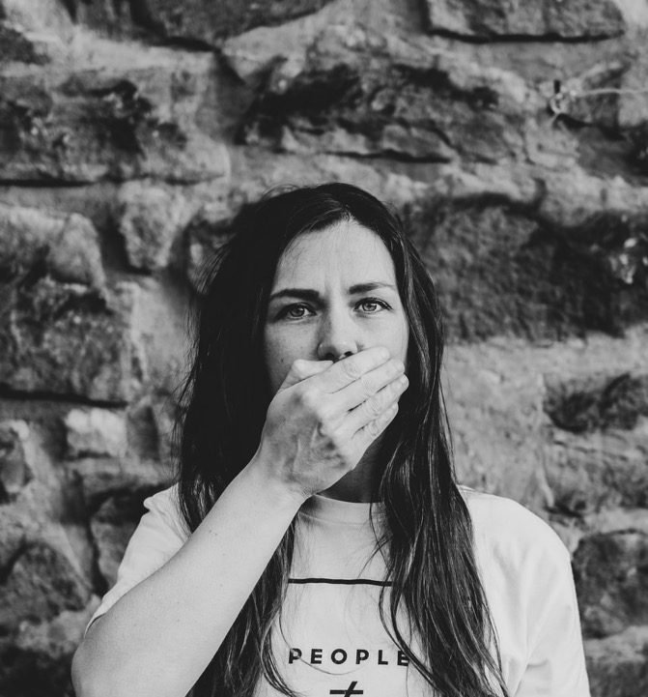
RELUCTANCE TO REACH OUT
Many abused women feel that they cannot approach their church or pastor.
This can be due to:
the silence of the church on this issue,
shame and stigma surrounding their situation, or
because their abusive partner may be part of the leadership or the congregation.

Slide 31
WHAT THE CHURCH CAN DO
The church needs to do at least 3 Things
BE AWARE
ENGAGE
SUPPORT
Restored, Ending Domestic Abuse, 2016

Slide 32
WHAT THE CHURCH CAN DO
First, the church needs to:
Be Aware
Restored, Ending Domestic Abuse, 2016

Slide 33
RAISE AWARENESS
The church must take a decided stand on the issue of abuse and, provide messages in sermons, workshops, seminars and classes that domestic abuse is inappropriate, un-Christlike and wrong.
Many church members like to think that domestic abuse “just does not happen here.”
Pray for those affected (victims & perpetrators) and for the work of local groups that address abuse.
Restored, Ending Domestic Abuse, 2016

Slide 34
RAISE AWARENESS
4. The local church can use posters, cards, leaflets and the church’s website to publicly indicate that domestic abuse is unacceptable and against God’s plan for Christian families.
5. The church must acknowledge the real pain and victimization caused by physical and sexual abuse and provide opportunities for healing and reconciliation for those who have been injured, and confrontation and appropriate assistance for those who have been abusers.
Restored, Ending Domestic Abuse, 2016

Slide 35
A WORD OF CAUTION
Many churches often do not have the needed expertise.
Without proper training and experience in this field, we can do more harm than good.
But we can learn how to support victims.
And we can empower victims to seek professional care from relevant agencies.
Restored, Ending Domestic Abuse, 2016

Slide 36
WHAT THE CHURCH CAN DO
Second, the church needs to:
Engage
Restored, Ending Domestic Abuse, 2016

Slide 37
ENGAGE
This second step involves the church becoming a safe place, with more considered actions taken by the congregation and leadership.
Church leaders need to do their homework and increase their understanding of domestic abuse. Use online resources and read books on the subject to be better informed.
Restored, Ending Domestic Abuse, 2016

Slide 38
ENGAGE AND EDUCATE
Educate the church by inviting a local domestic abuse service or program to do presentations and/or training.
Reserve a day on the church calendar when your church will focus on increasing awareness of issues linked to domestic abuse issues (e.g. Nov. 25 is the international day of action to end violence against women; UN Women.)
Restored, Ending Domestic Abuse, 2016

Slide 39
ENGAGE
Discuss domestic abuse (and issues of conflict, power, control) in pre-marital, marriage and relationship courses or resources, and programs for youth.
Plan special workshops and training for men on what it means to be a man that is walking in the footsteps of Jesus.
Restored, Ending Domestic Abuse, 2016

Slide 40
RESPECT AND LISTEN TO THE ABUSED
Believe the victim.
Do not ask for proof of violence.
Assure victim it is not her fault.
Reassure that confidentiality will be maintained but explain its boundaries.
Assure the victim of your concern and interest.
Be honest and upfront about your ability to help.
Restored, Ending Domestic Abuse, 2016

Slide 41
PRACTICAL STEPS
Churches and conferences should consider appointing a respected, sensitive person or persons from whom victims of physical abuse and inappropriate sexual contact can receive support and referral.
Many women are hesitant to discuss their victimization because of feelings of self-blame, shame, loyalty to the abuser, or fear.

Slide 42
PRACTICAL STEPS
Having a sympathetic listener acknowledge and denounce the abuse in a woman's life can go a long way in relieving the pain, isolation and self-blame.
This could be a useful project for women's ministry groups.
Some Latin American countries have created women-only police stations and discovered that these women-only units have facilitated the reporting of abuse.

Slide 43
HELP MEN ACKNOWLEDGE THEIR PROBLEM
God requires men to take full responsibility for their actions.
The first step in prevention is acknowledging that there is a problem.
Most abusive men do not admit to a problem.
Christians must resist the cultural pressures of society and affirm that every man and woman is made in God’s image
And should always be treated with dignity
Restored, Ending Domestic Abuse, 2016

Slide 44
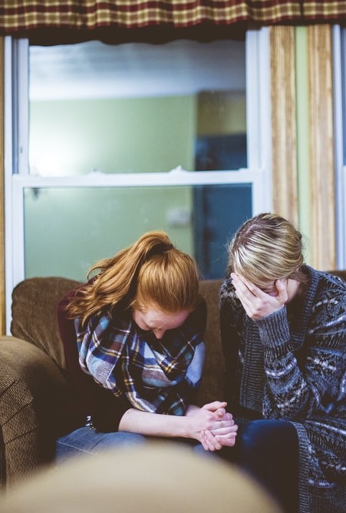
HELP WOMEN AFFIRM THEIR WORTH
In valuing themselves as part of God's creation, Christian women must be reassured that God approves of their saying no to men for unwanted sexual advances.
God wants all His daughters to reject domestic violence as a way of life.
They must also be empowered and encouraged to seek help when they have been taken advantage of.

Slide 45
WHAT THE CHURCH CAN DO
Third, the church needs to provide
Support
Restored, Ending Domestic Abuse, 2016

Slide 46
SUPPORT
Provide referral and support to local resources for survivors and perpetrators.
Work together with local service providers and to set up clear pathways/systems for referral.
Training could be provided to designated church members/officers needs to be sourced regularly and the staff need to be supported with good clinical supervision.
Restored, Ending Domestic Abuse, 2016

Slide 47
SUPPORT
Care should be taken to ensure that all interactions take place in a loving, inclusive and non-judgmental manner.
Some large churches could provide comprehensive support for survivors and/or perpetrators in collaboration with local service providers.
All support activities should be done in a way that ensures safety and confidentiality for women and their children.
Restored, Ending Domestic Abuse, 2016

Slide 48
WHAT MINISTERS CAN DO
Ministers who do pastoral counseling should screen for abuse.
Currently, many health care settings, do not routinely screen for a history of victimization.
Doctors often itemize injuries without any inquiry about context in which injuries were received or about the possibility that there is ongoing danger to the patient.
Even in the mental health profession, standard procedures for assessment do not always ask about physical and sexual abuse.

Slide 49
WHAT CHURCHES CAN DO
Some large churches could establish shelters that provide safe temporary housing to abused women and children.
More shelters alone are not the ultimate remedy for the family violence problem.
Efforts must be made to stop or at least reduce violence at its source.

Slide 50
CHURCH AND SEXUAL ABUSE-1
Churches need to establish mechanisms for addressing problems of sexuality within congregations.
A common practice of resolving clergy-parishioner sexual involvement by simply moving ministers to a new district is inappropriate and irresponsible.

Slide 51
CHURCH AND SEXUAL ABUSE-2
Moving a minister may ensure that knowledge of the abuse remains contained, but it does nothing to break the cycle of repetitive and possibly escalating sexual abuse.
In most cases the same behavior will occur in a new church setting.
Repeat abusers may need to be removed from ministerial work altogether.

Slide 52
THE 4 ‘Rs’ OF RESPONDING TO DOMESTIC ABUSE
RECOGNIZE
RESPOND
REFER
RECORD
That abuse does happen in Christian relationships
The signs of power and control in a relationship
‘I believe you’ is a helpful first response
Within your limitations and the safeguarding framework (especially if children are involved)
To Local professionals – go with her if you can
Dates/times and quotes of what has been said
Your actions and any concerns you may have and keep the notes in a secure place
Restored, Ending Domestic Abuse, 2016

Slide 53
DO’S IN RESPONDING TO VICTIMS
Find a safe place to talk.
Have someone else present – if this is acceptable to the woman.
Allow time for the person to talk.
Listen to what she has to say – and take it seriously.
Give priority to her immediate safety (and that of any children involved).
Empower her to make her own decisions.

Slide 54
DON’TS IN RESPONDING TO VICTIMS
Don’t judge her or what she tells you.
Refrain from making unrealistic promises.
Don’t suggest that she should ‘try again’; evidence shows that victims experience a number of violent incidents before seeking help.
Never minimize the severity of her experience or the danger she is in.
Don’t react with disbelief, disgust or anger at what she tells you or react passively.
Restored, Ending Domestic Abuse, 2016

Slide 55
BIBLICAL ADVICE: LOVE EACH OTHER
Love one another as I have loved you. John 13:34
These things I command you that ye love one another. John 15:17
Be kindly affectioned one to another with brotherly love. Rom 12:10
Serve one another. Gal 5:13
Let us not … provoke one another. Gal 5:26
Forbearing one another in love. Eph 4:2
Be kind one to another, tenderhearted, forgiving one another. Eph 4:32
Comfort one another. 1 Thes 4:18

