Slide 1
Daring to Ask for More
Four Divine Keys to Abundant
Spiritual Blessings
By Melody Mason
General Conference Women's Ministries International Women’s Day of Prayer

Slide 2
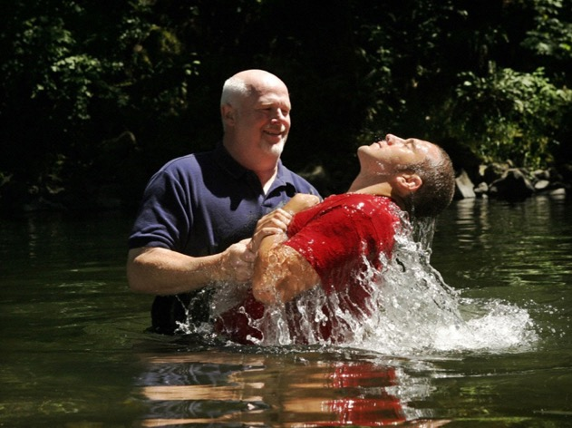

Slide 3
How desperate are you for deeper, richer spiritual blessings?
How desperate are you to see God bring answers to your prayers?

Slide 4
“Most professed Christians have no sense of the spiritual strength they might obtain were they as ambitious, zealous, and persevering to gain a knowledge of divine things as they are to obtain the perishable things of this life. Many are satisfied to be spiritual dwarfs… [Thus] many will be lost while hoping and desiring to be Christians. They make no earnest effort, and therefore they will be weighed in the balance and found wanting.”
Counsels for the Church, pp. 185-186

Slide 5
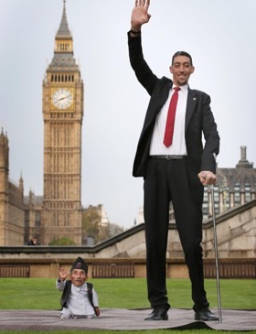
Why be a spiritual dwarf...
...when you can be a spiritual Giant!

Slide 6
Divine Keys
...to abundant spiritual blessings!

Slide 7
Key 1
1. PRIORITIZE
your daily time with God!

Slide 8
Do YOU
take time to eat & drink??

Slide 9
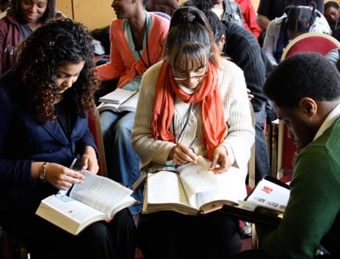
What about
spiritual food?

Slide 10
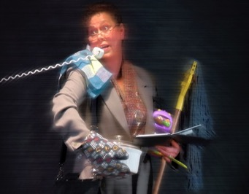
Good things can be the
enemy of the Best Thing!
“Minor matters occupy the attention and the divine power which is necessary for the growth and prosperity of the church, and which would bring all other blessings in its train, is lacking, though offered in plentitude.”
Testimonies vol. 8, p. 21

Slide 11
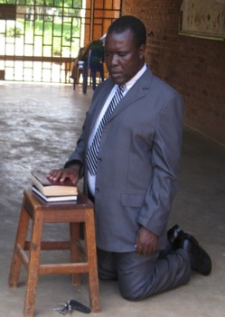
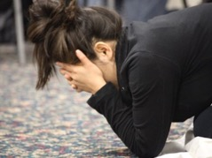
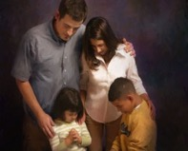
Prioritize!

Slide 12
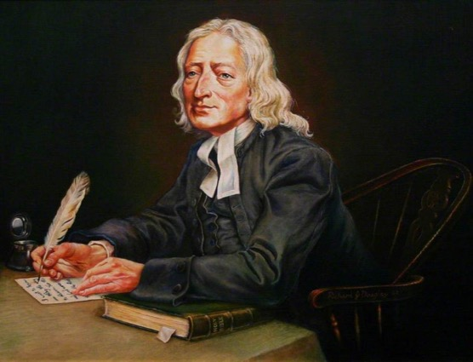
Story of John Wesley

Slide 13
“The darkness of the evil one encloses those who neglect to pray. The whispered temptations of the enemy entice them to sin; and it is all because they do not make use of the privilege God has given them in the divine appointment of prayer.”
Steps to Christ, p. 94

Slide 14
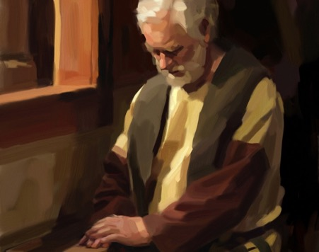
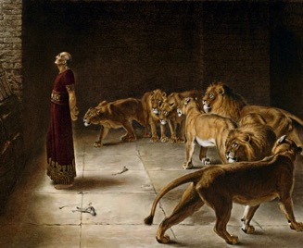
Don’t forget
DANIEL!
He was willing to go to the lions’ den rather than skip his prayer time with God!

Slide 15
Key 2
2. REMOVE
form/pretense/breaches!

Slide 16
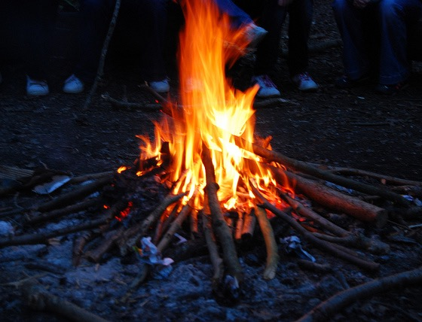

Slide 17
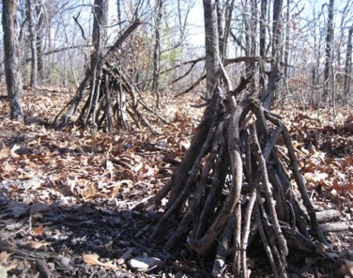

Slide 18
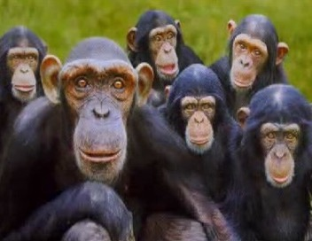
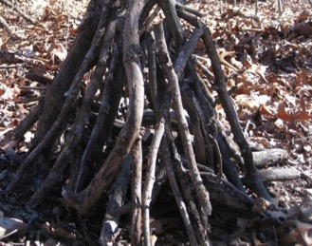
Are we like the monkeys?
Building a form but without the Fire!

Slide 19
“It is a solemn statement that I make to the church, that not one in twenty whose names are registered upon the church books are prepared to close their earthly history, and would be as verily without God and without hope in the world as the common sinner.”
Christian Service, p. 41

Slide 20
Most
Popular Religion
at the End of Time???

Slide 21
The Religion of Form...
“ This know also, that in the last days perilous times shall come. For men shall be lovers of their own selves, covetous, boasters, proud, blasphemers, disobedient to parents, unthankful, unholy…Having a form of godliness, but denying the power thereof:
from such turn away.”
II Tim 3:1-5 (KJV)

Slide 22
“If God were to take the
Holy Spirit out of our midst
today, about ninety-five
percent of what we are doing
in our churches would go on,
and we would not know the
difference. Yet if God had taken the Holy Spirit out of the midst of the first Christian community, about ninety-five percent of what they were doing would have ceased immediately.”
Carl Bates, Former President of Southern Baptist Convention

Slide 23
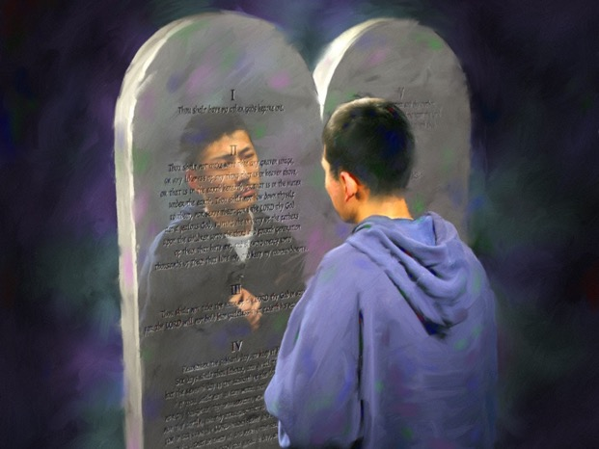
What does God see?
1 Sam. 16:7
Isa. 64:6

Slide 24
“There must be no pretense in the lives of those who have so sacred and solemn a message as we have been called to bear. The world is watching Seventh-day Adventists, because it knows something of their profession of faith, and of their high standard; and when it sees those who do not live up to their profession, it points at them with scorn.”
Christian Service, p. 277

Slide 25
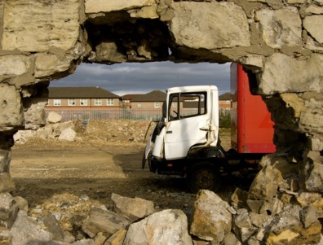
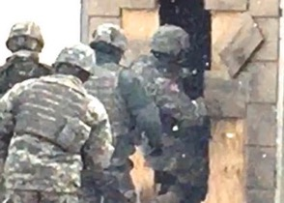
A breach is a hole in the wall!
It allows the enemy to sneak into our lives!

Slide 26
“There is nothing that Satan fears so much as that the people of God shall clear the way by removing every hindrance, so that the Lord can pour out His Spirit upon a languishing church and an impenitent congregation.”
Selected Messages, book 1, p. 124

Slide 27
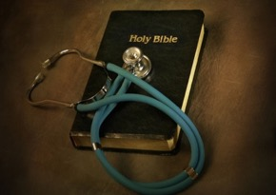
Take time to
EXAMINE
yourself for
spiritual breaches...
“Examine yourselves, whether ye be in the faith; prove your own selves...” II Cor. 13:5

Slide 28
Key 3
3. ASK
and keep asking!

Slide 29
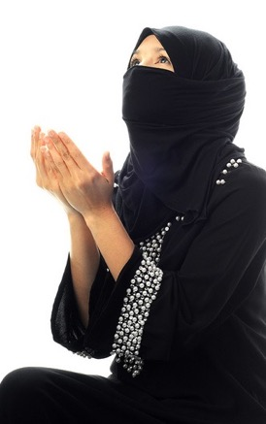
A mother
pleading
for her child
Matt 15:21-28

Slide 30
Would we have endured this faith test?
Do we endure today, when it seems God ignores our cries, when it seems He is answering others’ needs—while we are the outcast that He can’t possibly help?

Slide 31
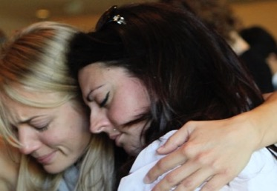
“And shall not God avenge His own elect which cry day and night unto him, though he bear long with them? I tell you that he will avenge them speedily. Nevertheless when the Son of man cometh, will he find faith on the earth?” Luke 18:7,8

Slide 32
Key 4
4. YIELD
to faith in God’s Word, not your feelings!

Slide 33
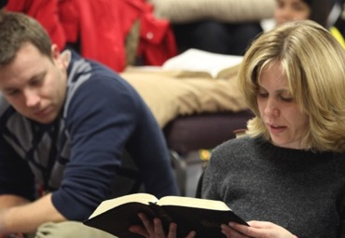
“Faith cometh by hearing and hearing by the Word of God.”
Rom. 10:17

Slide 34
The Battle is over
Fact versus Feeling!

Slide 35
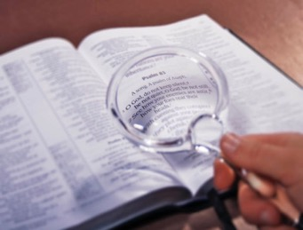
The kind of faith we need today is faith
that can stand
on God’s Word alone!

Slide 36
“Talk and act as if your faith was invincible. The Lord is rich in resources; He owns the world. Look heavenward in faith.”
Christ Object Lessons, p. 146

Slide 37
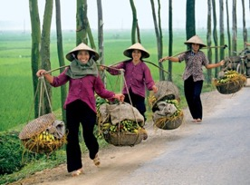
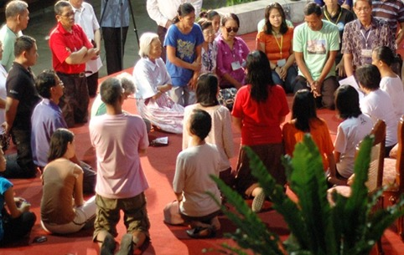
Yen’s Story
Miracle in Vietnam

Slide 38
“There is NO DANGER that the Lord will neglect the prayers of His people. The danger is that in temptation and trial, they will become discouraged and fail to persevere in prayer!”
Christ’s Object Lessons, p. 175

Slide 39
“Faith takes God at His word, with or without feeling. It is the substance of things hoped for, the evidence of things not seen. We can believe our fellowmen, and can we not trust the word of God? When we go to Him for wisdom or grace, we are not to look to ourselves to see if He has given us a special feeling as an assurance that He has fulfilled His word. Feeling is no criterion.

Slide 40
“Great evils have resulted when Christians have followed feeling. How do I know that Jesus hears my prayers?—I know it by His promise. He says He will hear the needy when they cry unto Him, and I believe His word. He has never said to the ‘seed of Jacob, seek ye Me in vain.’

Slide 41
“...If we walk in the light, we may come to the throne of grace with holy boldness. We may present the promises of God in living faith, and urge our petitions. Although we are weak, and erring, and unworthy, ‘the Spirit helpeth our infirmities.’ When we have offered our petition once, we must not then abandon it, but say, as did Jacob when he wrestled all night with the angel, ‘I will not let Thee go, except Thou bless me,’ and like him we shall prevail.”
Bible Echo, September 24, 1894, par. 4

Slide 42
“The enemy holds many of you from prayer by telling you that you do not
FEEL
your prayers, and that you would better wait until you realize more of the spirit of intercession lest your prayers should be a mockery. But you must say to Satan, ‘It is written that men ought always to pray and not to faint.’ We should pray until we do have the burden of our wants upon our souls, and if we persevere, we shall have it.”
Prayer, p. 268

Slide 43
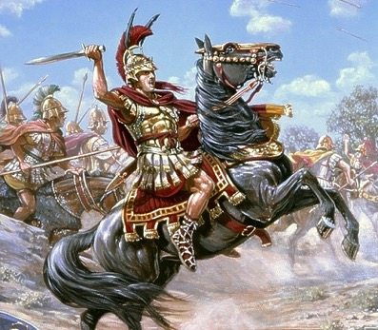
Alexander the Great

Slide 44
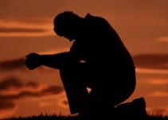
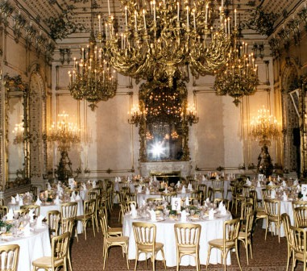
“I want a palace!”

Slide 45
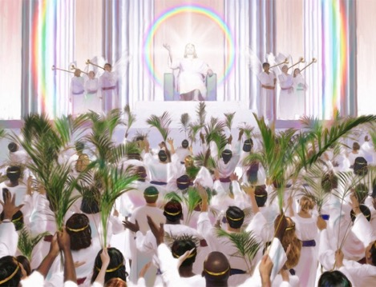
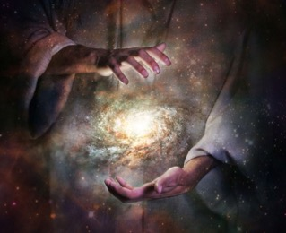
Jer. 32:17

Slide 46
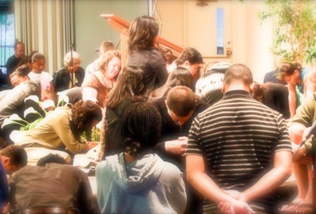
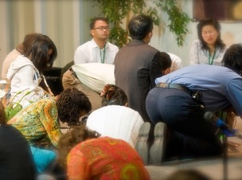
“Now unto Him that is able to do exceedingly abundantly above all that we ask or think, according to the power that worketh in us...Unto Him be the glory” Eph. 3:20,21

Slide 47
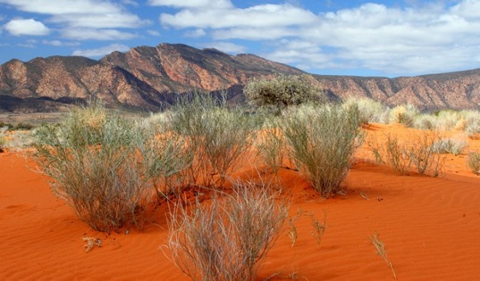
Why do we settle for living in the
Spiritual Wilderness?

Slide 48
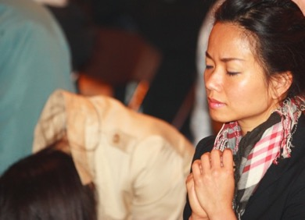
Dare to
Ask for More
International Day of Prayer
“Call unto me, and I will answer thee, and show thee great
and mighty things, which thou knowest not” Jer. 33:3 (KJV)

Slide 49
Let’s
Review
Key 1: P - PRIORITIZE your daily time with God!
Key 2: R - REMOVE Form/Pretense/Breaches!
Key 3: A - ASK and keep asking!
Key 4: Y - YIELD in faith to God’s Word and not your feelings!

Slide 50
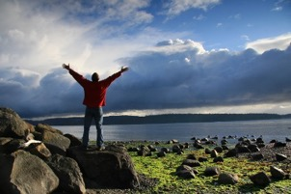
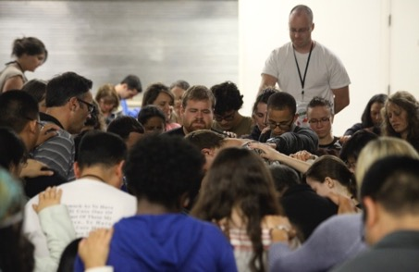
Join Us!
For a Special Program this afternoon!

