Slide 1
Why Prayer
Matters
By: Cindy Tutsch, DMin Copyright © 2021
Notes:
What should be the focus of our prayers in these Last Days? As we see the urgency of the times in which we live, what should be praying about?
Next Slide

Slide 2
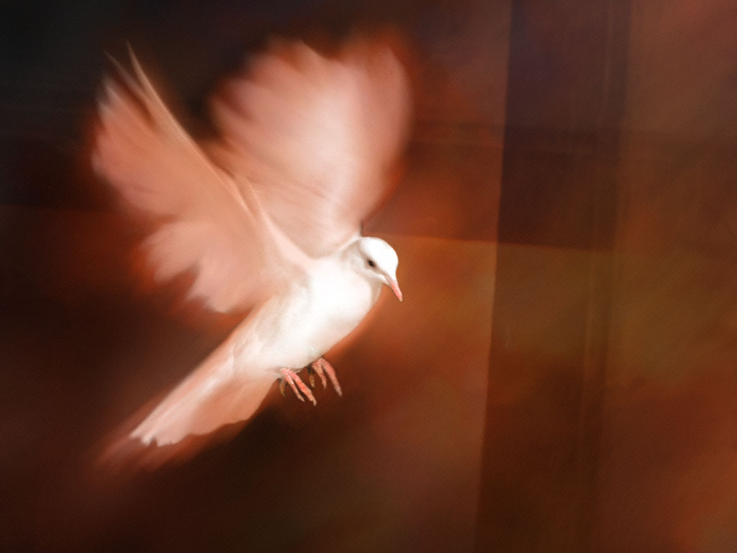
Notes:
What was Jesus' favorite topic? Love? The Kingdom of God? Forgiveness?
Next Slide

Slide 3
“Christ, the Great Teacher, had an infinite variety of subjects from which to choose, but the one upon which He dwelt most largely was the endowment of the Holy Spirit.”
~ Selected Messages, vol. 1, 156
Notes:
"Christ, the Great Teacher, had an infinite variety of subjects from which to choose, but the one upon which He dwelt most largely was the endowment of the Holy Spirit" (Selected Messages, vol. 1, 56).
Certainly, then, our first priority should be to receive the Holy Spirit.
Next Slide

Slide 4
Notes:
The Bible compares the outpouring of the Holy Spirit on the apostolic church at Pentecost to the early rains. Just before Jesus comes His Spirit will be poured out again. This is the Latter Rain, the special outpouring of God's Spirit on His people to prepare them for the time of trouble and to give them power to witness for His name.
Next Slide

Slide 5
“Let us know, Let us pursue the knowledge of the Lord. His going forth is established as the morning; He will come to us like the rain, like the latter and former rain to the earth.”
~ Hosea 6:3
Notes:
This experience is described in Hosea 6:3: "Let us know, Let us pursue the knowledge of the Lord. His going forth is established as the morning; He will come to us like the rain, like the latter and former rain to the earth."
Next Slide

Slide 6
“Are we hoping to see the whole church revived? That time will never come. There are persons in the church who are not converted, and who will not unite in earnest, prevailing prayer. We must enter upon the work individually. We must pray more, and talk less.”
~ Selected Messages, vol. 1, p. 122
Notes:
We can pray for our church, that it will be united in mission, purpose, and love, while recognizing that the whole church will never be revived.
“Are we hoping to see the whole church revived? That time will never come. There are persons in the church who are not converted, and who will not unite in earnest, prevailing prayer. We must enter upon the work individually. We must pray more and talk less” (Selected Messages, vol. 1, 122).
What else can we pray for in these last days? Certainly our governments,
Next Slide

Slide 7
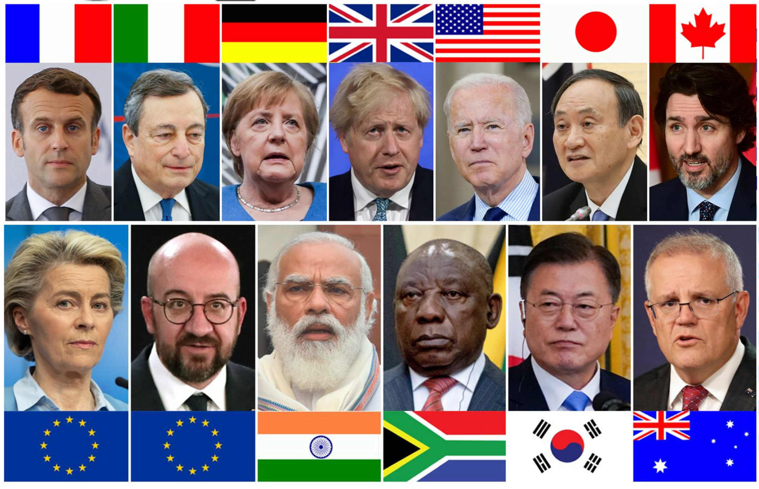
Notes:
the leaders of our nations.
Next Slide

Slide 8
“I urge, then, first of all, that requests, prayers, intercession and thanksgiving be made for everyone—for kings and all those in authority, that we may live peaceful and quiet lives in all godliness and holiness. This is good, and pleases God our Savior…”
1 Timothy 2:1-3, NIV
Notes:
Paul says, “I urge, then, first of all, that requests, prayers, intercession and thanksgiving be made for everyone—for kings and all those in authority, that we may live peaceful and quiet lives in all godliness and holiness. This is good, and pleases God our Savior…” (1 Timothy 2:1-3, NIV)
We can also engage in intercessory prayer for the salvation of our families, and of our friends and neighbors.

Slide 9
“Why do not two or three meet together and plead with God for the salvation of some special one, and then still another?”
~ Testimonies for the Church, vol. 7, 21
Notes:
"Why do not two or three meet together and plead with God for the salvation of some special one, and then still another?” (Testimonies for the Church, vol. 7, 21).
Next Slide

Slide 10
“. . . prayer is the key in the hand of faith to unlock heaven’s storehouse, where are treasured the boundless resources . . .”
~ Steps to Christ, 94, 95
Notes:
“…prayer is the key in the hand of faith to unlock heaven’s storehouse, where are treasured the boundless resources of omnipotence…” (Steps to Christ, 94, 95).
Next Slide

Slide 11
Keep your wants, your joys, your sorrows, your cares, and your fears before God. You cannot burden Him; you cannot weary Him. He who numbers the hairs of your head is not indifferent to the wants of His children.
~ Steps to Christ, 100
Notes:
And I love this passage on prayer written by a 19th century visionary:
“Keep your wants, your joys, your sorrows, your cares, and your fears before God. You cannot burden Him; you cannot weary Him. He who numbers the hairs of your head is not indifferent to the wants of His children. . .The relations between God and each soul are as distinct and full as though there were not another soul upon the earth to share His watchcare, not another soul for whom He gave His beloved Son” (Steps to Christ, 100).

Slide 12
Notes:
What about intercessory prayer? What can we learn about praying for those especially close to our hearts?

Slide 13
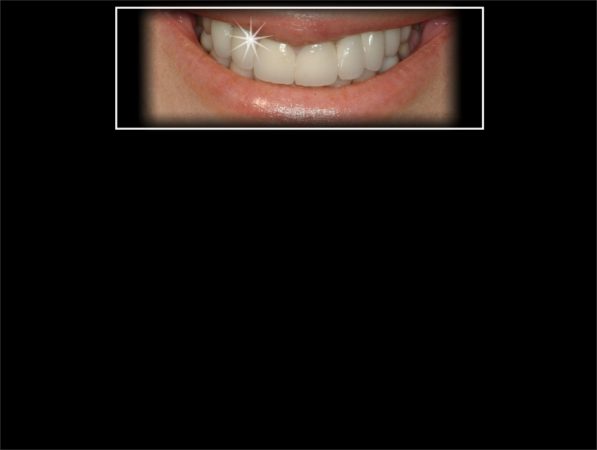
Notes:
How often have our hearts been cheered, our spirits uplifted, our courage strengthened

Slide 14
Notes:
by the simple words, “I’ll be praying for you!” And yet how easy it is to say those words with good intentions

Slide 15
Notes:
and then to go on our way and forget our promise.

Slide 16
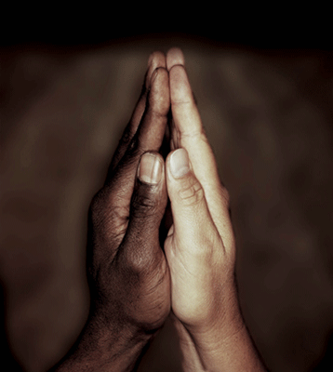
“Let us…pray for one another, bringing one another right into the presence of God by living faith.”
~ Review and Herald, August 28, 1888
Notes:
“Let us…pray for one another, bringing one another right into the presence of God by living faith” (Review and Herald, 28 August 1888).

Slide 17
“Begin to pray for souls; come near to Christ, close to His bleeding side. Let a meek and quiet spirit adorn your lives, and let your earnest, broken, humble petitions ascend to Him for wisdom that you may have success in saving not only your own soul, but the souls of others.”
~ Testimonies for the Church, vol. 1, 513
Notes:
God wants us to pray for specific persons – neighbors, friends…
“Begin to pray for souls; come near to Christ, close to His bleeding side. Let a meek and quiet spirit adorn your lives, and let your earnest, broken, humble petitions ascend to Him for wisdom that you may have success in saving not only your own soul, but the souls of others” (Testimonies for the Church, vol. 1, 513).

Slide 18
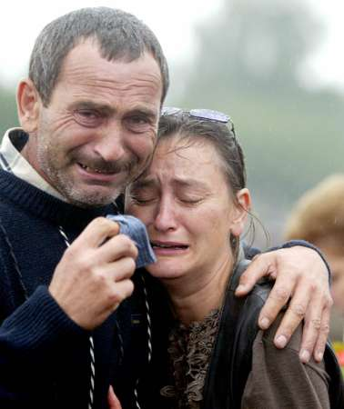
“Those who sow in tears shall reap in joy.” ~ Psalm 126:5
Notes:
Is it easy to pray for others? “Those who sow in tears shall reap in joy” (Psalm 126:5).
Let’s talk about praying for our own children. Here is a precious promise for parents…

Slide 19
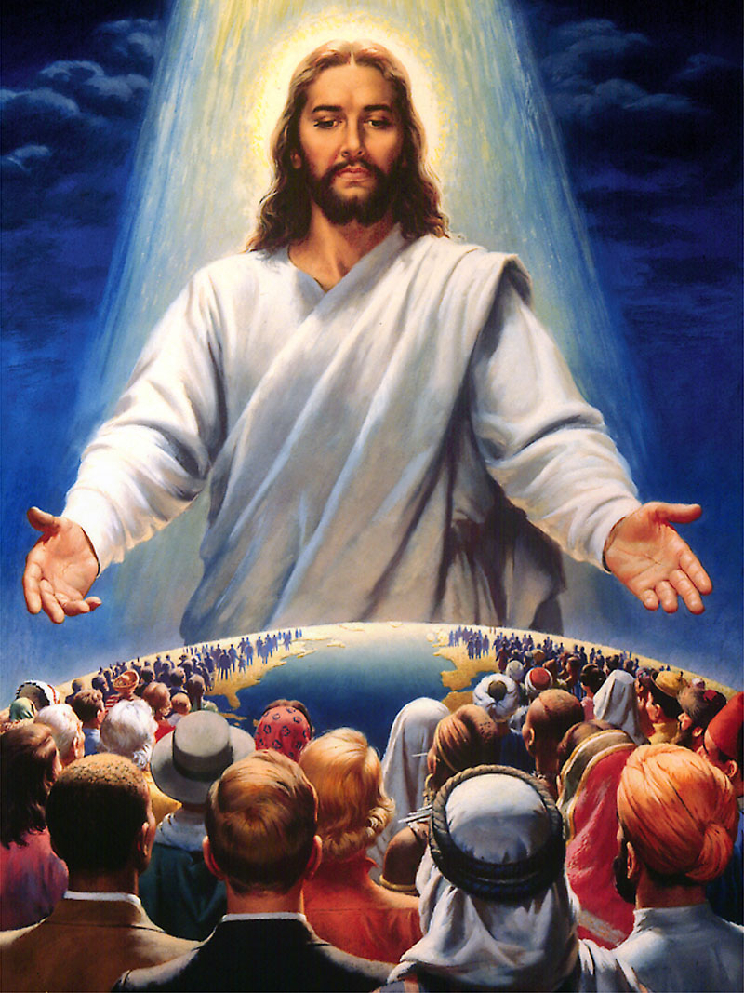
“Do not be afraid, for I am with you. I will gather you and your children from east and west and from north and south. I will bring my sons and daughters back to Israel from the distant corners of the earth.”
~ Isaiah 43:5, 6, NLT
Notes:
Do not be afraid, for I am with you. I will gather you and your children from east and west and from north and south. I will bring my sons and daughters back to Israel from the distant corners of the earth. ~ Isaiah 43:5, 6, NLT
Next Slide

Slide 20
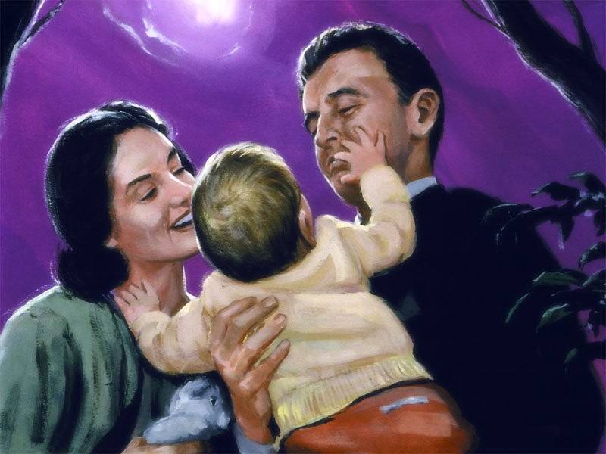
“But now the Lord says, ‘Do not weep any longer, for I will reward you. Your children will come back to you from the distant land of the enemy.’”
~ Jeremiah 31:16, NLT
Notes:
But now the Lord says, “Do not weep any longer, for I will reward you. Your children will come back to you from the distant land of the enemy” (Jeremiah 31:16, NLT). The distant land of the enemy is a symbol of our children who are in Satan’s playgrounds, far from the safety of the kingdom of grace. God’s promise is for them!
And though this picture illustrates the joy of parents at the resurrection who have lost children in death, I think the text also describes the joy of parents who receive their children back from spiritual death.
Next Slide

Slide 21
Isaiah 49:18, 25b
“Look and see, for all your children will come back to you. As surely as I live,” says the Lord, “they will be like jewels or bridal ornaments for you to display. For I will fight those who fight you, and I will save your children.” (NLT)
Notes:
Another beautiful promise:
“Look and see, for all your children will come back to you. As surely as I live,” says the Lord, “they will be like jewels or bridal ornaments for you to display. For I will fight those who fight you, and I will save your children” (Isaiah 49:18, 25b, NLT).
Next Slide

Slide 22
“But if parents would feel that they are never released from their burden of educating and training their children for God, if they would do their work in faith, cooperating with God by earnest prayer and work, they would be successful in bringing their children to the Saviour.” ~ Signs of the Times, April 9, 1896
Notes:
Do we quit praying for our children when they turn 18?
If parents would feel that they are never released from their burden of educating and training their children for God, if they would do their work in faith, cooperating with God by earnest prayer and work, they would be successful in bringing their children to the Saviour. ~Signs of the Times, 9 April 1896

Slide 23
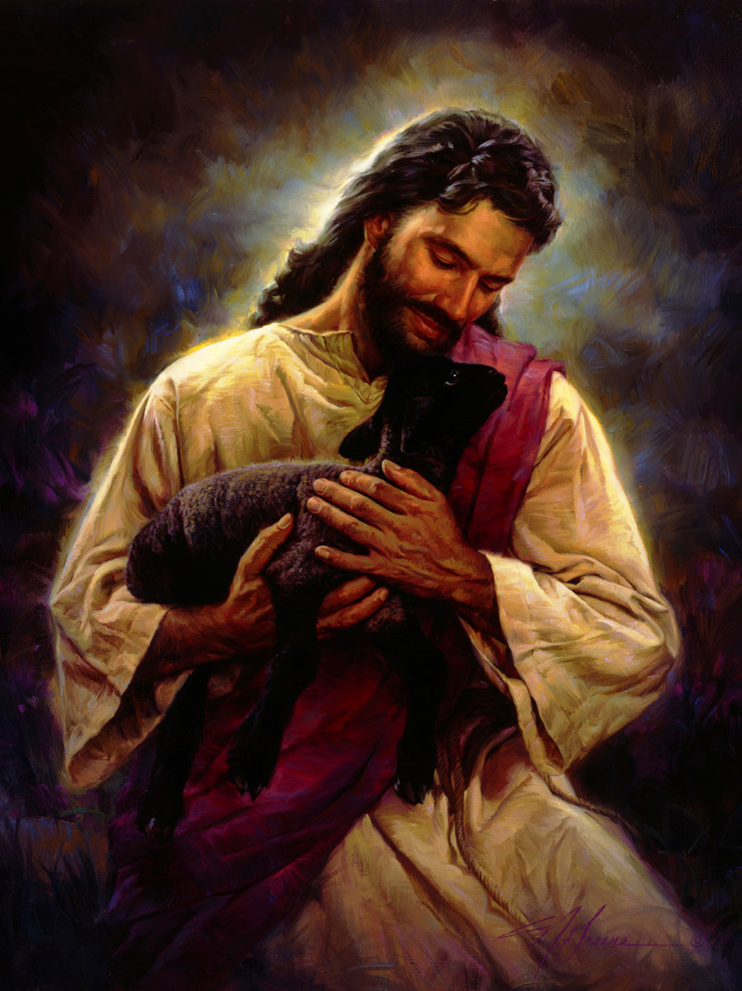
“I will search for my lost ones who strayed away, and I will bring them safely home again. I will bind up the injured and strengthen the weak.”
~ Ezekiel 34:16
Notes:
How intense should we be? How intense was Jesus? He says,
I will search for my lost ones who strayed away, and I will bring them safely home again. I will bind up the injured and strengthen the weak” (Ezekiel 34:16).
Next Slide

Slide 24
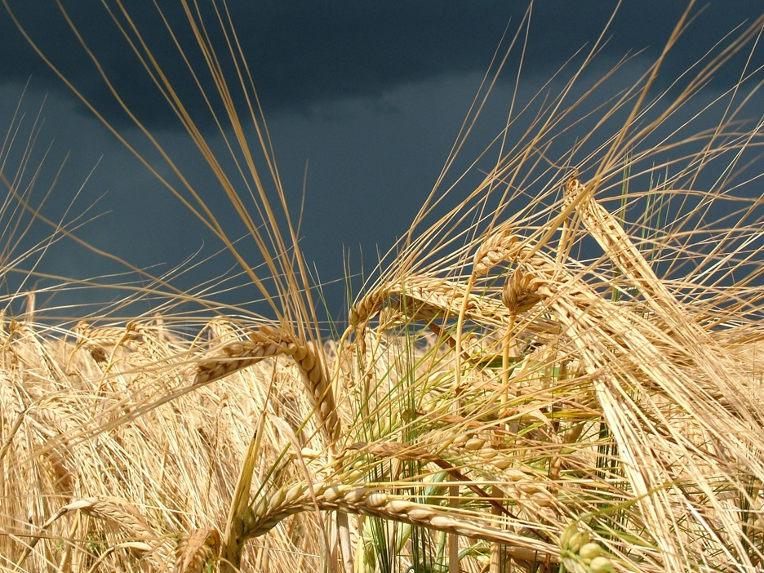
“And let us not grow weary while doing good, for in due season we shall reap if we do not lose heart.”~ Galatians 6:9
Notes:
Paul reminds us, “Let us not grow weary while doing good, for in due season we shall reap if we do not lose heart. ~ Galatians 6:9

Slide 25
Dear Husband:
Last night I visited Edson. . . I talked with him plainly but kindly, but his feelings were very strong that he had been [wronged]. . . I prayed over Edson, but his heart seemed unbroken. I then decided to spend the night in prayer, for our help could come from God alone. I had prayed five times and Edson four. The last time he broke all to pieces. He made an entire surrender to God and such earnest pleadings and entreaties I have seldom heard. He then prayed again and again, and seemed to be in agony of spirit, confessing his wrongs, broken in spirit, his tears freely mingled with his prayers. (con’t)
.
Notes:
Listen to parts of a letter Ellen wrote to her husband in 1876:
Dear Husband:
Last night I visited Edson. . . I talked with him plainly but kindly, but his feelings were very strong that he had been [wronged]. . . I prayed over Edson, but his heart seemed unbroken. I then decided to spend the night in prayer, for our help could come from God alone. I had prayed five times and Edson four. The last time he broke all to pieces. He made an entire surrender to God and such earnest pleadings and entreaties I have seldom heard. He then prayed again and again, and seemed to be in agony of spirit, confessing his wrongs, broken in spirit, his tears freely mingled with his prayers.
Next Slide

Slide 26
The room seemed to be lighted up with the presence of God. . . Salvation indeed had come to that house. He then accompanied [me] home. I did not sleep much last night and feel worn this morning, but very thankful that we broke through the cloud of darkness last night and obtained the victory. (con’t)
.
Notes:
The room seemed to be lighted up with the presence of God. . . Salvation indeed had come to that house. He then accompanied [me] home. I did not sleep much last night and feel worn this morning, but very thankful that we broke through the cloud of darkness last night and obtained the victory.
Next Slide

Slide 27
I was determined not to give [up] the struggle till victory came. I never saw Edson so deeply moved before and so sensible of his danger and weakness. . . I had spent many hours in prayer to God for Edson before I visited him. . .
Yours with love,
Ellen
~ Manuscript Release, vol 8, 29
.
Notes:
I was determined not to give [up] the struggle till victory came. I never saw Edson so deeply moved before and so sensible of his danger and weakness. . . I had spent many hours in prayer to God for Edson before I visited him. . .
Yours with love,
Ellen
~ Manuscript Release , vol. 8, 29
Next Slide

Slide 28
“After you have done your duty faithfully to your children, then carry them to God and ask Him to help you. Tell Him that you have done your part, and then in faith ask God to do His part, that which you cannot do.” ~ Child Guidance, 256
Notes:
It is Christ who melts the hearts of our children, not our nagging or scolding or lecturing.
After you have done your duty faithfully to your children, then carry them to God and ask Him to help you. Tell Him that you have done your part, and then in faith ask God to do His part, that which you cannot do. ~ Child Guidance, 256

Slide 29
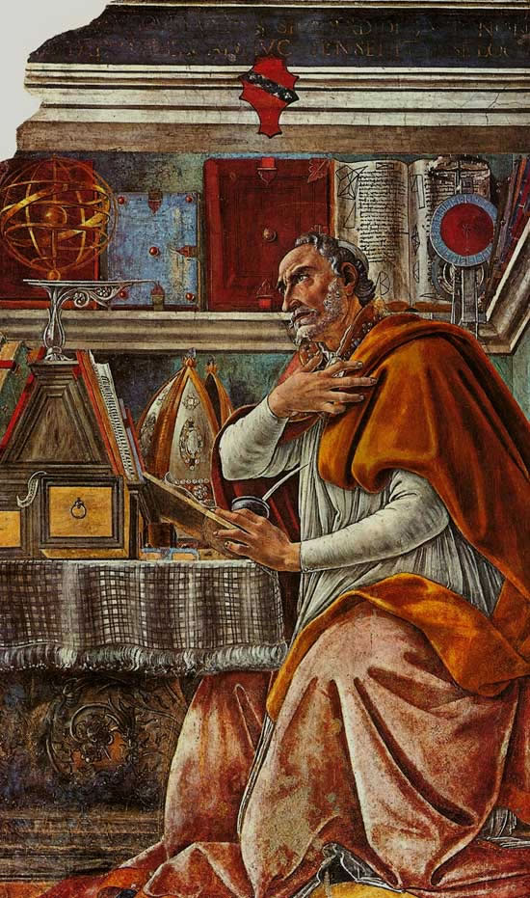
“He is pleased with the faith that takes Him at His word. The mother of Augustine prayed for her son’s conversion. She saw no evidence that the Spirit of God was impressing his heart, but she was not discouraged.... (con’t)
Notes:
He is pleased with the faith that takes Him at His word. The mother of Augustine prayed for her son’s conversion. She saw no evidence that the Spirit of God was impressing his heart, but she was not discouraged....

Slide 30
“She laid her finger upon the texts, presenting deep humiliation, her earnest importunities, her unwavering faith, prevailed, and the Lord gave her the desire of her heart. Today He is just as ready to listen to the petitions of His people…. (con’t)
Notes:
She laid her finger upon the texts, presenting deep humiliation, her earnest importunities, her unwavering faith, prevailed, and the Lord gave her the desire of her heart. Today He is just as ready to listen to the petitions of His people….

Slide 31
“His hand is not shortened that it cannot save, neither His ear heavy that it cannot hear;” and if Christian parents seek Him earnestly, He will fill their mouths with arguments, and, for His name’s sake, will work mightily in their behalf in the conversion of their children.” ~ Testimonies for the Church, vol. 5, 322, 323.
Notes:
“His hand is not shortened that it cannot save, neither His ear heavy that is cannot hear;” and if Christian parents seek Him earnestly, He will fill their mouths with arguments, and, for His name’s sake, will work mightily in their behalf in the conversion of their children. ~ Testimonies for the Church, vol. 5, 322, 323.

Slide 32
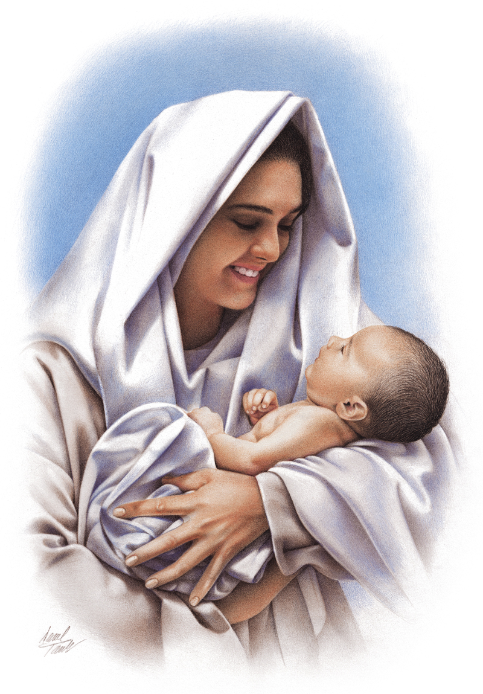
“Your compassionate Redeemer is ready to hear your prayers and to render you the assistance which you need. He knows the burdens of every mother's heart and is her best friend in every emergency.…(con’t)
Notes:
Your compassionate Redeemer is ready to hear your prayers and to render you the assistance which you need. He knows the burdens of every mother's heart and is her best friend in every emergency.…

Slide 33
His everlasting arms support the God-fearing, faithful mother. . . He sympathizes with every Christian mother in her cares and anxieties…(con’t)

Slide 34
[The Savior] “is woman's best friend today and is ready to aid her in all the relations of life… (con’t)
Notes:
[The Savior] “is woman's best friend today and is ready to aid her in all the relations of life. ~ Adventist Home, p. 204

Slide 35
“No work can equal that of the Christian mother. . . How often will she feel her burden's weight heavier than she can bear; and then how precious the privilege of taking it all to her sympathizing Saviour in prayer!... (con’t)
Notes:
No work can equal that of the Christian mother. . . How often will she feel her burden's weight heavier than she can bear; and then how precious the privilege of taking it all to her sympathizing Saviour in prayer! …

Slide 36
“She may lay her burden at His feet and find in His presence a strength that will sustain her and give her cheerfulness, hope, courage, and wisdom in the most trying hours…. (con’t)
Notes:
She may lay her burden at His feet and find in His presence a strength that will sustain her and give her cheerfulness, hope, courage, and wisdom in the most trying hours….

Slide 37
“How sweet to the careworn mother is the conscious-ness of such a friend in all her difficulties! If mothers would go to Christ more frequently and trust Him more fully, their burdens would be easier.”
~ Adventist Home, 204
Notes:
How sweet to the careworn mother is the consciousness of such a friend in all her difficulties! If mothers would go to Christ more frequently and trust Him more fully, their burdens would be easier. ~ Adventist Home, 204

Slide 38
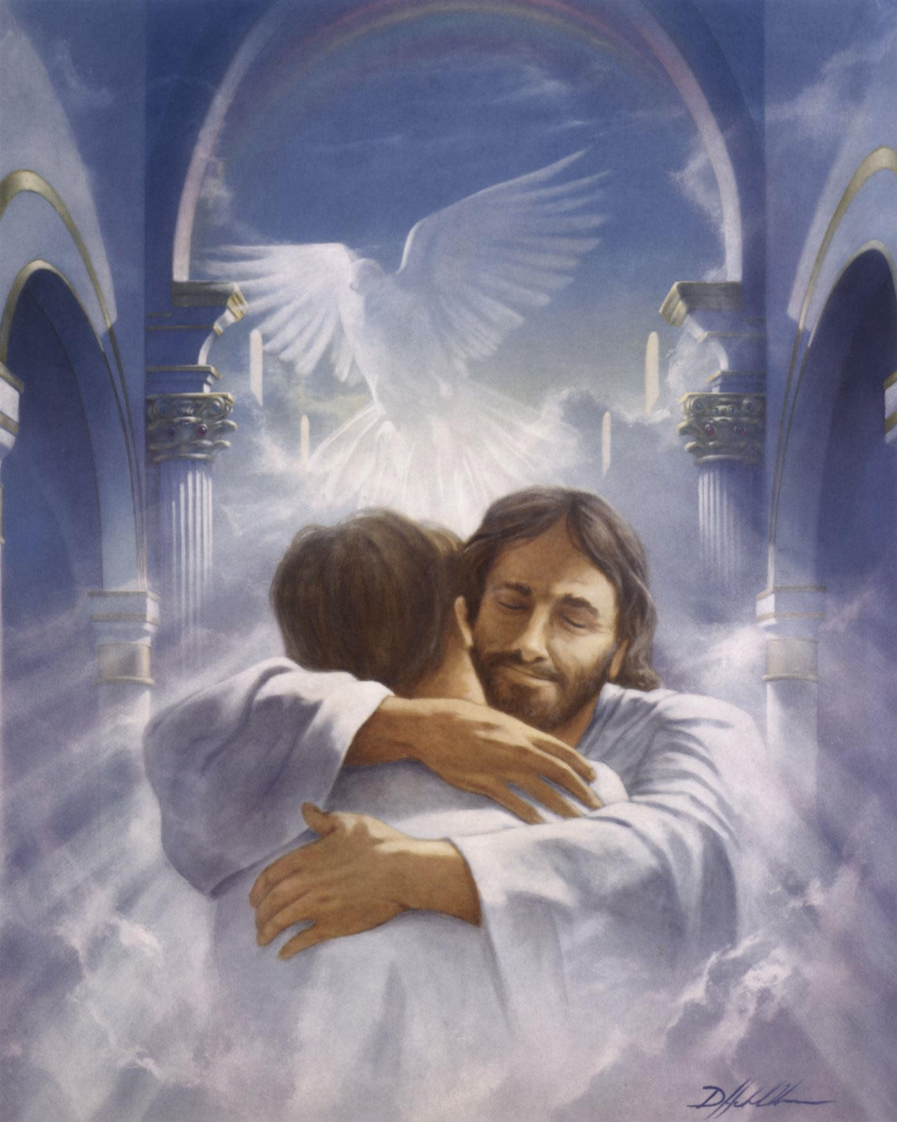
“With joy unutterable, parents see the crown, the robe, the harp, given to their children. The days of hope and fear are ended. The seed sown with tears and prayers may have seemed to be sown in vain, but their harvest is reaped with joy at last. Their children have been redeemed.” ~ Child Guidance, 569
Notes:
What will be the parents’ reward? “With joy unutterable, parents see the crown, the robe, the harp, given to their children. The days of hope and fear are ended. The seed sown with tears and prayers may have seemed to be sown in vain, but their harvest is reaped with joy at last. Their children have been redeemed.” ~ Child Guidance, 569

Slide 39
Notes:
That special outpouring of the Holy Spirit that we all need, that we must have before Jesus comes, will not happen without prayer and lots of it! Imagine a global chain praying for the outpouring of the Holy Spirit. It’s already happening! Are you part of it? Did you know that for several years Seventh-day Adventists have been praying 7 days a week at 7 AM and 7 PM around the world? Wherever you are, whatever you’re doing, I invite you to join them!

Slide 40
Christian Experience and Teachings
of EGW, 235
Notes:
And when Christ has won the battle in our hearts, in the hearts of our children, in the hearts of our neighbors and neighbors, what then? When we’ve said our last prayer, shed our last tear, what then?
“There are homes for the pilgrims of earth. There are robes for the righteous, with crowns of glory and palms of victory. All that has perplexed us in the providences of God will in the world to come be made plain. The things hard to be understood will then find explanation. The mysteries of grace will unfold before us. Where our finite minds discovered only confusion and broken promises, we shall see the most perfect and beautiful harmony. We shall know that infinite love ordered the experiences that seemed most trying. As we realize the tender care of Him who makes all things work together for our good, we shall rejoice with joy unspeakable and full of glory” (Christian Experience and Teachings of EGW, 235.1).
May we all pray much more--as individuals, as families, as a church family! As we come into fellowship with Jesus through prayer, we will know and trust Him in deeper ways which will strengthen us for whatever challenges lie ahead. God bless you!

