Slide 1
LEADERSHIP Certification Program Level 1
General Conference of Seventh-day Adventists Women’s Ministries Department
www.adventistwomensministries.org

Slide 2
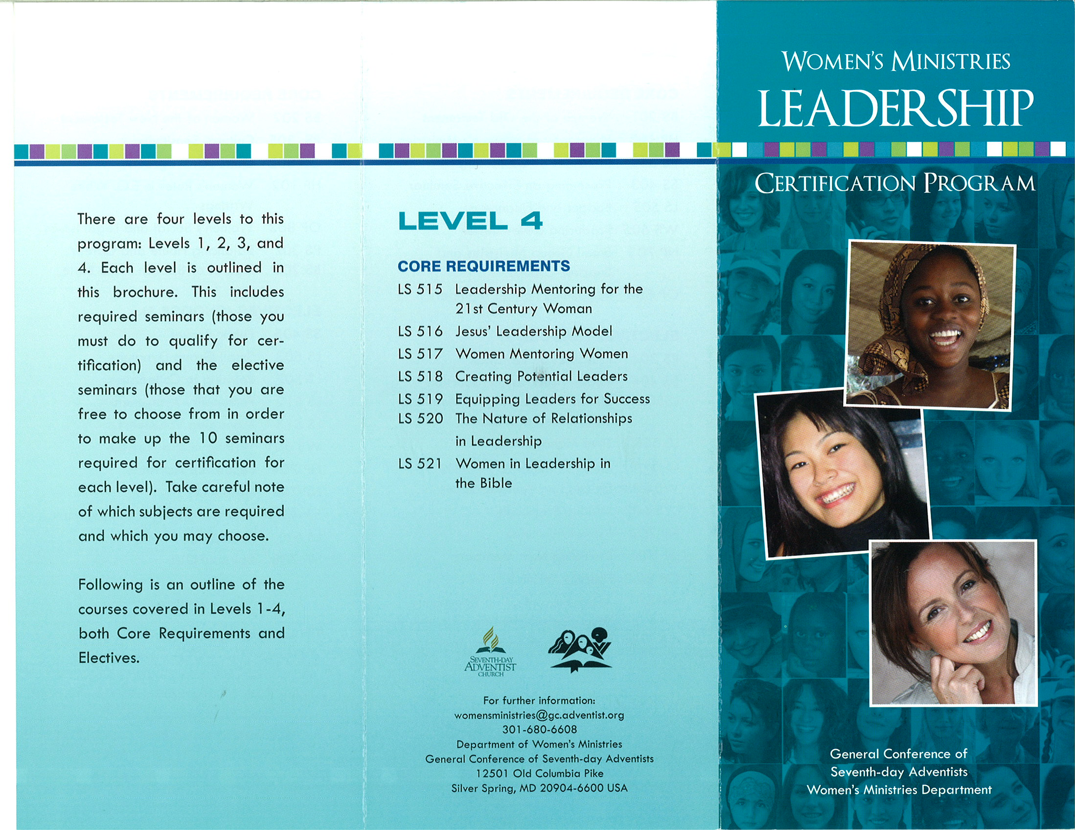
General Conference of Seventh-day Adventists Women’s Ministries Department
www.adventistwomensministries.org

Slide 3
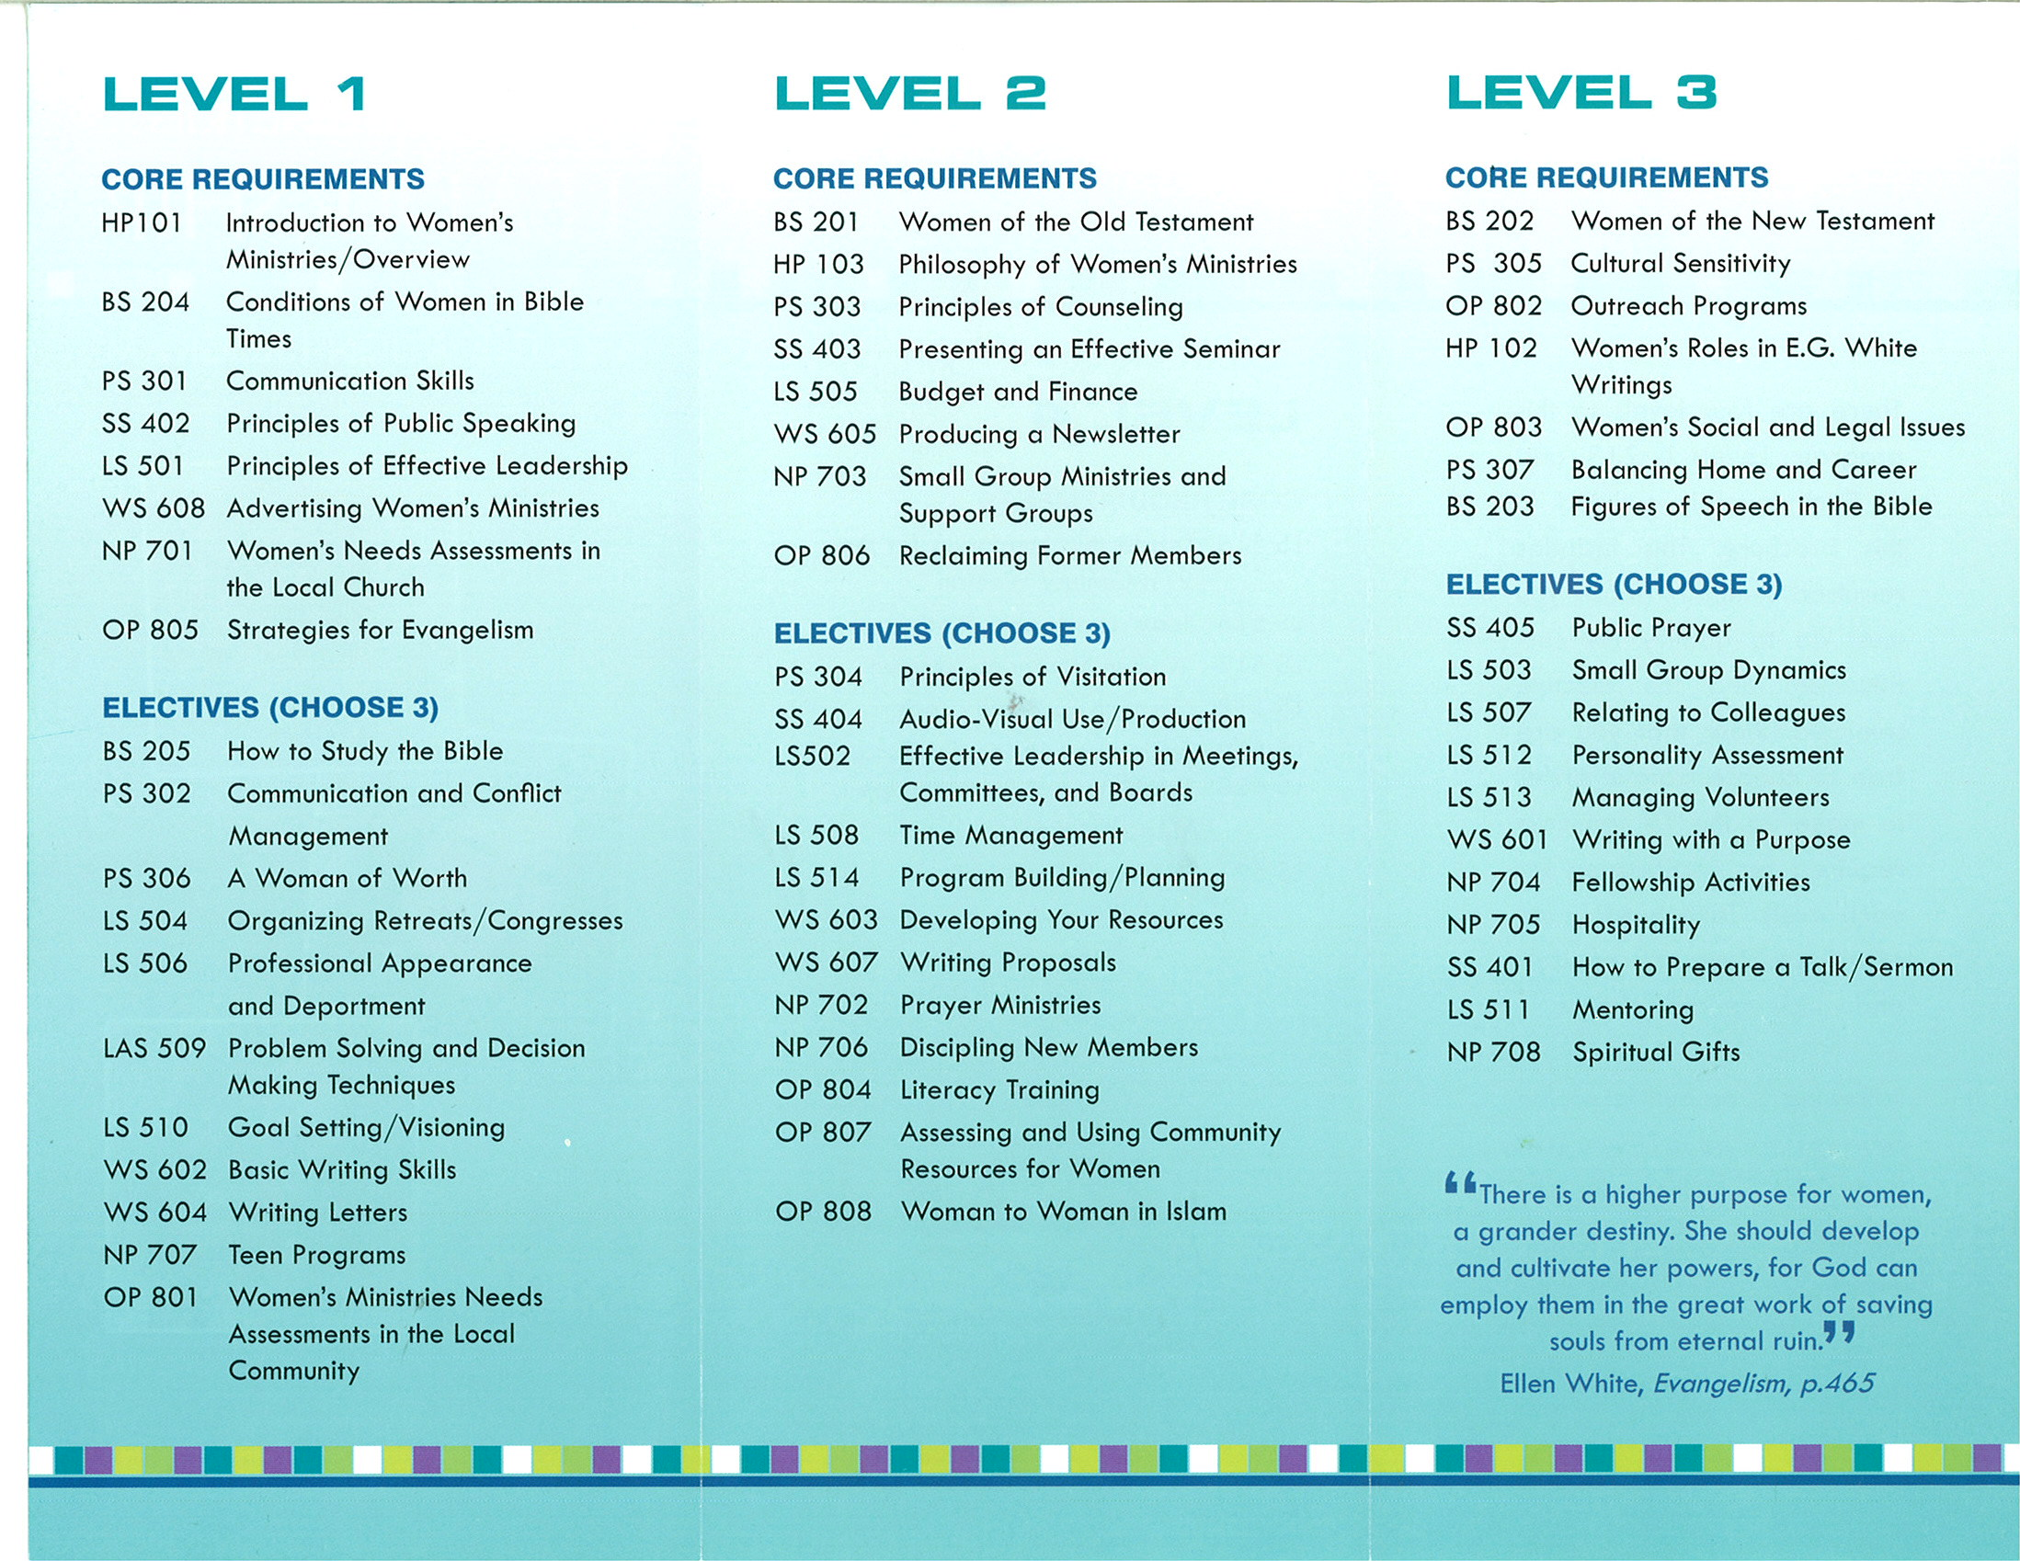
General Conference of Seventh-day Adventists Women’s Ministries Department
www.adventistwomensministries.org

Slide 4
Communication and Conflict Management
Written by
Daphne Jean Thomas
Leadership Certification Program - Level 1
Notes:
Why is Communication so important?
Misunderstandings and conflict have existed since time began. As Women’s Ministries leaders it is critical that our communication is clear and effective if we are indeed hoping to provide a ministry. We need to recognize that while sin continues on earth, conflict is inevitable. However, consecrating ourselves to God and giving our problems to Him along with skillful management of our communication efforts can bring about a positive outcome.

Slide 5
FACE
EYES
BODY
VOICE
WORDS
The ways we interact with fellow humans
Notes:
“Communication” is the way we interact with fellow humans, the way we get our message across. We communicate with our eyes, faces and bodies as well as our words and voices. Sometimes “poor” communication is the cause of feuds and fights.
“Good” communication and the ability to manage conflict effectively is a skill—one that all of us can learn—and that we must learn if we are to be effective Women’s Ministries leaders.
The ability to interact successfully and “get along with” people is a critical ingredient to excellence in “people skills.” We cannot hope to achieve the kind of people skills we need without God. It is God who can influence our minds and govern our mouths so that those with whom we communicate can sense we care for them and only want their best good.

Slide 6
The Role of Perception
We SEE things:
not as they are
but as we are
Notes:
The Role of Perception
Quite often, in the course of regular communication, a difference of understanding will arise. Sometimes, even after explanation, the other person cannot see or accept our viewpoint. We cannot understand why. “What’s the problem; I’ve explained it to them; how can they possibly not see it my way now?”
Perception has a critical role in our interpretation of any given situation. Similarly, this same perception has considerable influence over our reactions to the situation.
Our perception develops, as we grow older, through a variety of influences such as our family background, our ethnic background, our age, work experiences, values, and spiritual outlook.
Almost everything affects our perception. Someone who grows up on the farm will have a very different perception of what a busy day is as compared to someone who has grown up in the city. The difference in our backgrounds, education, religious beliefs, and our personal history will affect how clearly we understand each other. The less we understand the meaning of the words, body language, and behavior of the other person, the easier it will be for us to have an inaccurate perception of what they are communicating to us.
We see things:
not as they are
but as we are

Slide 7
Listen well, so that the message sent and
the message received are what you want
Notes:
We want to develop our ability to listen well, so that the message sent and the message received are interpreted for the mutual understanding of both.
A significant factor in improving our communication, reducing conflict and understanding the other person’s point of view, is the recognition that our perceptions are always incomplete to some extent, and perhaps even inaccurate. I once heard it said, “There’s your viewpoint, my viewpoint, and then there’s reality!”
Perhaps you’ve heard the story of a battle ship commander guiding his ship through the night.
Seeing a light coming toward them he signaled for the other craft to stand aside.
Back came a signal that not only refused to stand aside, but suggested they should be the ones to stand aside instead.
Greatly irritated he signaled back, telling his rank as a commander and demanded that the craft stand aside.
Back came the reply, signaled by an ordinary seaman, that they must stand aside.
Affronted he signaled “This is a battleship, change your course!”
Back came the reply “This is a lighthouse, change your course!”
We laugh at this little illustration, but we too have often persevered with an argument, a decision, or a course of action based on a faulty perception. How important it is to gather all the information we can and seek to understand where the other person is coming from, before we set our mind on something.

Slide 8
Our Perception of Reality
is Not Necessarily Reality
Challenging the validity of our perceptions
Challenging the absoluteness of our perceptions
Challenging the current accuracy of our perceptions
Notes:
Our Perception of Reality is Not Necessarily Reality
Recognizing our limitations is the basis for taking responsibility for how we think.
Taking responsibility for how we think means:
Challenging the validity of our perceptions
Challenging the absoluteness of our perceptions
Challenging the current accuracy of our perceptions
Perception colors and influences our understanding and manner of communicating in every situation, and we have each developed set patterns in our behaviors. That is, we often react the same way—for some this can be backing down when we should be more assertive, or tending to overreact when we should obtain more information first. So often, we end up regretting our actions.

Slide 9
Our behaviors can be:
LOGICAL CONSIDERED MATURE
Take responsibility!
Choose your responses
Interrupt reactive patterns
Don’t react! Communicate!
Notes:
Our patterns or usual behaviors can be logical, considered and mature, or they can be a frequent cause of unsatisfactory communication experiences for us and for those with whom we communicate.
If we tend to operate in a “reactive mode” to the circumstances in our life we are actually losing power and control. An example of this would be:
Being defensive
Saying something impulsively we later regret
Giving in and later wishing we had spoken up
Avoiding an issue that should have been confronted
Can you identify any patterns in your behavior? (Anyone brave enough to share?)
Own your perceptions – Don’t let them own you!
Take responsibility! Own your role in relationships and circumstances
Choose your responses
Interrupt reactive patterns
Don’t react –communicate!

Slide 10
Communication Styles
The Director
The Party Person
The Stabilizer
The Accountant
Notes:
Communication Styles
We each develop a particular style of communication. Recognizing different styles of communication will help us interact and communicate with people who have very different styles of communication from our own. Do you find that some people are more irritating than others? They are not unpleasant people; they haven’t done anything wrong; they just don’t seem to be on your wavelength. They just have a different style of communicating and it seems strange, maybe even wrong to you! But, they are thinking the same way of your style!
Communication styles can be divided into several different groups. Consider these brief descriptions:
The Director:
You know this type of person, perhaps it might even be you—they are impatient, they want everything done yesterday. They even speak quickly, often using short forms of language such as “ASAP” (As Soon As Possible). They are direct in their communication—say what they think—sometimes abrasively. They are often to be found in leadership positions. Keep in mind that this person thinks in terms of projects that need to be completed—if they trample over you it’s unlikely that they intended too—they sometimes forget that others care about the process as much as the completed project. Realizing the difference helps you to not personalize what “The Director” often does without even being aware that they may be hurting or stepping on someone.
The Party Person
Another outgoing type, these people are friendly, optimistic and informal. They enjoy life and they communicate clearly. They are energetic and creative—give them opportunity to establish their goals and visions and don’t dampen their enthusiasm. These individuals often forget that the party is not all about them and will be oblivious to you at times. Again, don’t take this personally. Just realize that you might have to be more persistent, gently so, for information that you deem as critical.
The Stabilizer.
A quieter person; shy, but friendly. A wonderful support person, loyal and caring—they have difficulty in saying no. Give them space to speak and don’t interrupt. Because they are quiet don’t ignore them or assume they have nothing to contribute. Involve them with requests for comments or their help.
The Accountant
Every team needs this quiet, conscientious, attention-to-detail person. They are systematic and attend to the details involved with finances and filing. As with the stabilizer, involve this person and give them the opportunity to share their knowledge and ideas. This person will respond best when they can sense that there is structure and framework to what you are trying to accomplish.
Each of these four types is valuable to the team. Each type has its strengths and weaknesses. As a leader, get to know each member of your team and learn to appreciate the varied strengths they bring. Listen to their communication style—don’t dismiss them because they are quiet, don’t take offence because they are direct to the point of being blunt. Learn to work with them, to involve them and appreciate them.

Slide 11
The Role of Empathy in Communication
Empathy is learning to listen with your head and your heart.
Take seriously the other person’s needs and concerns.
Value their right to their feelings and attitudes.
Their privacy, values and experiences
Reserve judgment and blame.
Notes:
The Role of Empathy in Communication
Empathy is sensing another’s feelings and attitudes as if we had experienced them ourselves. Being able to be empathetic toward the person we are communicating with will open wide the channel of communication – and understanding.
Empathy is learning to listen with your
head and your heart.
Creating Empathy by What We Think
We need to recognize that people are able to sense what we really think about them. Even though we may be skilled at acting a part, inevitably the truth will come out, and if we do not genuinely have respect for someone they will sense this. The way we think about the other person will communicate itself to them, thus enhancing or seriously jeopardizing our chance for effective communication.
Take seriously the other person’s needs and concerns. We may think these needs and concerns are inappropriate or unimportant—but they are real to that person, and as such, we need to take them seriously.
We must value their right to their feelings and attitudes, which are the result of their life’s experiences. We may not be able to relate to their feelings and attitudes, but it’s important to relate to them as people.
Their privacy, values and experiences may be foreign to us, even unacceptable, but they are integral to the other person’s viewpoint. Our goal is to understand how they are perceiving things. We do not have to be afraid that this means we are agreeing with them or condoning what they are trying to do. We are simply keeping the lines of communication open.
Reserve judgment and blame. This is important if we are to achieve a worthwhile outcome. When people sense they are judged (or even blamed) by you, and particularly if they believe they may be found wanting, they are much less likely to want to hear what you have to say.

Slide 12
Creating Empathy By What We Do
Be aware of and respectful of any cultural differences
Look at the person and take an active interest in what she is saying
Ask relevant questions for clarification
Use open body language
Be very aware of your facial expression
Make affirming gestures
Use a warm vocal tone
Notes:
Creating Empathy by What We Do
While what we actually think can be communicated subconsciously to the other person and therefore reduce or enhance the build up of empathy between you and the other person, what we actually do is even more obvious and is influenced by our thoughts about the person.
Be aware of and respectful of any cultural differences.
Look at the person and take an active interest in what they are saying when communicating.
Ask relevant questions for clarification. If you allow your concentration to fade, so that it becomes obvious you haven’t been listening, or, if others distract you constantly, you are signaling to the person that what they are saying is not of great interest to you.
Use open body language—make and hold eye contact, face the person—lean forward a little and avoid crossed arms. If the situation is difficult—try to find a quiet place and sit down rather than stand. (Never stand if that other person is sitting).
Be very aware of facial expression—have a pleasant expression—smile! And try not to frown even if you are concentrating.
Make affirming gestures - such as nod and sounds of agreement at appropriate intervals.
Use a warm vocal tone. Listen to your voice; don’t let it become intimidating, cold, flat or screechy; don’t raise it if the conversation doesn’t go as you had planned. Try to keep your voice warm and encouraging.

Slide 13
Empathy Blockers!
Domination:
Threatening
Ordering
Criticizing
Name Calling
Shouting
Notes:
Empathy Blockers
Certain words or phrases block empathy instantly. Sometimes we use them without realizing the damage they can do. When we have finished using these thoughtless expressions we have often “lost” our chance to communicate to the other person.
Domination
Threatening- “If you aren’t able to get to work on time we’ll have to review your job here.” “Do it or else”
Ordering “I’ll see you immediately in my office.”
Criticizing “You don’t work hard enough.”
Name Calling “Only an idiot would say that.” “You’re neurotic.”
‘Shouting “You should have said no….” “You ought to face the facts….” These two examples slip out of our mouths easily, but they are quite destructive to a developing relationship.

Slide 14
Empathy Blockers!
Manipulation:
Withholding relevant information
Interrogating
Praising to manipulate
Notes:
Manipulation
Withholding Relevant Information: “If you knew more about this you would see it differently.” Issues of confidentiality make this a difficult one, but if you can’t share the information, it’s probably better not to mention it at all.
Interrogating: “How many hours did this take you?”
Praising to Manipulate: “You’re so good at report writing; I’d like you to do this one.”

Slide 15
Empathy Blockers!
Disempowerment:
Diagnosing motives
Untimely advice
Changing the topic
Notes:
Disempowerment
Diagnosing motives: “You are very possessive.”
Untimely advice: “If you’d just straighten up your desk you wouldn’t be in this panic.”
Changing the topic : “I’m worried about my son.” “Yes, it is a worry; did I tell you I’ve got a new job?”

Slide 16
Empathy Blockers!
Denial:
Refusing to address the issue
Notes:
Denial
Refusing to address the issue: There’s nothing to discuss. I can’t see any problems.”

Slide 17
The Communication Process
7% VERBAL
What you said
38% VOCAL
How you said it
55% VISUAL
Body language/non verbal
Notes:
We tend to think that the words we communicate to someone are the bulk of our communication. We couldn’t be more wrong!
THE COMMUNICATION PROCESS
7% VERBAL—What you said (the message itself)
38% VOCAL—How you said it (the intonation, projection and resonance of the voice…)
55% VISUAL—body language / non verbal
The preceding diagram shows how much, and more importantly, what people remember after you
have spoken.
A motto that many specialists in communication use: It’s not what you say – it’s how you say it!

Slide 18
We have to remember:
Much of what we communicate is unconscious
2. Much of what we communicate is unintentional
3. Much of what we communicate is incongruent
Notes:
We have to remember:
1. Much of what we communicate is unconscious
2. Much of what we communicate is unintentional
3. Much of what we communicate is incongruent

Slide 19
Communication is CONGRUENT when:
What we SAY and
what we DO match.
Notes:
Communication is congruent when:
What we SAY and what we DO match.
Example: What if I were to stand here like this (wring hands, don’t smile, let your voice tremble, stare at the floor more than the people) and say: “I’m so excited to be here!” Would I be very believable to you? (Now do the same but look and act excited!)

Slide 20
Managing Conflict
In situations of crisis and potential conflict always remember:
S T A R
We need to:
STOP
THINK
ANALYZE
RESPOND
Notes:
We need to:
In situations of crisis and potential conflict always remember: S T A R
STOP (Don’t panic – don’t react!)
THINK (gather information)
ANALYZE (using gathered information decide how you can best empathize with this person)
RESPOND (respectfully communicate your understanding of the situation and what would work for you)
When conflict does arise will you always have time to think about the above process and work it through step by step? NO! The key is to begin to incorporate the principles and practice them on a regular basis – let them become a part of who you naturally are. When you are in a conflict situation you can always tell yourself to STOP! This will help you to not react quickly and will give you a few mental seconds to begin processing the situation in a more controlled way.
Best growth and learning occur when conflict is handled honestly and constructively!

Slide 21
Conflict Resolution Strategies
AVOID Wait / See
FORCE Win / Lose
ACCOMMODATE Lose / Win
COMPROMISE Lose / Lose
COLLABORATE Win / Win
Notes:
There are a variety of conflict management strategies that may be used most appropriately in different situations.
AVOID Wait / See
When the issues are trivial, or circumstances dictate that a solution is better left until later.
Maybe until you or the other people have calmed down, or reinforcements have arrived.
Perhaps it is better to avoid decision making when you are so tired / stressed that your judgment may not be sound
When moral or safety issues are involved.
Not to be used just because you are afraid to deal with conflict! Issues will only build up and become more complicated.
FORCE Win / Lose
This is when you force the issue to get the decision you want, usually for safety or ethical/ moral/legal issues. As the leader you are ultimately responsible for decision-making. If you have strong biblical principles for your decision on any of these issues you must stand firm. Share your reasons. Sometimes it is a good strategic move to ask the group to go away and think about the decision, pray and then meet again to make the decision. That way you may have the team share in the decision rather than imposing your view upon them. Remember, you are not omnipotent—they may come back with a better idea or solution ! Someone always looses and somebody may want to even the score.
ACCOMMODATE Lose / Win
There are times when it is most appropriate to “give in,” in a conflict situation. This can occur when for one reason or another you were wrong (possibly you did not have all of the information), or when the other person has legitimate authority (e.g., the conference president). In such circumstances, particularly if you feel strongly about the situation, calmly state your reasons for disagreeing and then “accommodate” with dignity. Again, someone loses—you. You need to decide if it is worth it.
COMPROMISE Lose / Lose
This approach is used when attempted collaboration has been unsuccessful
When the relationship or the issue is important enough to not give it up altogether
When both sides strongly believe they are correct and you want each to get nearer their goal, so you come to an agreement by mutual concessions.
COLLABORATE Win / Win
This is the desired goal in all conflict situations
Put our frustration aside, look at the situation
Discuss our different viewpoints calmly and professionally
Work together so that we are both happy with the final outcome
Work on reframing the conflict, think laterally and come to agreement
Negotiate. What are the points you can concede in order to obtain agreement for what is most important. Both sides give and take some until both are satisfied.

Slide 22
The Five Steps in Resolving Conflicts
1. Pray about the Problem Together
2. Clarify the Issues. Focus on the Needs and Goals
3. Understand Each Other’s Perspective
4. Break the Conflict into Small Steps
5. Give and Take
Notes:
The Five Steps in Resolving Conflicts
1. Pray about the Problem Together
Do this humbly not as a way to bring judgment down on the other person! Commit to trying to find a solution, and then define the conflict as a mutual problem. In the majority of conflict situations, neither side is totally wrong or totally right. In most cases there are things to sort out on both sides. So try to perceive the situation as a mutual problem not a win / lose struggle.
2. Clarify the Issues—Focus on the Needs and Goals
Reframe the situation with the questions: What do we need to do to get out of this situation? What are our goals? What are the concerns? Don’t be dragged back into recriminations or old gossip that is quite destructive.
3. Understand Each Other’s Perspective
Treat the other person and their viewpoint with respect. Take the time to give each other time to state a viewpoint (active listening without interruption). Once we really understand the other person’s viewpoint it is much easier to want to come to an agreement. Use specific communication—use “I” words instead of “you” words. (Instead of “You make me so mad when you do that!,” I might say, “I feel so angry when something is said to me without considering my perception in the situation”)
4. Break the Conflict into Small Steps
If the conflict is serious it may not be possible to sort all of the problems out at one time. Identify the options and develop the ones that give everyone more of what they want. Try to agree to deal with one issue at first, and then you can move on to the next.
5. Give and Take
Take a long-term view. Support what is legitimate and fair—resist greed and injustice. “Give” in areas that are high value to others and easy for you to give. Remember that you cannot expect to have everything go your way.

