Slide 1
LEADERSHIP Certification Program Level 1
General Conference of Seventh-day Adventists Women’s Ministries Department
www.adventistwomensministries.org

Slide 2
How to Study the Bible
Written by
Alice Rich
Leadership Certification Program - Level 1
Notes:
Introduction
We’re here today to talk about one of the most important, most beneficial, most critical responsibilities and privileges that we have in our lives, and that’s Bible Study. Some see it as a chore, some see it as a hard and mind boggling effort, and some feel they don’t get anything out of Bible Study yet they study anyway out of a sense of obligation. But some have learned that Bible study is an open doorway to the heart and character of God―an opportunity, a priceless treasure, a faithful guide, a life transforming journey that will extend into eternity. This may be the personal experience of each of you here today; maybe for some you wish that this were true for you. Our goal today is to give you a sturdy foundation and glimpse into what can be in store for you as you become better equipped as students of the word. As WM Leaders we want to be prepared to mentor the women of our churches so that they may also be better equipped as students of the Word.
What we will attempt to do today is to lay the foundation for a good, solid approach to Bible Study. We’ll consider what that means for us as individuals and some of the principles that will guide us in our endeavors with God’s Word.
[Lead the group in a prayer for the presence and guidance of the Holy Spirit]

Slide 3
All Scripture is God-breathed
and is useful for teaching, rebuking,
correcting and training in righteousness,
so that the man of God may be
thoroughly equipped for
every good work.
2 Tim. 3:16-17
Notes:
Consider the words of 2 Timothy 3:16-17, NIV
“All Scripture is God- breathed and is useful for teaching, rebuking, correcting and training in righteousness, so that the man of God may be thoroughly equipped for every good work.” 2 Timothy 3:16-17
Hearing “God breathed” causes me to picture God kneeling down and breathing the breath of life into Adam. As I open up God’s Word and under the guidance of the Holy Spirit read and take His Word into my life, God is breathing His life into me!
Note to Leader: Verses have been supplied throughout in order to give integrity to what is being said. Don’t feel that you need to go over each of them; doing so would probably absorb too much of your time. Also I have included the reference of the version used and I have used a variety of versions and even paraphrases when appropriate―this is to encourage becoming more familiar with a variety of resources available to us. [NASB = New American Standard Bible; RSV = Revised Standard Version; LB = Living Bible; NIV = New International Version; GN = Good News…]

Slide 4
A. Quiet Time
How Important is it to God?
Jesus died to make it possible!
God has called you into fellowship
Jesus is eager to spend time with you
God created us to be in a relationship with Him
Notes:
Daily Quiet Time with God (Developing a state of mind to always be available to God)
Our purpose today is to learn how to study the Bible. First we’ll look at what we need to do to prepare our hearts and minds to be fertile soil for God’s Word. We each need to spend a daily quiet time with God so that our hearts and minds will be like cultivated soil―always ready for the word of God to be planted and take root. We each often get overwhelmed with the burdens of life and find our devotional time being crowded out. We have to be at work on time, the children have to be fed and dressed, breakfast must be prepared and the dishes have to be done. Already I’m tired and the day is barely begun! How do I find time to spend with God―and especially to not have the cares of life overtake my thoughts when I am studying? We must decide just how important having daily quiet time is to us―unless it’s a high priority to us, we will not manage to carve out a time commitment each day.
A. Quiet Time - How important is it to God?
Jesus died to make a relationship with God possible! If God considers having a relationship with you important enough to give His life for you, are you willing to make sure that you allow time for Him?
God has called you into fellowship with His Son. “God, who has called you into fellowship with His Son Jesus Christ our Lord, is faithful.” 1 Corinthians 1:9 (NIV)
Jesus eagerly desires to spend time with you. “Look! I’ve been standing at the door and constantly knocking. If anyone … opens the door, I will come in and fellowship with him and he with me.” Revelation 3:20 (LB)
God created us so we could be in relationship with Him! (Genesis 1:27, 2:7, 3:8)

Slide 5
B. Quiet Time
How Important is it to You?
It’s your source of strength.
You can’t be healthy without it!
It’s the way to be effective!
Notes:
B) Quiet Time - How important is it to you?
Personal time alone with God will be the source of your strength.
“Very early in the morning, while it was still dark, Jesus got up, left the house and went off to a solitary place, where He prayed.” Mark 1:35 (NIV)
This was true for Jesus too! He made a habit of spending time alone with God, so He would have the strength needed for each day. See also Luke 22:39; Luke 5:16.
You cannot be a healthy Christian without it!
“Man cannot live on bread alone but on every word that God speaks.” Matthew 4:4 (GN)
It’s the only way you will be truly effective in service for God.
If we look at the lives of those who were effective in service for God we find that they each developed the habit of spending regular quiet time with God. (Abraham, Moses, David, Daniel, Paul, Mary, Priscilla…)

Slide 6
C. Why Have a Daily Quiet Time?
To show devotion to God
To get direction
To delight yourself in God
To be transformed
Notes:
C) Why have a Daily Quiet Time?
To demonstrate our devotion to God.
“[Hezekiah] was successful, because everything he did…he did in a spirit of complete devotion to His God.” 2 Chronicles 31:21 (GN)
God desires and deserves our devotion. (Revelation 4:11; Psalm 29:2; John 4:23)
To get direction from God.
“This is what the Lord says―your Redeemer, the Holy One of Israel: ‘I am the Lord your God, who teaches you what is best for you, who directs you in the way you should go.” Isaiah 48:17
“Your word is a lamp unto my feet and a light for my path.” Psalm 119:105 (NIV)
“You have made known to me the path of life…” Psalm 16:11(NIV)
“A man’s steps are directed by the Lord. How then can anyone understand his own way?” Proverbs 20:24 (NIV)
To gain Delight in God.
“… You will fill me with joy in your presence…” Psalm 16:11 (NIV)
“Delight yourself in the Lord; and He will give you the desires of your heart.” Psalm 37:4 (KJV)
To “delight” yourself in the Lord means to spend time with Him. The objective of your quiet time is not to just study about Christ, but to actually spend time enjoying Him! The more you enjoy being “with” Christ, the more you will want to learn about Him. The more you learn about Him the more you will want to be with Him. Devotion and Bible study will feed and nurture an ever growing relationship with God.
To be transformed into His likeness.
“And we, who with unveiled faces all reflect the Lord’s glory, are being transformed into His likeness with ever-increasing glory, which comes from the Lord, who is the Spirit.” 2 Corinthians 3:18 (NIV)
“When the council saw the boldness of Peter and John … they were amazed and realized what being with Jesus had done for them!” Acts 4:13 (LB)
Daily quiet time with God sets the tone for our relationship with God and to His Word. If we seek to study the Bible, but are not willing to spend time developing our relationship with God we have to ask ourselves what our motivation is.

Slide 7
D. How to Begin a Daily Quiet Time
1. Select a specific time (when you’re most refreshed!)
Notes:
D) How to begin a Daily Quiet Time
Select a specific time.
The best time to have a quiet time is when I am most refreshed.
Reasons for considering an early morning quiet time:
It is the example set by Jesus and most Bible characters.
(Abraham, Jacob, Moses, Hannah, Job, Hezekiah, David, Daniel, etc.)
It seems logical to begin the day spending time with Jesus!
(The time to tune your instrument is before you play the concert, not after!)
It demonstrates that meeting with God is your first priority. You give Him the first part of your day.
You are likely to be more rested, your mind is less cluttered, and it’s often the quietest time in your home!
Whatever time you set, be consistent!

Slide 8
D. How to Begin a Daily Quiet Time
2. How Long should a quiet time be
3. Choose a special place
4. Gather your resources
5. Begin with the right attitudes
Notes:
2. How long should a quiet time be?
That’s between you and God, but here is a suggestion:
Start with 15 minutes and let it grow. If you are not currently having daily devotional/study time, don’t try to jump in for an hour at a time: you may get discouraged and quit altogether. Make a commitment to spend 15 minutes a day in God’s Word on a consistent basis. If you do this I can guarantee that over the next few weeks you will begin to see the difference God will make in your life! (Devotional books are for extra reading―it is important to spend time reading from the Bible each day.)
3. Choose a special place; Jesus did!
“Jesus left the city and went, as He usually did, to the Mount of Olives…to pray.” Luke 22:39 (GN) “Very early in the morning, while it was still dark, Jesus got up, left the house and went off to a solitary place, where He prayed.” Mark 1:35 (NIV)
4. Gather the resources that you will need.
A Bible, a songbook if you want to sing, a notebook to write down what the Lord reveals to you and to keep your prayer list.
5. Begin with the right attitudes:
Reverence “Be still, and know that I am God.” Psalm 46:10 (Respectful – be quiet inside) Expectant “Open my eyes to see wonderful things in your heart.” Psalm 119:18 (LB) Be willing “But seek first His Kingdom and His righteousness, and all these things will be given to you as well.” Matthew 6:33 (NIV)

Slide 9
6. A Plan to Get your started
Relax
Read
Reflect
Record
Request
Plan to be successful!
Notes:
6. A plan to get you started:
Relax (1 minute)
Be still and quiet! Prepare your heart. Take a few deep breaths and wait on God.
Read (4 minutes)
Read a section of scripture, begin reading where you left off the day before. Read from a Bible that you have not written notes in – read until you feel God has taught you something. When God speaks to you, stop and think about what He has revealed to you.
Reflect (4 minutes) (Meditate)
Think about what the passage means for your life and then write down your thoughts. Part of reflecting is memorizing verses that speak to you in a special way.
Record (2 minutes)
Write out a personal application statement including how and when you will carry it out. If you write it down and decide a plan of action you are more likely to become a doer of the Word.
Request (4 minutes) (Prayer)
Conclude your quiet time by talking to God about what He has shown you and by talking to Him about special prayer requests.
Plan to be successful!
Go to bed at a regular time each night so you will be well rested.
Get up immediately and get thoroughly awake.
Stay consistent.
Don’t give up if you miss a day or two―just get back on track.
“Let’s not get tired of doing what is right, for after awhile we will reap a harvest of blessing if we don’t get discouraged and give up.” Galatians 6:9 (LB)

Slide 10
How To Hear God’s Word
Be ready and eager!
Pray and rely on the Holy Spirit
Be aware
“But the Holy Spirit can strengthen our spiritual eyesight, enabling us to see what our natural eyes cannot see, or our ears hear, or our mind comprehend.”
Ellen G. White, Sons and Daughters of God, p. 34.
Notes:
How to Hear God’s Word
1. Be ready and eager to hear God! (Ask God to prepare your heart.)
Jesus said, “He who has ears to hear, let Him hear!” Luke 8:8b (NIV)
“Let your hearts hold fast to my words….” Proverbs 4:4( NASB)
2. Pray first. Rely on the Holy Spirit. (He’s your private Tutor!)
“But when He, the Spirit of Truth, comes, He will guide you into all truth.” John 16:13 (NASB)
“But the Holy Spirit can strengthen our spiritual eyesight, enabling us to see what our natural eyes cannot see, or our ears hear, or our mind comprehend. By the Spirit which searches all things, even the deep things of God, have been revealed precious truths which cannot be described by pen or voice.” Ellen G. White, Sons and Daughters of God, p. 34.
3. Be aware of those things that prevent us from hearing God.
Jesus says, “Therefore consider carefully how you listen. Whoever has will be given more; whoever does not have, even what he thinks he has will be taken from him.” Luke 8:18(NIV)

Slide 11
A. What are things that may prevent my hearing the Word of God?
A Closed Mind
A Superficial Mind
A Preoccupied Mind
Notes:
What are things that may prevent my hearing the Word of God? To find the answer let’s look to see what Jesus has said in Luke 8:11-15:
A closed mind - what causes me to close my mind to God? (Fear, doubt, unbelief, pride, bitterness?) “This is the meaning of the parable [reference to verses 5-8]; the seed is the word of God. Those along the path are the ones who hear, and then the devil comes and takes away the word from their hearts, so that they may not believe and be saved…”
A superficial mind - am I really serious about wanting to hear God speak? Or, do I really only care if people think I am a Christian? Do I give up on God as soon as things get a little tough? Verse 13: “Those on the rock are the ones who receive the word with joy when they hear it, but they have no root. They believe for awhile, but in the time of testing they fall away.”
A preoccupied mind – am I too busy and concerned with other things to concentrate on what God has to say? Verse 14: “The seed that fell among the thorns stands for those who hear, but as they go on their way they are choked by life’s worries, riches and pleasures, and they do not mature.”
We want to be the seed that fell on good soil! Verse 15: “But the seed on good soil stands for those with a noble and good heart, who hear the word, retain it, and by persevering produce a good crop.”

Slide 12
B. How Do I Deal with Problems that May Prevent me Hearing God? ?
Confess and Repent
Object Lesson
Begin being obedient
Notes:
How do I deal with problems that may be preventing me from hearing God?
Confess and repent of any sin in my life. (“If we confess our sin He is faithful and just and will forgive us our sins and purify us from all unrighteousness.“ 1 John1:9. Also consider James 1:21, “Therefore, get rid of all moral filth and the evil that is so prevalent and humbly accept the word planted in you, which can save you.”)
Object lesson: Say you had a glass of milk but you wanted a glass of water. Would you add water to the milk or would you pour the milk out and rinse the glass and then fill it with water? We need to get rid of the “moral filth” of our life and fill ourselves more and more with the word of God.
Begin being obedient. As Luke 8:15 points out we need to cultivate hearts prepared to receive God’s word, to receive God’s Word, retain it by meditation and memorizing, and by applying it (being obedient to what God has revealed to you) and allowing the Holy Spirit to bring God’s work to fruition in our life. Keep in mind that no matter how small the act of obedience God is building your character and transforming your mind.

Slide 13
4. Take notes on what you hear.
5. Act on what you hear.
“We must pay more careful attention to what we’ve heard, so that we do not drift away!” Hebrews 2:1
Notes:
4. Take notes on what you hear. Keep a spiritual notebook. This will help you organize and retain the blessings of God.
“We must pay more careful attention to what we’ve heard, so that we do not drift away!” Hebrews 2:1
5. Act on what you hear! “Do not merely listen to the Word, and so deceive yourselves. Do what it says!” James 1:22

Slide 14
How to Read God’s Word
How often should I read God’s word? Daily
“The scriptures] shall be his constant companion. He must read from it every day of his life so that he will learn to respect the Lord His God by obeying all of His commands.” Deuteronomy.17:19
Notes:
How to Read God’s Word
1. How often should I read God’s word? Daily
“The scriptures] shall be his constant companion. He must read from it every day of his life so that he will learn to respect the Lord His God by obeying all of His commands.” Deuteronomy.17:19

Slide 15
How to Read God’s Word
2. Suggestions for successful reading:
Have a plan
Bible without notes
Read it in different translations/paraphrases.
Paraphrase
Translation
Read it aloud, quietly to yourself!
Notes:
Suggestions for successful reading:
Have a plan! Read it systematically. There are many “read the Bible through in a year” plans or devise your own. You want to avoid just reading a text here and there or even a chapter here and there. Get used to reading a whole book of the Bible through, even if it is in more than one sitting so you will get a better understanding of the larger context.
Bible without notes. In your study Bible you will probably want to make lots of notes, (I do!), but have a Bible to read from that is not filled with notes. When you have notes you are tempted to focus on the same points each time. If you are reading from a Bible without notes you will be more available to new thoughts.
Read it in different translations/paraphrases.
Paraphrase – A paraphrase will reflect the translator’s interpretation. It is easy to read and is helpful to get a concept of the overall subject. But a paraphrase is not reliable for a final understanding of what the original text actually said. The paraphrase can be very helpful, though, when checked against a translation for accuracy. It often manages to say things in an easier way for us to understand.
Translation – A translation is a rendering of scripture from the original language to our own. Original text or the sources as close to the original text as possible are used. A group of scholars work together on a translation and the process is a very long, careful process. One of your handouts will give some guidance on various translations to use.
Read it aloud, quietly to yourself! This will help your mind to not wander.
Reading just (approximately) 15 minutes a day, will allow you to read through the entire Bible in one year!

Slide 16
Benefits of Bible Study
Stronger, healthier mind
Able to live a pure life
Guidance in our lives
Bring us into the will of God
Notes:
Benefits of Bible Study
1. It will give us a stronger, healthier mind – (better judgment, evenly-balanced mind, clearer comprehension and understanding, strengthened retentive ability and memory)
“Do not conform any longer to the pattern of this world, but be transformed by the renewing of your mind. Then you will be able to test and approve what God’s will is―His good, pleasing and perfect will.” Romans 12:2 (The renewal comes from God’s Word) (NIV)
“As they themselves drink from the fountain of living water, from them will flow living streams to bless and refresh others.” Counsels to Parents, Teachers, and Students, p. 450
2. We will be better able to live a pure life.
“Christ loved the church and gave Himself up for her to make her holy, cleansing her by the washing with water through the word…” Ephesians 5 25-26 (NIV)
“How can a young man keep his way pure? By living according to your word.” Psalm 119:9 (NIV)
3. We will be more aware of God’s guidance in our lives.
“I guide you in the way of wisdom and lead you along straight paths. When you walk, your steps will not be hampered; when you run, you will not stumble. Hold on to instruction, do not let it go; guard it well, for it is your life.” Proverbs 4:11-13 (NIV) [verses 4-5 show us that God’s Word is the way of wisdom]
“Send forth your light and your truth, let them guide me; let them bring me to your holy mountain, to the place where you dwell.” Psalm 43:3 (NIV) Light and truth are common references to God’s Word.
“The unfolding of your word gives light; it gives understanding to the simple [childlike].” Psalm 119:130 (NIV)
4. It will bring us into the will of God.
“If you remain in me and My words remain in you, ask whatever you wish, and it will be given you.” John 15:7. See also Romans 12:2

Slide 17
Will God’s Word Make a Difference?
1. YES! “Deep, earnest study of the word under the guidance of the Holy Spirit will give you fresh manna, and the same Spirit will make its use effectual.” Testimonies, vol.6, p. 163
Notes:
Can I be sure that God’s Word Will Really Make a Difference for Me?
God’s character depends on it because He has claimed that His word always accomplishes what He intended for it.
“…My word that goes out from my mouth: It will not return to me empty, but will accomplish what I desire and achieve the purpose for which I sent it.” Isaiah 55:11
Note: We need to be in tune with God’s intent for His claims and promises―that becomes more clear as we become very familiar with His word and commune with Him in prayer.
Yes!
“Deep, earnest study of the word under the guidance of the Holy Spirit will give you fresh manna, and the same Spirit will make its use effectual.” Testimonies, vol.6, p. 163

Slide 18
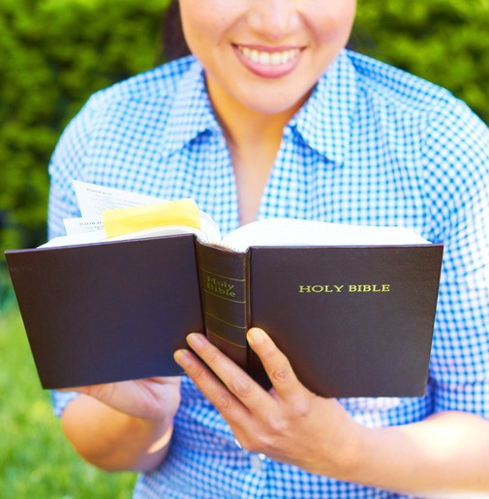
Will God’s Word Make a Difference?
2. What does it take for this to work for me?
Accept, Store Up, and the Holy Spirit
Application
Notes:
2. What does it take for this to work for me?
Accept, Store Up, and the Holy Spirit
Application
We’re told in 1 Timothy 4:7b (Ph) “Take the time and trouble to keep yourself spiritually fit.”

Slide 19
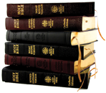
How to Study God’s Word
Study for yourself!
Use pen and paper.
Ask questions.
Always Check the context.
Notes:
How to Study God’s Word
“If you accept my words and store up my commands within you, turning your ear to wisdom and applying your heart to understanding, and if you call out for insight and cry aloud for understanding, and if you look for it as for silver and search for it as for hidden treasure, then you will understand the fear of the Lord and find the knowledge of God.” Proverbs 2: 1-5
Study for yourself - don’t depend on what others say.
“They accepted the message eagerly and studied the scriptures everyday…” Acts 17:11
“Be a good workman … Know what His Word says and means.” 2 Timothy 2:15
Use pen and paper - if you don’t write things down you will forget!
Know what questions to ask. (Suggestions below and in the section on Meditation)
Always check the context within which a verse(s) is/are written.
Read what comes before, and what comes after the verses being studied. If you are reading a chapter – scan the previous chapter or read the last paragraph to see what was being discussed. This will often set the stage for you; it may indicate to you why the author is about to say what he says. If you are studying just a verse or two, read the verses prior to and after ―again this will help you to understand the context within which the verses being studied were written

Slide 20
5. Guidelines for study by verse or chapter
What is the theme of the chapter?
Which verse stands out the most (to me) in the chapter?
What persons are mentioned?
What are the commands we should keep?
What are the promises we should claim?
What are the lessons we should remember?
Which words and phrases did you like best?
Which words kept recurring throughout the chapter?
Notes:
5. Guidelines for study by verse or chapter (will cover in the section on Meditation also)
What is the theme of the chapter?
Which verse stands out the most (to me) in the chapter?
What persons are mentioned? What information is included?
What are the commands we should keep?
What are the promises we should claim?
What are the lessons we should remember?
Which words and phrases did you like best?
Which words kept recurring throughout the chapter?

Slide 21
Which words were not clear as to their meaning?
What logical reason can you detect for the inclusion of this chapter in the Bible?
Is there an example for me to follow?
What are the errors of living that we should avoid?
What does this chapter teach about God?
What does this passage tell me about my relationship to God?
Notes:
Which words were not clear as to their meaning?
What logical reason can you detect for the inclusion of this chapter in the Bible?
Is there an example for me to follow?
What are the errors of living that we should avoid?
What does this chapter teach about God?
What does it teach me about His character?
What does it teach me about how He relates to people?
What does it teach me about how to worship and love God?
What does this passage tell me about my relationship to God?
What does it teach me about God’s relationship to me?
What does it teach me about my relationship to other believers?
What does it teach me about my relationship to unbelievers?
What does it teach me about my relationship to me?

Slide 22
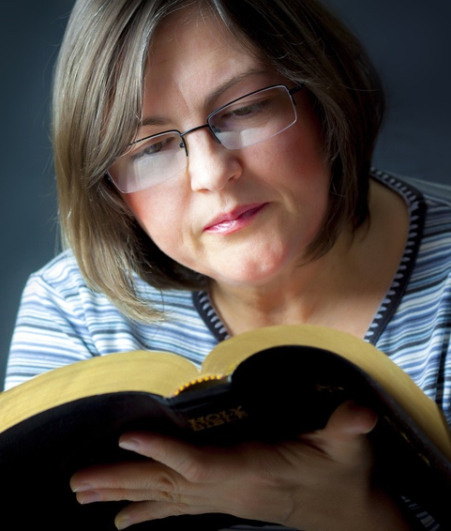
6. How do I begin a daily Bible Study program?
The key is simply to begin! Then be consistent. Don’t try to be the perfect student right away ―this is a lifelong process.
Notes:
6. How do I begin a daily Bible Study program?
The key is simply to begin! Then be consistent. Don’t try to be the perfect student right away ―this is a lifelong process.

Slide 23
Memorizing God’s Word
A. Benefits of Memorizing Scripture
Resist temptation
Make wise decisions
Will strengthen| Gives you peace
Comforts you
Helps you witness
Notes:
Memorizing God’s Word
“Guard my words as your most precious possession. Write them down, and also keep them deep within your heart.” Proverbs 7:2-3 (LB)
A. Benefits of memorizing Scripture
1. It helps me resist temptation.
“I have hidden your Word in my heart that I might not sin against you.” Psalms 119:11
2. It helps me make wise decisions.“ Your word is a lamp to guide me and a light for my path.” Psalm 119:105
3. It strengthens me and gives me peace when I am under stress. “Your promises to me are my hope. They give me strength in all my troubles; how they refresh and revive me!” Psalm 119:49 (LB)
4. It comforts me when I am sad.
“Your words are what sustain me…They bring joy to my sorrowing heart and delight me.” Jeremiah 15:16 (LB)
5. It helps me witness to unbelievers.
“Always be prepared to give an answer to everyone who asks you to give the reasons for the hope that you have.” 1 Peter 3:15 (NIV)

Slide 24
B. When to Memorize
During your quiet time.
While exercising
While waiting
At bedtime (Psalm 63:6)
Notes:
B. When to memorize
During your quiet time.
While exercising
While waiting (any spare moments – doctor’s office, metro…)
At bedtime (Psalm 63:6)

Slide 25
C. How to Memorizing Scripture
Pick a verse that speaks to you
Say the reference
Read the verse aloud many times.
Glance at the first phrase and say it aloud
Notes:
C. How to memorize a verse
Pick a verse that speaks to you – write it on a note card.
Say the reference before and after the verse.
Read the verse aloud many times. Think about its meaning.
Glance at the first phrase and say it aloud. Glance at the next phrase and say both phrases aloud. Continue this process until you have said the whole verse.

Slide 26
5. Say the verse from memory later in the day
6. Repeat the verse several times
7. Always memorize the verse word perfect
8. Get a partner so you can check each other
Notes:
5. Try to say the verse from memory later in the day. If you cannot remember the complete verse, glance at the cards to refresh your memory.
6. Repeat the verse several times each day for a week or until you feel that the verse is firmly implanted in your mind.
7. Always memorize the verse word perfect (just as written).
8. Get a partner so you can check each other.
Three main keys for memorizing scripture:
1. Review 2. Review 3. Review
“Your teachings are worth more to me than thousands of pieces of gold and silver.” Psalm 119:72 (NCV)

Slide 27
How to Meditate in God’s Word
A. What Does Meditation Mean?
Listening to God’s Word
Reflecting on God’s word
Rehearsing God’s Deeds
Ruminating on God’s Law
Notes:
How to Meditate on God’s Word
A. What does meditation mean?
The Bible uses two different Hebrew words to convey the idea of meditation, and together they are used some fifty-eight times. These words have various meanings:
listening to God’s word
reflecting on God’s works
rehearsing God’s deeds
ruminating on God’s law
and more.
In each case there is s stress upon changed behavior as a result of our encounter with the living God. Repentance and obedience are essential features in any biblical understanding of meditation. Meditation creates the emotional and spiritual space which allows Christ to construct an inner sanctuary in the heart. This fellowship with God and His word transforms the inner personality―helping us to become like Christ. (Thoughts taken from Celebration of Discipline” by Richard Foster, pp 15, 20)
“My eyes stay open through the watches of the night, that I may meditate on your promises.”
Psalm 119:148
“…His word is in my heart like a fire, a fire shut up in my bones…” Jeremiah 20:9 (NIV)

Slide 28
B. Benefits of Meditation
Our Love for God Will Grow
Our Faith Will Grow
We Will Become Like Christ
Key to Answered Prayer
Key to Successful Living
Notes:
B. Benefits of meditation:
1. Our love for God will grow. (As our mind dwells on God we begin to know Him more, the more we get to know Him the more we love Him…)
2. Our faith will grow stronger. (As we meditate on God and His love, power, strength―the more confident we become.)
“Thou wilt keep him in perfect peace, whose mind is stayed on thee: because he trusteth in Thee.” Isaiah 26:3 (KJV)
3. It is the key to becoming like Christ.“…your life is shaped by your thoughts.” Proverbs 4:23 (GN)“…be transformed by the renewing of your mind.” Romans 12:2
“As we … contemplate the Lord’s glory, we are being transformed into His likeness.…” 1 Corinthians 3:18
“We should meditate upon the scriptures, thinking soberly and candidly upon the things that pertain to our eternal salvation. The infinite mercy and love of Jesus, the sacrifice made in our behalf, call for the most serious and solemn reflection…By constantly contemplating heavenly themes, our faith and love will grow stronger.” Ellen G. White, Sons and Daughters of God, p. 109 (Emphasis supplied)
4. It is the key to answered prayer.
“If you live your life in Me, and my words live in your hearts, you can ask whatever you like, and it will come true for you.” John 15:7 (Ph)
5. It is the key to successful living.
“…Meditate on (the Word) day and night, so you may be careful to do everything written in it. Then you will be prosperous and successful.” Joshua 1:8
Is meditation just part of my Bible Study time? No! It is the “on-going” processing of what God’s word means and what He wants to reveal to you as an individual.
“My soul is feasted as with marrow and fat, and my mouth praises thee with joyful lips, when I think of thee upon my bed, and meditate on thee in the watches of the night.” (Psalms 63:5,6)

Slide 29
C. Six Ways to Meditate on a Verse
Picture it!
Pronounce it!
Paraphrase it!
Personalize it!
Pray it!
Probe it!
Notes:
C. Six ways to mediate on a verse
Sample verse: “For God so loved the world that He gave His one and only Son, that whoever believes in Him shall not perish but have eternal life.” John 3:16
1. Picture it! Visualize the scene in your mind. [Can you picture God and Jesus standing in heaven looking down on earth ―talking about how much they love humanity? Look, they are pointing especially at you! God puts His hand on the shoulder of Jesus and He says, “Are you absolutely sure you are willing to go through with this Son?” “Yes, Father, I am!” And God, with sadness looks at His Son and then at earth once again and a smile breaks out on His face. “Yes, I love them that much!”
2. Pronounce it! Say the verse aloud, each time emphasizing a different word.
“For God so loved the world…”
“For God so loved the world…”
“For God so loved the world…”
(Think about the word you are emphasizing ―what does it add to the text?)
3. Paraphrase it! Rewrite the verse in your own words. Example; God loved absolutely every person on this earth so much that He was willing to give up the one thing that was most priceless to Him, His son!…
4. Personalize it! Replace the pronouns or people in the verse with your name. For God so loved (your name) that He gave His One and only son, so that if (your name) believes in Him he/she will not perish but have eternal life.
5. Pray it! Turn the verse into a prayer and say it back to God. Example.: Lord, thank you so much for loving me so deeply that…
6. Probe it! Ask the following nine questions: Is there any…
Sin to confess?
Promise to claim?
Attitude to change?
Command to keep?
Example to follow?
Prayer to pray?
Error to avoid?
Truth to believe?
Something to thank God for?

Slide 30
How to Apply God’s Word
A. Application Questions
?
Ask this question first: What did it mean to the original hearers?
Ask this question second: What is the underlying timeless principle?
Ask this question third: Where or how could I practice that principle?
Notes:
How to Apply God’s Word:
“Do not fool yourselves by just listening to the Word. Instead, put it into Practice.” James 1:22
“Whoever practices and teaches these commands will be called great in the kingdom of heaven.” Matthew 5:19
A. Application Questions:
Ask this question first: What did it mean to the original hearers?
Ask this question second: What is the underlying timeless principle?
Ask this question third: Where or how could I practice that principle?
“Now that you know these things – do them! That is the path of blessing!” John 13:17 (LB)

Slide 31
B. Example of Application
and the Importance of Checking Context
Based on Acts 10:9-48
What did it mean to the original hearers?
What is the underlying timeless principle?
Where or how could I practice that principle?
Notes:
B. Example of application and the importance of checking context:
Based on Acts 10:9-48: Peter was up on the roof praying. He became hungry and was waiting for lunch when he fell into a trance. In vision he saw a large sheet being let down from heaven, on the sheet he could see all kinds of animals. In verse 13 a voice says to him, “Get up, Peter, kill and eat.” Peter replied, “Surely not, Lord! I have never eaten anything impure or unclean.” The voice replies to Peter, “Do not call anything impure that God has made clean.” This happened three times and then the sheet was taken back to heaven.
If we were to just read verses 9-16 we could conclude that Peter had just been told not to call any meat unclean – it’s ok to eat pork now! In fact, this is one of the texts that people will use to argue that the OT clean/unclean restrictions no longer apply. There are two problems with this. To come to such a conclusion we would have to search the others areas in Scripture that deal with clean/unclean foods to see if our principle pans out. Second, we have to read the rest of the chapter to see what this scenario meant to Peter, who received the vision, in order to understand the context within which it was given.
Reading the rest of the chapter to understand the context of verses 9-16:
Some non-Jewish people visited Peter and asked that he come to the home of Cornelius the centurion.
In verse 28 Peter pointed out that it is against the law for a Jew to associate with a Gentile.
“But,” Peter said, “God has shown me that I should not call any man impure or unclean. So when I was sent for, I came without raising objection….”
As we see from the above verses and in the rest of the chapter the vision was to prepare Peter to be willing to take the gospel to the Gentiles; the verses were not about unclean meats being made clean.
Application Process:
What it meant to the original hearers: The Gentiles are not to be considered unclean.
What is the underlying timeless principle? God’s grace is provided for everyone.
How can I apply this principle? I will consider everyone I meet as someone Jesus died for ―therefore they are of great value.

Slide 32
Ask Questions Gather Information
Notes:
Ask Questions and Gather Information

Slide 33
Using Bible Study Principles and Guidelines
Looking at Matthew 15:21-28
Leaving that place, Jesus withdrew to the region of Tyre and Sidon. A Canaanite woman of that vicinity came to him, crying out, “Lord, Son of David, have mercy on me! My daughter is suffering terribly from demon possession.” Jesus did not answer a word. So his disciples came to him and urged him, “Send her away, for she keeps crying out after us.” He answered, “I was sent only to the lost sheep of Israel.” The woman came and knelt before him. “Lord, help me!” she said. He replied, “It is not right to take the children’s bread and toss it to their dogs.” “Yes, Lord,” she said, “but even the dogs eat the crumbs that fall from their masters’ table.”
Then Jesus answered, “Woman, you have great faith! Your request is granted.”
And her daughter was healed from that very hour.
Notes:
Using the Bible Study Principles and Guidelines:
We’ll look at Matthew 15:21-28.
Leaving that place, Jesus withdrew to the region of Tyre and Sidon. A Canaanite woman of that vicinity came to him, crying out, “Lord, Son of David, have mercy on me! My daughter is suffering terribly from demon possession.” Jesus did not answer a word. So his disciples came to him and urged him, ‘Send her away, for she keeps crying out after us.” He answered, “I was sent only to the lost sheep of Israel.” The woman came and knelt before him. ‘Lord, help me!” she said. He replied, “It is not right to take the children’s bread and toss it to their dogs.” “Yes Lord,” she said, “but even the dogs eat the crumbs that fall from their masters’ table.” Then Jesus answered, “Woman, you have great faith! Your request is granted.” And her daughter was healed from that very hour.

Slide 34
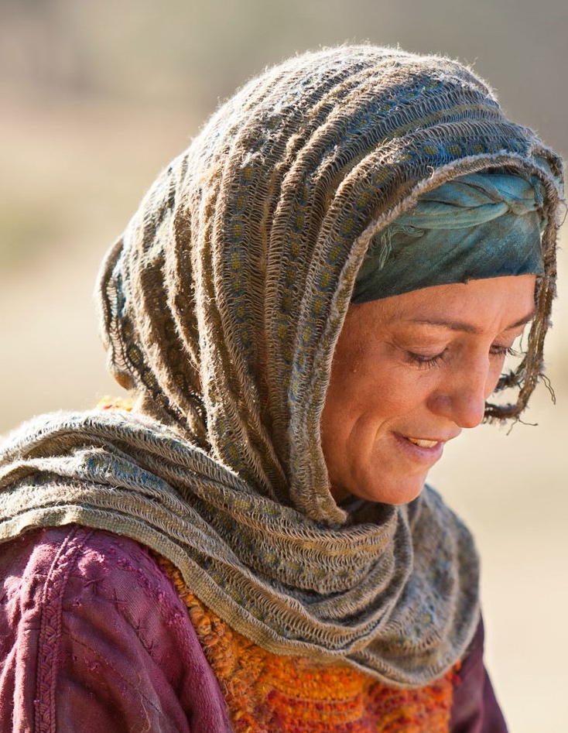
After the first reading we might have some of the following question/reactions:
Why did Jesus ignore her at first?
When Jesus made the reference about not tossing the children’s bread to their dogs, was He calling the woman a dog?
Notes:
After the first reading we might have some of the following questions/reactions:
Why did Jesus ignore her at first?
When Jesus made the reference about not tossing the children’s bread to their dogs, was He calling the woman a dog?
Without any further study we may conclude that the main emphasis of this story is something like this: God grants the requests of those who are persistent and faithful.
This is a very worthy lesson to learn! But now, by using more in depth Bible study skills, we will find that there is still much more to learn in this story. We’ll ask several of the basic questions as provided in our Bible study guidelines and I’ll share added information taken from various study resource tools.

Slide 35
What came before this story?
Matthew 15:21-28
What came before this story?
What is the theme of the chapter?
What persons are mentioned? What information is included?
Which verse, words or phrase stands out to me most in the chapter?
Notes:
What came before this story? Matthew 15:1-20
With a quick scan I see that Jesus is teaching about clean/unclean in regards to people/relationships/actions…
Jesus had just rebuffed the disciples (15:16-20) for not being very quick to understand that “the things that come out of the mouth come from the heart, and these make a man ‘unclean.’” (Evil thoughts, murder, adultery…)
Based on this insight I can see that perhaps Jesus was also teaching something about clean/unclean in Matthew 15:21-28.
What is the theme of the chapter?
Clean – Unclean
What persons are mentioned? What information is included?
Jesus, disciples, Canaanite woman, her daughter, took place in the region of Tyre and Sidon
Daughter was demon possessed
Which verse/words or phrase stands out to me most in the chapter? In this particular study I’ll add the question: Which words (or thoughts) were not clear as to their meaning?
“It is not right to take the children’s bread and toss it to their dogs.” (I’ll admit – this verse bothered me prior to understanding the story as a whole!) Also: “but even the dogs eat the crumbs that fall from their master’s table.”
To understand I want to know what children’s bread, dogs, and the crumbs for the master’s table meant in this story.

Slide 36
My first step would be to check the notes in my study Bible on these particular verses and see what I learn. I would also check the concordance to see if I find any similar references in other parts of the scripture. Then I would also check at least one commentary resource to see what information I might gather. Listed are some helpful pieces of information that I found:
Notes:
My first step would be to check the notes in my study Bible on these particular verses and see what I learn. I would also check the concordance to see if I find any similar references in other parts of the scripture. Then I would also check at least one commentary resource to see what information I might gather. Listed are some helpful pieces of information that I found:
Tyre is pronounced “Tire” and Sidon is pronounced “Sý-don” according to People and Places in the Bible, p. 226, 248
Jesus had been rejected by the Jews both in Judea and Galilee. He sought an opportunity to instruct His disciples in laboring for non-Jews. Jesus withdrew to the hills of the border country between Galilee and Phoencia (DA 399) – He could see the cities of Tyre and Sidon from there. SDA Comm., vol 5, p.420
In verse 26 where it says “their dogs” the Greek says “little dogs” meaning a pet dog in the home. (NIV Study Bible p1465)
Jewish people sometimes referred to Gentiles as dogs. So, Jesus was actually calling this woman a dog! But, of course, He was teaching his disciples a lesson (remember He had been teaching them lessons about clean/unclean). He was not trying to be cruel to the woman.
People in the Orient did not adore dogs quite the way our culture does. For the most part dogs (pariah) roamed wild and would scavenge for food. They were seen as dirty and unwanted, this is how the Jews viewed Gentiles! But, there were small dogs (kunaria) that they kept as house pets. Often the family would toss scraps of food from the table. The word describing this dog is what Jesus used of the Canaanite woman. So we can see that this is why she then played on what He said and replied with, “Yes, but even the dogs eat the crumbs that fall from their masters table.” William Barclay’s Commentary, vol.12, p.122.

Slide 37
What did the bread stand for?
This is a reference to bread of salvation.
The Jews were to receive the Good News of salvation and be the ones to take it to the peoples of the world. Instead, they were harboring what they knew and proclaiming everyone else as unworthy and unable to understand spiritual matters.
SDA Bible Commentary, vol.5, p.420
Notes:
What did the bread stand for?
This is a reference to bread of salvation.
The Jews were to receive the Good News of salvation and be the ones to take it to the peoples of the world. Instead, they were harboring what they knew and proclaiming everyone else as unworthy and unable to understand spiritual matters. SDA Bible Commentary, vol.5, p.420

Slide 38
What do we know about the woman?
What do we know about the disciples?
What do we learn about Jesus?
Notes:
What do we know about the woman?
She was Canaanite – considered a heathen by the Jews.
Her daughter was demon possessed.
The Canaanite woman had evidently heard about Jesus because she sought him out believing that He could help her daughter.
As a Canaanite she also knew what the Jews thought of her. But she came anyway.
She addressed Jesus as “Lord, Son of David” which indicates some level of understanding on her part. She could have been stating her faith in Him as the coming Messiah or she knew it to be a respectful way to address Him.
At first Jesus ignored her and the disciples, in frustration, wanted to shoo her away.
Then Jesus indicated that what he had to offer was reserved for the lost sheep of Israel―she simply knelt before Him and pleaded for help.
When Jesus said, “It is not right to take the children’s bread and toss it to the dogs” she didn’t get angry or go away hurt, and she didn’t argue―she accepted the role He offered her, agreed with Him, and then built her case on that.
She had confidence that there was enough of the “bread” even for her. It was at this point that Jesus commended her faith and granted her request.
What do we learn about the disciples?
This encounter demonstrated that they still didn’t get the point about clean/unclean.
Jesus uses this woman’s situation as an object lesson―maybe through her faith they will get the point!
What do we learn about Jesus?
It seems there is no end to His ability to use situations to teach lessons.
Jesus affirmed her faith just as publicly as she had had to endure presenting her request in front of His disciples.

Slide 39
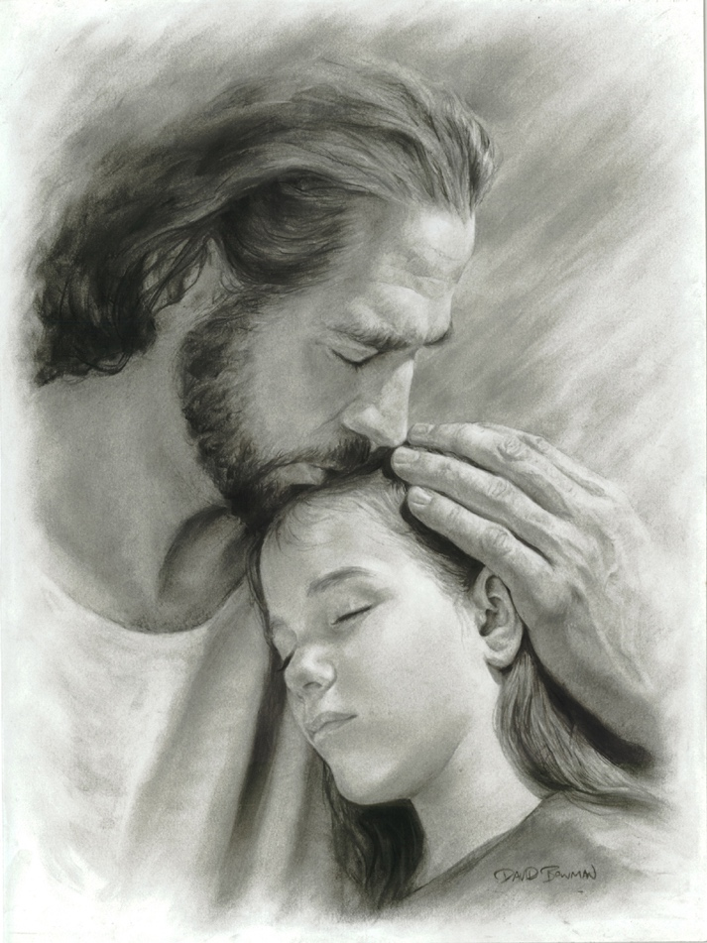
What are the lessons
we can learn from this story?
It pays to hold on in faith!
Hold on even when it seems that God is not listening.
Hold on even if others reject you!
Jesus’ mercy is available and there is enough for everyone!
Jesus will affirm your faith.
Notes:
What are the lessons we can learn from this story?
It pays to hold on in faith!
Hold on even when it seems that God is not listening.
Hold on even if everyone around you is acting as though you are the untouchable one!
Jesus’ mercy is available to everyone and there is always enough to go around!
Jesus will affirm your faith.

Slide 40
What does this passage teach me about my relationship with God?
What does it teach me about my relationship with other people?
Notes:
What does this passage teach me about my relationship with God?
I didn’t like that He called her a dog! I was busy being offended by that when I should have known that Jesus was up to something good on her behalf. When I find myself in similar situations in life I want to be more like this woman and just persevere in faith knowing that Jesus is able.
I would have a hard time just agreeing with what Jesus said and progressing from there. I would want to argue a little bit―I would want to say, “Yes it is fair! There’s enough for me too.” I want to learn to be like this woman and just trust that wherever Jesus is leading me – it’s a good place to be!
What does it teach me about my relationship with other people?
Not to judge someone else as being unworthy of God’s salvation, His attention, His mercy, His miracles….
Not to assume that because someone is from the wrong side of the tracks (that would mean something different for each of us) that I have nothing to learn from them. The Disciples wanted to send her away when they, at the very least, should have been standing back to see what Jesus was about to do.

Slide 41
What does this story teach me about
how to worship and love God
To believe in Him as the Messiah
To trust Him
Get on your knees!
Notes:
What does this story teach me about how to worship and love God?
To believe in Him as the Messiah
To trust Him even if the circumstances seem to be telling me that things aren’t going well for me.
When things continue to go wrong and it seems He is not listening I need to fall down on my knees and plead for mercy.
Work within His framework, including: taking note of everything that happens assuming that with God the pieces will connect together. My life is not a lot of random things happening here and there. God is fitting pieces together to teach me lessons and to use me to witness and serve others.

Slide 42
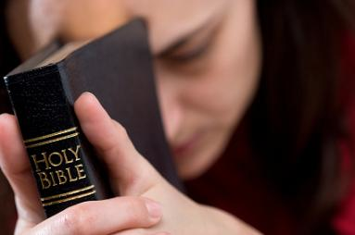
What application of His Word
will I make in my life?
When I begin to feel overwhelmed at work or with what is happening in a relationship I will ask God for help. If I become convinced He didn’t listen I will choose to trust that He did hear and that He will handle things in the best way possible.
Notes:
What application of His word will I make in my life?
When I begin to feel overwhelmed at work or with what is happening in a relationship, I will ask God for help. If I become convinced He didn’t listen, I will choose to trust that He did hear and that He will handle things in the best way possible.

Slide 43
“Guard My Words as your most precious possession. Write them down, and also keep them deep within your heart.”
Proverbs 7:2-3 (LB)
Notes:
I hope that as we peered into and unfolded the word of God you received new insight, a special blessing, and that your desire to dig into His word has grown!
“Guard my words as your most precious possession. Write them down, and also keep them deep within your heart.” Proverbs 7:2-3 (LB)
We have provided several handouts for you that will be helpful as you begin building your resources for Bible study. There are many tools you can use, and there are several different Bible study methods. A handout was prepared that gives a brief overview of three major methods of study, and recommendations were listed on books that you can purchase that will describe in detail various Bible Study methods.
I would like to close with prayer as we ask God to help us be faithful to His word and good stewards of the time that He has given us here on Earth.

