Slide 1

LEADERSHIP
Certification Program
Level 1
General Conference of Seventh-day Adventists Women’s Ministries Department
www.adventistwomensministries.org

Slide 2

Introduction to
Women’s Ministries
By Dorothy Watts
Updated by Ardis Stenbakken
(2013)
Leadership Certification Program - Level 1
Notes:
I. The History of Women’s Ministries
A. The Beginning of Women’s Ministries
Women’s Ministries is not something new in recent history. In 1898 Mrs. Sarepta Myrenda Irish Henry, (often referred to as S.M.I. Henry) with the encouragement of Ellen G. White, headed a church department for women’s ministry. The story of how it began is a thrilling one!

Slide 3
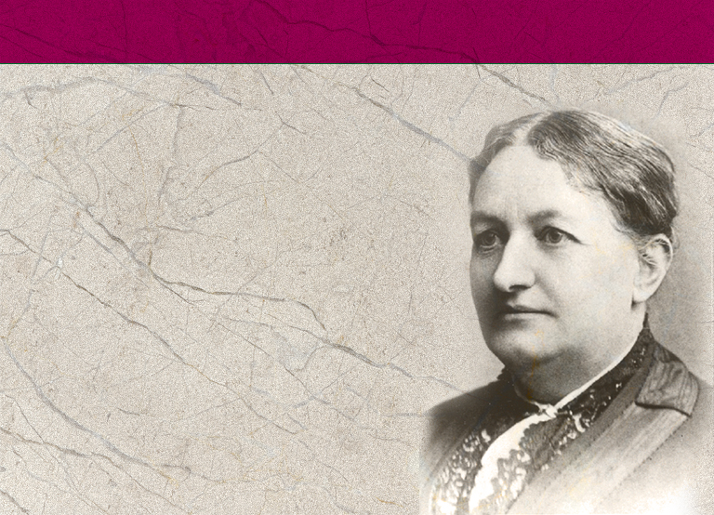
Sarepta Myranda Irish (1839 – 1900)
Notes:
Sarepta Myranda Irish (1839 – 1900) was born into the family of a Methodist minister who did much pioneering work in Illinois. Being too frail, in her father’s opinion, to work at the household chores, Sarepta spent her childhood and youth accompanying him on his itineraries and learning theology. Later in her youth she attended Rock River Seminary. In 1861 she married James W. Henry, a teacher, who died 10 years later as a result of injuries suffered in the American Civil War, leaving her with three small children. She supported her family by teaching and by writing stories and poetry for publication.
Appalled one day in the spring of 1874 that her child had been enticed to enter a saloon by the offer of candy, she set out to organize the Christian women of Rockford, Illinois, to active promotion of temperance. Gradually her sphere of action enlarged, and she became a national evangelist for the newly organized Women’s Christian Temperance Union.
Because of Sarepta’s heavy workload of travel and speaking, she became ill in the late 1880's and by the year 1895 became an invalid from a heart ailment. Hoping to find help, she went to the Battle Creek Sanitarium. In the late summer of 1896 she accepted the teachings of the Seventh-day Adventist Church, and shortly afterward she was healed while in prayer, and resumed her WCTU work.
In 1898 she conceived a plan for what she called “woman ministry.” Lecturing on the role of the mother in the moral education of society, she stressed this from coast to coast in the United States and Canada. She also presented her plan to Adventist congregations. A. W. Spalding remarked later that from her work instituted in the Seventh-day Adventist Church came the first semblance of an organized effort to train parents and to give help in their problems. (Seventh-day Adventist Encyclopedia, Vol. 10, p. 691)
In 1898 she resigned her position as national evangelist for the WCTU in order to devote herself to mobilizing the women of the Adventist Church to work for God. She felt that properly organized, trained, and directed, they could do a work equal, if not superior, to that of the WCTU which was probably the most powerful women’s organization of the time.
Mrs. Henry had been working with a very consecrated and superior group of women: women of education, means, and Christian character. They were tireless, energetic, enthusiastic, and hard working. By comparison, it seemed that many of the Seventh-day Adventist women were more or less apathetic, un-ambitious, and provincial in their outlook. They had received wonderful counsel and instruction; they were earnest and devoted, but actually they knew little of their own mission and possibilities in the church. She began to devise a plan to engage the Adventist women in united service for God.

Slide 4

Sister Henry:
“...I have thought, with your experience, under the supervision of God, you could exert your influence to set in operation lines of work where women could unite together to work for the Lord.
Notes:
At this time she received a letter from Ellen G. White who was then in Australia that said in part:
“Sister Henry:
“...I have thought, with your experience, under the supervision of God, you could exert your influence to set in operation lines of work where women could unite together to work for the Lord.

Slide 5
Sister Henry:
“There certainly should be a large number of women engaged in the work of ministering to suffering humanity, uplifting, educating them how to believe—simply believe—in Jesus Christ our Savior…
Notes:
“There certainly should be a large number of women engaged in the work of ministering to suffering humanity, uplifting, educating them how to believe—simply believe—in Jesus Christ our Savior....

Slide 6
Sister Henry:
“ I am pained because our sisters in America are not more of them doing the work they might do for the Lord Jesus... Many women love to talk. Why can’t they talk the words of Christ to perishing souls? The more closely we are related to Christ, the more surely the heart will know the wretchedness of souls who do not know God....
Notes:
“I am pained because our sisters in America are not more of them doing the work they might do for the Lord Jesus.... Many women love to talk. Why can’t they talk the words of Christ to perishing souls? The more closely we are related to Christ, the more surely the heart will know the wretchedness of souls who do not know God....

Slide 7

Sister Henry:
“Believing the teachings of Christ, that through you,
the human agency, he communicated his light,
his truth, you are the frail instrument through
whom the hidden power of God does
work, that his strength may be
perfected and made glorious in
your weakness.”
Mrs. E. G. White
Notes:
“Believing the teachings of Christ, that through you, the human agency, he communicated his light, his truth, you are the frail instrument through whom the hidden power of God does work, that his strength may be perfected and made glorious in your weakness.
“ (Signed) Mrs. E. G. White.”

Slide 8
“It must go from our women to all the homes the world over. And when each woman among our people shall come to appreciate her opportunity, and rejoice in it, realizing not the burdens she must bear,
Notes:
Now that her idea had become a specific assignment, and she felt she had the green light to go ahead, Mrs. Henry began enthusiastically to work out her dreams in a practical way.
In her book, A Woman Ministry, she stated her vision of the work women could do in their own homes, and then she continued: “It must go from our women to all the homes the world over. And when each woman among our people shall come to appreciate her opportunity, and rejoice in it, realizing not the burdens she must bear,

Slide 9
…but the abundant strength that is given with which to carry them, seeing not the danger from the lions in the way, but how they quail and fawn before the courage of even a weak woman’s mighty faith; then shall our ministry go abroad in their work, strong, refreshed, victorious.”
Notes:
…but the abundant strength that is given with which to carry them, seeing not the danger from the lions in the way, but how they quail and fawn before the courage of even a weak woman’s mighty faith; then shall our ministry go abroad in their work, strong, refreshed, victorious.”

Slide 10
The worker, by signing the card pledged “to be so instructed in all truth, to be so led and used by the power of the Holy Spirit, to be so taught a true woman’s ministry in my own home, among my neighbors, and in my own immediate social circle, that I may be prepared to labor for suffering humanity,
Notes:
Mrs. Henry set about to develop resources: she prepared study cards, one for the worker, and one for the learner. The worker, by signing the card pledged “to be so instructed in all truth, to be so led and used by the power of the Holy Spirit, to be so taught a true woman’s ministry in my own home, among my neighbors, and in my own immediate social circle, that I may be prepared to labor for suffering humanity,

Slide 11
…and to help in uplifting the fallen, and educating the ignorant to believe, simply believe—in Jesus Christ our Savior; for the first glance of any soul must be Jesus Christ. Then if he follows the Lamb of God as he remains a learner, he will have an intelligent knowledge of what is truth.”
Notes:
and to help in uplifting the fallen, and educating the ignorant to believe, simply believe—in Jesus Christ our Savior: for the first glance of any soul must be Jesus Christ. Then if he follows the Lamb of God as he remains a learner, he will have an intelligent knowledge of what is truth.”

Slide 12

The pledge of the learner was “to study to know the principles which constitute Christ’s character as they are set forth in His Word, and to live them out practically in the common affairs of everyday life.”
Notes:
The pledge of the learner was “to study to know the principles which constitute Christ’s character as they are set forth in His Word, and to live them out practically in the common affairs of everyday life.”

Slide 13
Mrs. Henry Wrote to Ellen White:
“I have for some time been wanting to write to you and tell you how the Women’s work is going on, for I know that many things in it would gladden your heart, although, of course, there are other things that might give you many sad hours....
Notes:
Mrs. Henry wrote to Ellen White:
“I have for some time been wanting to write to you and tell you how the Women’s work is going on, for I know that many things in it would gladden your heart, although, of course, there are other things that might give you many sad hours....

Slide 14
I have never before realized situations quite so sad as some that appear in these letters, and this gives me to understand how truly the Lord moved in opening up this line of work for our women.
Notes:
I have never before realized situations quite so sad as some that appear in these letters, and this gives me to understand how truly the Lord moved in opening up this line of work for our women.

Slide 15
Already we begin to see results in the conversion of souls. These conversions have been principally among the husbands of our sisters.
Notes:
Already we begin to see results in the conversion of souls. These conversions have been principally among the husbands of our sisters.

Slide 16
“This work is going forward among our women with great power. They are eager to take hold, and the letters which I receive reveal how great was the need that they should be set to work.”
Notes:
“This work is going forward among our women with great power. They are eager to take hold, and the letters which I receive reveal how great was the need that they should be set to work.”

Slide 17
Encouragement from Ellen White:
“The work you are doing to help our sisters feel their individual accountability to God is a good and necessary work. Long has it been neglected; but when this work has been laid out in clear lines, simple and definite,
Notes:
She was encouraged by letters from Ellen G. White. One letter stated:
“The work you are doing to help our sisters feel their individual accountability to God is a good and necessary work. Long has it been neglected; but when this work has been laid out in clear lines, simple and definite,

Slide 18
…we may expect that the essential duties of the home, instead of being neglected, will be done much more intelligently. The Lord would ever have us urge upon those who do not understand the worth of the human soul.
Notes:
…we may expect that the essential duties of the home, instead of being neglected, will be done much more intelligently. The Lord would ever have us urge upon those who do not understand the worth of the human soul.

Slide 19
“If we can arrange, as you are now working, to have regularly organized companies intelligently instructed in regard to the part they should act as servants of the Master, our churches will have life and vitality such as have been so long needed.
Notes:
“If we can arrange, as you are now working, to have regularly organized companies intelligently instructed in regard to the part they should act as servants of the Master, our churches will have life and vitality such as have been so long needed.

Slide 20

“....Our sisters have generally a very hard time, with their increasing families and their unappreciated trials. I have so longed for women who could be educators to help them to arise from their discouragement, and to feel that they could do a work for the Lord.
Notes:
“....Our sisters have generally a very hard time, with their increasing families and their unappreciated trials. I have so longed for women who could be educators to help them to arise from their discouragement, and to feel that they could do a work for the Lord.

Slide 21
“And this effort is bringing rays of sunshine into their lives, and is being reflected upon the hearts of others. God will bless you, and all who shall unite with you, in this grand work.”
Ellen G. White
Notes:
And this effort is bringing rays of sunshine into their lives, and is being reflected upon the hearts of others. God will bless you, and all who shall unite with you, in this grand work.” Ellen G. White

Slide 22
In 1899 Mrs. Henry published a weekly column in the Adventist Review headlined, “Woman’s Gospel Work.”
Notes:
In 1899 Mrs. Henry published a weekly column in the Adventist Review headlined, “Woman’s Gospel Work.” The column was filled with Bible studies, poetry, letters, and practical advice.

Slide 23
“Her work is always received with the greatest interest at every place where she goes. The newspapers are very liberal in their notices of her work, often giving a good sketch of her life, and a very complete synopsis of her lectures.”
Notes:
In November 1899 Mrs. Henry wrote to Ellen White about her trip to the western United States to promote the work of Women’s Ministries.
Her secretary added a postscript that said, “Her work is always received with the greatest interest at every place where she goes. The newspapers are very liberal in their notices of her work, often giving a good sketch of her life, and a very complete synopsis of her lectures.”

Slide 24

Mrs. Henry herself wrote:
“I was absent from home five months; traveled over nine thousand miles; have spoken two hundred and fourteen times;
Notes:
Mrs. Henry herself wrote, “I was absent from home five months; traveled over nine thousand miles; have spoken two hundred and fourteen times;

Slide 25
…was subject to nearly all conditions of living and climate which would test the strength of the most robust, and yet have returned in good working order...
Notes:
was subject to nearly all conditions of living and climate which would test the strength of the most robust, and yet have returned in good working order...

Slide 26
“After one day of rest I have taken up the work which is waiting for me in my office, without any sense of especial weariness, and with a consciousness of strength and courage for all that is before me.”
Notes:
After one day of rest I have taken up the work which is waiting for me in my office, without any sense of especial weariness, and with a consciousness of strength and courage for all that is before me.”

Slide 27
By June of 1901 the Women’s column disappeared from the Review and Herald. The committee became discouraged without their strong leader, and Women’s Ministries ceased as a department of the church.
Notes:
On January 3, 1900, Mrs. Henry attended a special session of leaders of the General Conference in Graysville, Tennessee. By January 12 she had become very ill with pneumonia. Although everything possible was done to save her life, she died on January 16, 1900. She was buried beside her mother and father at Pecatonica, Illinois.
The nine-member Women’s Ministries committee at the General Conference tried to carry on her work for a time. However, by June of 1901 the Women’s column disappeared from the Review and Herald. The committee became discouraged without their strong leader, and Women’s Ministries ceased as a department of the church, though individual women continued to work for God in many ways. It was not revived again until 1990 with the re-establishment of Women’s Ministries at the General Conference.

Slide 28
Book: The Whirlwind of the Lord: The fascinating true story of Sarepta Myrenda Irish Henry by Margaret Rossiter Thiele
Notes:
For more information on Mrs. Henry, there is an excellent book, The Whirlwind of the Lord: The fascinating true story of Sarepta Myrenda Irish Henry [hardcover] by Margaret Rossiter Thiele, the granddaughter of SMI Henry.

Slide 29
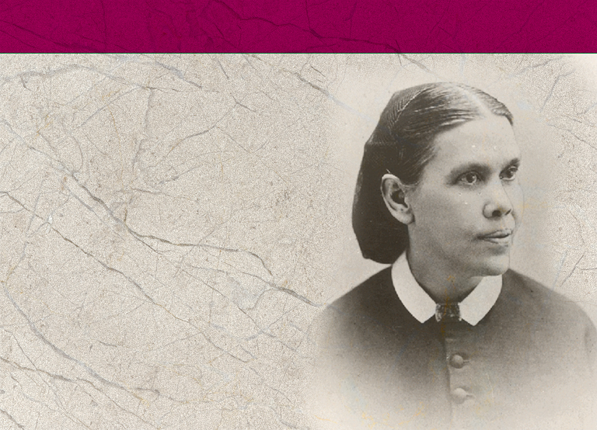
B. Women’s Ministries Time Line
1844
Ellen Harmon receives her first vision.
Notes:
B. Women’s Ministries Time Line
Note to the Presenter: Give everyone the Time Line Handout (found in Appendix 4). Below is a list of important dates to go over with the class.
1844 - In December Ellen Harmon receives her first vision.

Slide 30
1874
First Dorcas Society formed in Battle Creek, Michigan, by Mrs. Henry Gardner.
Mrs. S. M. I. Henry becomes a national evangelist for the Women’s Christian Temperance Union.
1896
Mrs. S. M. I. Henry joins the SDA Church after attending Battle Creek Sanitarium for treatment.
Notes:
1874 - First Dorcas Society formed in Battle Creek, Michigan, by Mrs. Henry Gardner in October.
- Mrs. S. M. I. Henry becomes a national evangelist for the Women’s Christian Temperance Union.
1896 - Mrs. S. M. I. Henry joins the Seventh-day Adventist Church after attending Battle Creek Sanitarium for treatment.

Slide 31
1898
Mrs. Henry corresponds with Ellen G. White and outlines “woman ministry”; Ellen White encourages her.
March 30, Mrs. Henry given a ministerial license by the General Conference.
Mrs. Henry wrote a four page supplement to the December 6, 1898, Review and Herald.
Notes:
1898 - Mrs. Henry corresponds with Ellen G. White and outlines “woman ministry”; Ellen White encourages her.
- March 30, Mrs. Henry given a ministerial license by the General Conference.
- SMI Henry wrote a four page supplement to the December 6, 1898, Review and Herald.

Slide 32
1899
Mrs. Henry produced a weekly page in the Review called “Women’s Gospel Work.” She traveled extensively promoting Women’s Ministries.
1900
Mrs. Henry dies. Nine member committee continues a short while, then disbands. Organized work of Women’s Ministries stops.
Notes:
1899 - Mrs. Henry produced a weekly page in the Review called “Women’s Gospel Work.” She traveled extensively promoting Women’s Ministries.
1900 - Mrs. Henry dies. Nine member committee continues a short while, then disbands. Organized work of Women’s Ministries stops.

Slide 33
1913
Dorcas Society becomes part of the Home Missionary Department, later the Lay Activities and then the Personal Ministries Department. It focuses on helping the poor.
1915
July 16, Ellen White dies.
Notes:
1913 - Dorcas Society becomes part of the Home Missionary Department, later the Lay Activities, and then the Personal Ministries Department. It focuses on helping the poor.
1915 - July 16, Ellen White dies.

Slide 34
1973
First “Role of Women in the Church” committee meets at Camp Mohaven, Ohio.
1980
At Dallas GC Session, President Neal C. Wilson calls for church to find ways to organize and use vast potential represented by women’s talents.
Notes:
1973 - First “Role of Women in the Church” committee meets at Camp Mohaven, Ohio.
1980 - Dallas General Conference Session, President Neal C. Wilson calls for church to find ways to organize and use the vast potential represented by women’s talents.

Slide 35
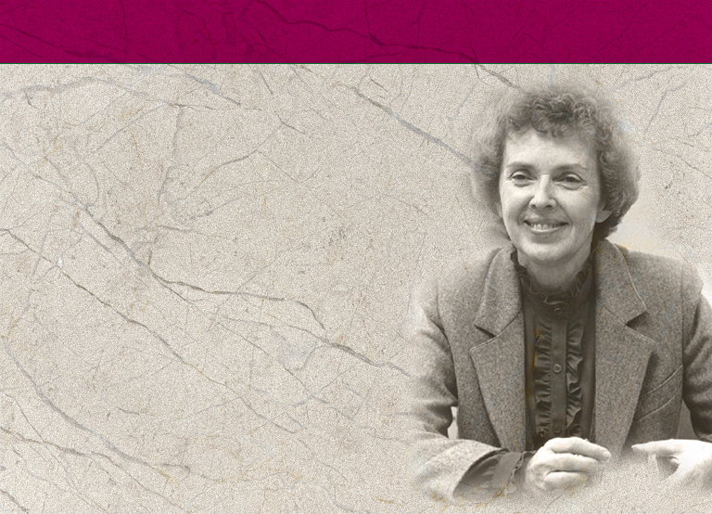
1985
March: Commission on the Role of Women meets. Includes delegates from world field.
Annual Council establishes
Women’s Ministries Advisory Committee. Betty Holbrook is appointed Chair Person.
Notes:
1985 - March: Commission on the Role of Women meets. Includes delegates from world field. Recommend an affirmative action plan be developed to improve women’s involvement in the church.
- July: The General Conference Session in New Orleans votes “affirmative action” for the involvement of women in the work of the church be a priority plan with church leadership, and to request leaders use their executive influence to open to women all aspects of ministry in the church that do not require ordination.
- Annual Council establishes a Women’s Ministries Advisory Committee. Betty Holbrook is appointed chair person.

Slide 36
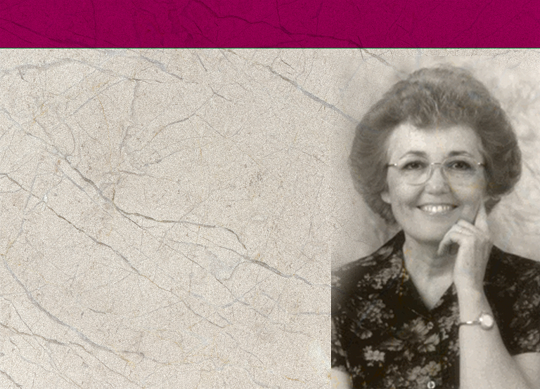
1988
Karen Flowers becomes head of the Women’s Ministries Advisory Committee. They formulate a mission statement for Women’s Ministries, the same one now in use by the WM Department.
The GC Women’s Ministries Advisory drafts proposal for President Neal Wilson outlining full-time position for a Women’s Ministries director.
Notes:
1988 - Karen Flowers becomes head of the Women’s Ministries Advisory Committee. They formulate a mission statement for Women’s Ministries, the same one now in use by the Women’s Ministries Department.
- The GC Women’s Ministries Advisory drafts proposal for President Neal Wilson outlining full-time position for a Women’s Ministries director.

Slide 37
1989
Karen Flowers presented a study on women in leadership in the world field to the “Commission on the Role of Women” at Cohutta Springs, GA. The meeting recommended that the GC open an office of Women’s Ministries with a
full-time director for
Women’s Ministries.
Notes:
1989 - March 16, “Forgotten Heritage,” and editorial in the Adventist Review summarizes the work of SMI Henry and calls for re-establishment of Women’s Ministries.
- Karen Flowers presented a study on women in leadership in the world field to a Commission on the Role of Women at Cohutta Springs, Georgia. The meeting recommended that the General Conference open an office of Women’s Ministries with a full-time director for Women’s Ministries.

Slide 38
1990
A fabric wall-hanging depicting Adventist women serving Christ in every division of the world is displayed at the General Conference Session in Indianapolis. It is now on display in the General Conference building.
Notes:
1990 - A fabric wall-hanging depicting Adventist women serving Christ in every division of the world is displayed at the General Conference Session in Indianapolis. It is now on display in the General Conference building.

Slide 39
1990
A group of 35 women representing various groups ask the church to appoint a full-time Director of Women’s Ministries at all levels. They recommend that the Director’s duties include:
Identifying, assessing and developing strategies to meet women’s needs
Generating and disseminating accurate information concerning the role of women in the church
Sponsoring retreats for the purpose of spiritual nourishment
Directing activities to educate women regarding church governance and policies
Notes:
1990 - A group of 35 women representing various groups asks the church to appoint a full-time Director of Women’s Ministries at all levels. They recommend that the Director’s duties include:
Identifying, assessing and developing strategies to meet women’s needs
Generating and disseminating accurate information concerning the role of women in the church
Sponsoring retreats for the purpose of spiritual nourishment
Directing activities to educate women regarding church governance and policies

Slide 40
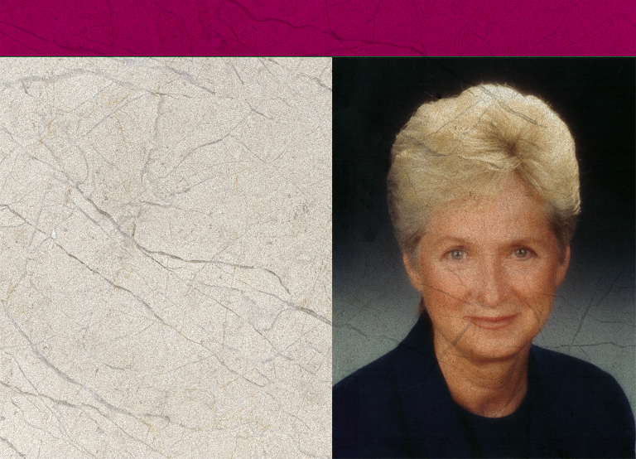
1990
Annual Council, October 4, voted to open an office of Women’s Ministries. Rose Otis is elected director of Women’s Ministries.
Notes:
1990 - Annual Council, October 4, voted to open an Office of Women’ Ministries. Rose Otis is elected director of Women’s Ministries.
(Note: The fact that it was the Office of Women’s Ministries meant that it was under the direction of the President; it was not a separate department of the church as yet.)

Slide 41
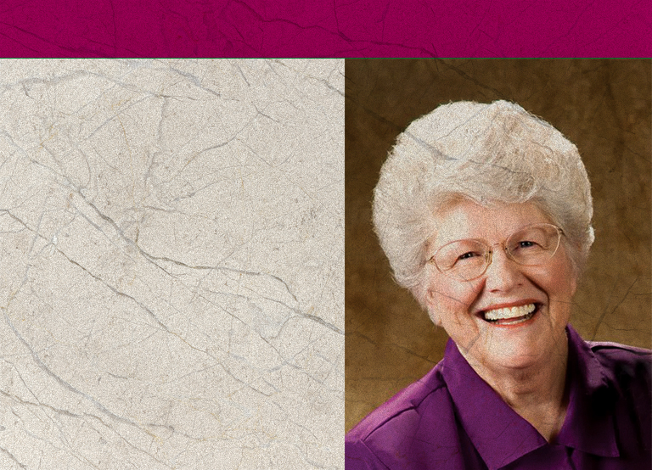
1995
1995 was declared the Year of the Adventist Woman.
Women’s Ministries was given full departmental status at the GC Session in Utrecht.
Ardis Stenbakken is elected as Associate Director.
Notes:
1995 - 1995 was declared the Year of the Adventist Woman
- Women’s Ministries given full departmental status at the General Conference Session in Utrecht.
- Ardis Stenbakken is elected as Associate Director.

Slide 42
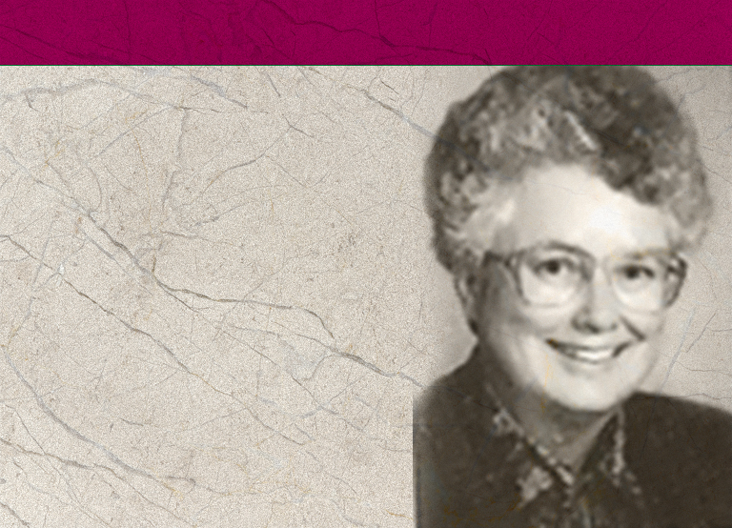
1996
EAD, EUD, and IAD establish Women’s Ministries Departments.
First Women’s Ministries World Advisory held in March.
Dorothy Eaton Watts chosen to replace Rose Otis who resigned to become a Vice-President for the North American Division.
Notes:
1996 - First Women’s Ministries World Advisory held in March. These sessions involve all the Division Women’s Ministries Directors, lay plans for Women’s Ministries for the next five years, and adopt policies and initiatives such as Abuse Prevention Day.
- Dorothy Eaton Watts elected to replace Rose Otis, who resigned to become a Vice-President for the North American Division.

Slide 43
1997
At Annual Council, Ardis Stenbakken is chosen to replace Dorothy Watts who resigned when her husband became president of Southern Asia Division.
Lynnetta Siagian Hamstra is elected Associate Director of General Conference Department of Women’s Ministries.
Notes:
1997 - At Annual Council Ardis Stenbakken was chosen to replace Dorothy Watts who resigned when her husband became president of Southern Asia Division.
- Lynnetta Siagian Hamstra elected as Associate Director of General Conference Department of Women’s Ministries.

Slide 44
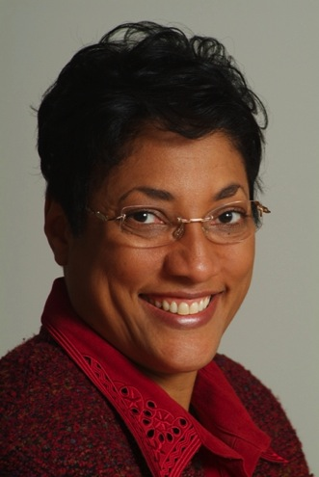
2004
Ardis Stenbakken retires at the end of 2004.
Heather-Dawn Small is elected Director of Women’s Ministries.
2005
Raquel Queiroz da Costa Arrais is elected Associate Director.
Notes:
2004 - Ardis Stenbakken retires at the end of 2004
- Heather-Dawn Small is elected Director of Women’s Ministries.
2005 - Raquel Queiroz da Costa Arrais elected as Associate Director

Slide 45
North American Division
C. Date Women’s Ministries began
in the Division and the Directors
Elizabeth Sterndale (1990-1997)
Rose Otis (1997-1998)
Mary Maxson (1999-2005)
Carla Baker (2006 - present)
Notes:
Women’s Ministries in the Divisions and Division Women’s Ministries Directors
The Date is when Women’s Ministries began in the Division followed by the Directors
1990
North American Division
Elizabeth Sterndale (1990 – 1997)
Rose Otis (1997 – 1998)
Mary Maxson (1998 - 2005 )
Carla Baker (2006 - present)

Slide 46
Northern Asia Pacific Division
(formerly Far Eastern Division and then Asia Pacific Division)
Nancy Bassham (1991 - 1994)
Linda Koh (1994 - 1997)
Mary Wong (1997 - 2002)
Young-Ja Lee Nam (2002 - 2005)
Sally Lam Phoon (2006 -2015)
Notes:
1991
Northern Asia Pacific Division (formerly Far Eastern Division and then Asia Pacific Division)
Nancy Bassham (1991 - 1994)
Linda Koh (1994 - 1997)
Mary Wong (1997 - 2002)
Young-Ja Lee Nam (2002 - 2005)
Sally Lam Phoon (2006 - present)

Slide 47
Southern Asia Pacific Division
(formerly Far Eastern Division and Asia Pacific Division)
Nancy Bassham (1991 - 1994)
Linda Koh (1994 – 2003)
Ellen Missah (2004 - 2005)
Helen Gulfan (2005 - present)
Notes:
1991
Southern Asia Pacific Division (formerly Far Eastern Division and Asia Pacific Division)
Nancy Bassham (1991 - 1994)
Linda Koh (1994 – 2003)
Ellen Missah (2004 - 2005)
Helen Gulfan (2005 - present )

Slide 48
Euro-Asia Division
Ludmila Krushenitskaya (1991 - 2000)
Natasha Ivanova (2000 – 2001)
Raisa Ostrovskaya (2001 - present)
Notes:
1991
Euro-Asia Division
Ludmila Krushenitskaya (1991 - 2000)
Natasha Ivanova (2000 – 2001)
Raisa Ostrovskaya (2001 - present)

Slide 49
West Central Africa Division
(formerly Africa-Indian Ocean Division)
Thelma Nortey (1991 - 1995)
Priscille Metanou (1995 - 2010)
Omobonike Adeola Sessou (2010 - present)
Notes:
1991
West Central Africa Division (formerly Africa-Indian Ocean Division)
Thelma Nortey (1991 - 1995)
Priscille Metanou (1995 - 2010)
Omobonike Adeola Sessou (2010 - present)

Slide 50
Trans-European Division
Birthe Kendel (1991 - 2000)
Anne-May Wollan (2000 - 2010)
Clair Sanches-Schutte (2010 - present)
Notes:
1991
Trans-European Division
Birthe Kendel (1991 – 2000)
Anne-May Wollan (2000-2010)
Clair Sanches-Schutte (2010-present)

Slide 51
Southern Asia Division
Pastor and Mrs. Injety James (1991 - 1995)
Frances Campbell (1996 - 1998)
Hepzibah Kore (1998 - 2010)
Pramila Masih (2010 - present)
Notes:
1991
Southern Asia Division
Pastor and Mrs. Injety James (1991 - 1995)
Frances Campbell (1996 - 1998)
Hepzibah Kore (1998 - 2010)
Pramila Masih (2010 - present)

Slide 52
South Pacific Division
Carol-Ferch Johnson (1992 - 2000)
Joy Butler (2001 - 2008)
Erma Johnson (2008 - present)
Notes:
1992
South Pacific Division
Carol-Ferch Johnson (1992 - 2000)
Joy Butler (2001 - 2008)
Erma Johnson (2008 - present)

Slide 53
Middle East Union
(Attached field of the world church until 1995)
Valerie Fidelia (1992-1995)
Aranka Bajic (2007-2012)
Notes:
1992
Middle East Union (Attached field of the world church until 1995)
Valerie Fidelia (1992 - 1995)
Aranka Bajic (2007-2012)

Slide 54
South American Division
Susana Schulz (1993 - 1994)
Vasti Viana (1994 - 2000)
Evelyn Nagel (2000 - 2005)
Wiliane Marroni (2006 - 2015)
Marly Peyerl (2015-present)
Notes:
1993
South American Division
Susana Schulz (1993 - 1994)
Vasti Viana (1994 - 2000)
Evelyn Nagel (2000 - 2006 )
Wiliane Marroni (2006-2015)
Marly Peyerl (2015-present)

Slide 55
South African Union Conference
(Attached field of the world church until 2003)
Ivy Petersen (1994-2002)
Priscila Ben (2001-2003)
Notes:
1994
South African Union Conference
(Attached field of the world church until 2003)
Ivy Petersen (1994 - 2002)
Priscila Ben (2001-2003)

Slide 56
Southern Africa-Indian Ocean Division
Emilienne Rasamoely (2003 - 2005)
Caroline Chola (2006 - present)
Notes:
2003
Southern Africa-Indian Ocean Division
Emilienne Rasamoely (2003 - 2005)
Caroline Chola (2006 - present)

Slide 57
Inter-American Division
Waveney Martinborough (1996 - 2000)
Gloria Trotman (2000 – 2010)
Cecilia de Iglesias (2010 - 2015)
Dinorah Rivera (2015– Present)
Notes:
1996
Inter-American Division
Waveney Martinborough (1996 - 2005 )
Gloria Trotman ( 2000- 2010)
Cecilia de Iglesias ( 2010-2015)
Dinorah Rivera (2015-Present)

Slide 58
Inter-European Division
(formerly Euro-Africa Division)
Noelle Vitry (1996 - 2005)
Christiane Vertallier (2005 - 2010)
Denise Hochstrasser (2010 - present)
Notes:
1996
Inter-European Division (formerly Euro-Africa Division)
Noelle Vitry (1996 - 2005)
Christiane Vertallier (2005 - 2010)
Denise Hochstrasser (2010 - present)

Slide 59
East Central Africa Division
Pastor Tswelelo Lekolwane (1996 - 1997)
Priscilla Handia Ben (1997 - 2012 )
Joy Gashaija (2003 - 2010)
Debbie Maloba (2010 - present)
Notes:
1996
East Central Africa Division
Pastor Tswelelo Lekolwane (1996 – 1997) (Pastor Lekolwane represented his division in the 1996 Women’s Ministries Advisory and began to work hard to get a woman appointed in the Division)
Priscilla Handia Ben (1997 - 2012 )
Joy Gashaija (2003 - 2010)
Debbie Maloba (2010 - present)

Slide 60
II. Mission Statement
The Department of Women’s Ministries exists to uphold, encourage, and challenge Adventist women in their pilgrimage as disciples of Jesus Christ and members of His world church.
Notes:
II. Mission Statement
As noted earlier, the Women’s Ministries Advisory wrote a mission statement for Women’s Ministries in 1988. This statement is comprehensive and is still followed, although the format has been divided into three primary parts for better emphasis.
The introduction says, and summarizes, the general mission of Women’s Ministries:
The Department of Women’s Ministries exists to uphold, encourage, and challenge Adventist women in their pilgrimage as disciples of Jesus Christ and members of His world church.

Slide 61
Mission Statement
Our mission is in the larger sense common to all Christians—that of uplifting Christ in the church and in the world. But more specifically, we are called to:
Notes:
The statement continues with a further succinct introduction:
Our mission is in the larger sense common to all Christians—that of uplifting Christ in the church and in the world. But more specifically, we are called to:

Slide 62

Mission Statement
Nurture:
elevate women as persons of inestimable worth because they have been created and redeemed
enable women to deepen their
faith and experience spiritual
growth and renewal
Notes:
The first section of the mission statement is under Nurture:
elevate women as persons of inestimable worth because they have been created and redeemed
enable women to deepen their faith and experience spiritual growth and renewal

Slide 63
Nurture:
build networks among women in the world church to encourage bonds of friendship and mutual support and the creative exchange of ideas and information
mentor young Adventist women, encouraging their involvement and creating paths for them as they reach for their potential in Christ.
Notes:
build networks among women in the world church to encourage bonds of friendship and mutual support and the creative exchange of ideas and information
mentor young Adventist women, encouraging their involvement, and creating paths for them as they reach for their potential in Christ.

Slide 64

Empower:
challenge each Adventist woman with her potential to complement the gifts given to other women and men as they work side by side to further the global mission of the Seventh-day Adventist Church
Notes:
The next section is grouped under the Empower heading:
challenge each Adventist woman with her potential to complement the gifts given to other women and men as they work side by side to further the global mission of the Seventh-day Adventist Church

Slide 65
Empower:
bring women’s unique perspectives to the issues facing the world church
Notes:
bring women’s unique perspectives to the issues facing the world church

Slide 66

Outreach:
seek expanding avenues of dynamic Christian service for women that out of the fullness we as women have personally found in Jesus Christ, we may be empowered to share the good news within our families, among our fellow believers, and in ever expanding circles in the unsaved world.
Notes:
The last section of the Mission Statement concerns Outreach:
seek expanding avenues of dynamic Christian service for women that out of the fullness we as women have personally found in Jesus Christ, we may be empowered to share the good news within our families, among our fellow believers, and in ever expanding circles in the unsaved world.

Slide 67
One of the strengths of Women’s Ministries…
It is important that all Women’s Ministries leaders and committees look at this mission statement carefully to see that all sections of the Mission Statement are studied and plans developed to cover as many of these areas as possible according to the needs of their particular area.
Notes:
One of the strengths of Women’s Ministries from the start has been that it is a ministry that seeks to ascertain and meet needs. Thus, Women’s Ministries does not always look the same from place to place, but these ministries should all reflect back on the Mission Statement.
It is important that all Women’s Ministries leaders and committees look at this mission statement carefully to see that all sections of the Mission Statement are studied and plans developed to cover as many of these areas as possible according to the needs of the particular area.
As you can see from the Mission Statement, Women’s Ministries is much more than retreats and entertainment programs.

Slide 68
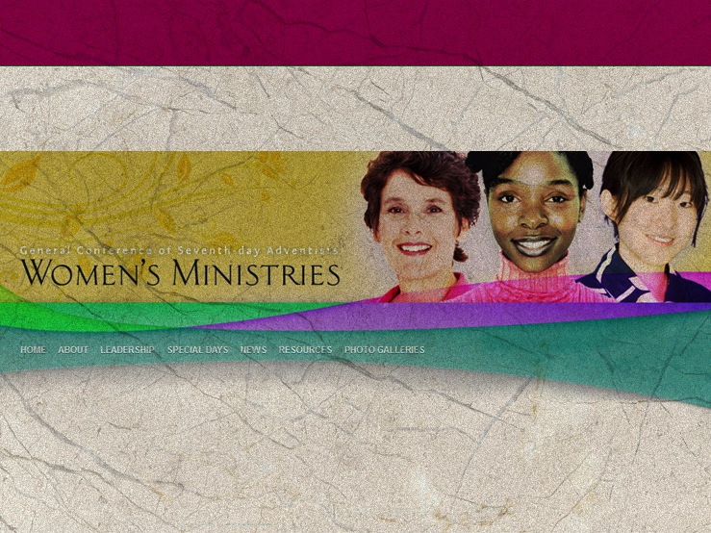
III. Overview of Women’s Ministries
Programs and Resources
GC Women’s Ministries website: adventistwomensministries.org
Notes:
III. Overview of Women’s Ministries Programs and Resources
Based on the Mission Statement, the General Conference Women’s Ministries has developed a number of programs and resources. They are constantly developing seminars, brochures, and other resources for use at all levels. Many of the seminars, sermons, and other materials can be down-loaded from the GC Women’s MInistries web site: http://adventistwomensministries.org/.
Others can be obtained from the Adventist Book Center or AdventSource, and even directly from the Review and Herald Publishing Association. It is important to check with your local Division to see which they can make available; Many Divisions have also generated resources which will be important to your territory. Here is an overview of some of the things available.

Slide 69

PROGRAMS AN RESOURCES
Devotional Books
Scholarship Program
International Women’s Day of Prayer
Women’s Ministries Emphasis Day in June
Notes:
Devotional Books. One of the early projects conceived of by Rose Otis was to publish a devotional book. The first one, Among Friends, was prepared for the year 1993. It was such a success the program continued and all royalties from these books have gone to fund the Women’s MInistries scholarships. A book has been published for every year since 1993. Both the writers and the readers have become very international, and a number of the books have been translated into other languages including French, Spanish, Portuguese, Chinese, Romanian, and German. There has been an effort to always make these books so that women can always feel comfortable sharing these books with women of any religious background.
Scholarship Program. Originally almost all scholarships were funded by profits from the Women’s Ministries daily devotional books. Since then, Scholarshipping Our Sisters (SOS) has raised thousands of dollars for scholarships. Scholarship monies are distributed directly to the educational institution involved and is divided among all the world divisions of the Seventh-day Adventist Church. (Note to presenter: It would be a good idea to find the current number of scholarships given and number of countries represented. This can be learned from the Women’s Ministries web site or directly from the General Conference office.) Any woman who is planning to attend a Seventh-day Adventist college in the division in which she lives may apply. Primary consideration is given to those in the last two years of college-level study. Scholarships are for those in any area of study who would otherwise be unable to afford a Christian education. These are awarded on the basis of need, ability, and the recipient’s determination to improve herself. She must be committed to serve the Lord in whatever way He directs and to be a part of the mission of the Seventh-day Adventist Church.
3. International Women’s Day of Prayer. Early March of each year is a time women of most Christian denominations celebrate a day of prayer. Women’s Ministries has set the first Sabbath of March as the International Women’s Day of Prayer. Women usually plan a full day of prayer, meetings, and activities centered around a spiritual theme. A packet of materials is prepared by the General Conference Department of Women’s Ministries for use on this day. It includes sermons, skits, liturgies, and prayer group ideas. This packet is prepared in English and sent out to the division directors at least nine months in advance for translation and distribution.
4. Women’s Ministries Emphasis Day in June. The second Sabbath in June is designated on the church calendar as Women’s Ministries Emphasis Day. It is a day to report to the church on the activities of Women’s Ministries and to promote local projects. The General Conference Department of Women’s Ministries prepares a packet of materials for use on this day. It includes a variety of materials including sermons, children’s story, dialogues, liturgies, and program ideas. These materials are prepared in English and sent to division directors at least nine months in advance for translation and distribution.
If you are unable to celebrate this Emphasis Day on the designated Sabbath, plan to celebrate it as close to this date as possible.

Slide 70

5. Women’s Ministries Offerings
6. enditnow/Abuse Prevention Emphasis Day
7. LOGO
8. Women’s Ministries Handbook
Notes:
5. Women’s Ministries Offerings. There is no official Women’s Ministries offering day world-wide, but some divisions have set up a date for taking an offering and policies as to how it is to be used. You need to check with your individual division regarding this.
6. enditnow/Abuse Prevention Emphasis Day. The fourth Sabbath of August was voted into the world-wide Church calendar as Abuse Prevention Emphasis Day in 2001 at Annual Council. In 2012 the name of the day was changed to enditnow. A packet including sermons, brochures, a suggested Sabbath program, children’s story and much more, all focused on abuse, is prepared by the Women’s Ministries Department at the General Conference and is for the use of the church congregation and those who need the caring, safe environment of the church. This material is prepared in conjunction with many other Church departments and ADRA. Again, if this date is not available in your church, celebrate it another day as close to this date as possible.
7. LOGO. The Women’s Ministries logo depicts four women of varying ethnic backgrounds. These women represent not only the inclusiveness of Women's Ministries but also represent some of the objectives of Women's Ministries:
It represents women of all ages
It represents women of different ethnic origins
It represents women working together
It represents women with a book. It may be a Bible, representing spiritual growth. The women may be learning for themselves or teaching others. It may be a literacy book. It may be that the women are studying leadership or mentoring other woman. Or it may be a book on any of the other areas of interest to women, but women are growing and sharing.
This logo represents women supporting and caring for each other; together they represent an important part of the church, and together they can make a difference.The logo is trademarked and is only to be used to identify the Women's Ministries Department of the Seventh-day Adventist Church. If you want to use it, please check the official GC Women’s Ministries web site for colors, sizes, uses, etc.
8. Women’s Ministries Handbook. This handbook contains the Mission Statement, roles and objectives, philosophy, and history of Women’s Ministries. It contains information on many ministries of Women’s Ministries and policies for the smooth running of the department. It also contains a listing of resources. The original handbook was revised in 1997. The division directors translate this in languages of her division as the need arises. It may be used as a guide for the development of a division or union handbook. It is the how-to-do-it guide for all Women’s Ministries directors and should be studied carefully. There is also a condensed version of the Handbook available on the General Conference Women’s Ministries web site.

Slide 71
9. Leadership Certification
10. Mosaic
11. “Homes of Hope and Healing
12. “Outreach is for Everyone”
postcards
Notes:
9. Leadership Certification. The General Conference Department of Women’s Ministries produces a series of seminars to train women to fill leadership roles. This is a three-year-training program that continually recycles, thus providing continuing professional education and the development of women for leadership in Women’s Ministries as well as other areas of church work. The seminars can be used for leadership retreats, training programs at local churches, as well as for self-study by those who miss the group training sessions. Each seminar will contain material for a lecture as well as handouts, resource material, and PowerPoints.
The course outline with seminar descriptions has been given to each division director and the completed seminars have been supplied to each division for translation.
10. Mosaic. Mosaic is the every-other-month General Conference newsletter that can be obtained in hard copy or via the web site. It contains news, coming events, ministry suggestions, and much more. Contact the General Conference Women’s Ministries or your individual division to find out about how to obtain it. It is translated in many parts of the world. Some Divisions also have their own newsletter.
11. The “Homes of Hope and Healing” program involves opening homes to neighbors for fellowship and learning. There are eight lessons.
12. “Outreach is for Everyone” postcards. If you are looking for ways to involve women in reaching out to their friends and neighbors, these 10 postcards outline ideas for outreach using their individual gifts. These can be downloaded from the General Conference Women’s Ministries web site.

Slide 72
13. Women's Ministries Pastor's and Elder's Handbook
14. “Women in the Bible and Me”
15. “Bible Studies for Busy Women”
16. “Outreach is for Everyone”
Notes:
13. Women's Ministries Pastor's and Elder's Handbook. Often pastors and other church leaders do not understand Women’s Ministries; this is a resource you can give to them to help them understand and support. A condensed edition is available from the GC Women’s Ministries web site.
14. “Women in the Bible and Me” is a series of 14 Bible studies prepared especially for women by Evelyn Glass, a long-time Women’s Ministries director. These are for nurture and encouragement. Published by the Review and Herald Publishing Association.
15. “Bible Studies for Busy Women.” These 14 interactive and reproducible Bible studies were written by Ardis Dick Stenbakken and Carole Ferch-Johnson when women asked for inexpensive Bible studies that can be used in small groups. Available from Pacific Press Publishing Association.
16. “Outreach is for Everyone.” The is an evangelism manual that covers about everything women would need to know to plan and carry out an evangelism series or even do one-to-one Bible studies or small group or seminar evangelism. If your church is planning any type of public outreach, this book can be a great help.

Slide 73
“Likewise, teach the older women to be reverent in the way they live, not to be slanderers or addicted to much wine, but to teach what is good. Then they can urge the younger women to love their husbands and children, to be self-controlled and pure, to be busy at home, to be kind, and to be subject to their husbands, so that no one will malign the word of God.”
Titus 2:3-5
Notes:
Conclusion
Women’s Ministries has been a blessing to individual women and to the local church and community right from the first. And with your support, it will continue to be. The programs, Bible studies, and other spiritual activities will nurture your soul. The leadership training can empower and help you be prepared to fully partake in the mission of the church. As you and other women work together to meet the needs of your church and community, and mentoring other women, you too will be fulfilling the outreach mission of the church. Further, you will be fulfilling the task presented in Titus 2:3-5 by finding and helping to meet the needs of your church and community.
Likewise, teach the older women to be reverent in the way they live, not to be slanderers or addicted to much wine, but to teach what is good. Then they can urge the younger women to love their husbands and children, to be self-controlled and pure, to be busy at home, to be kind, and to be subject to their husbands, so that no one will malign the word of God.

Slide 74
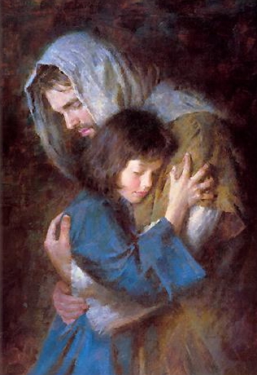
“Many women do noble things,
but you surpass them all.
Charm is deceptive, and beauty is fleeting;
but a woman who fears the Lord is to be praised.
Honor her for all that her hands have done,
and let her works bring her praise at the city gate."
Proverbs 31:29-31
Notes:
Paul wrote to the culture of his day; If he were writing today, he would undoubtedly urge women to be involved in their community, making a difference. He would encourage mothers to be the best mothers they can be, and professional women to reflect Christ in the marketplace, and all women to forward the mission of the church, working with other women and men locally and globally according to the God-given gifts she possesses.
“Many women do noble things,
but you surpass them all.”
Charm is deceptive, and beauty is fleeting;
but a woman who fears the Lord is to be praised.
Honor her for all that her hands have done,
and let her works bring her praise at the city gate.
Proverbs 31:29-31

