Slide 1
We Value Compassion
WEST Visayan Conference
Women’s Ministries, SI’s, PK’s,
Acts of COMPASSION DURING COVID LOCkDOWn

Slide 2
Women’s Ministries Acts of Compassion Initiatives

Slide 3
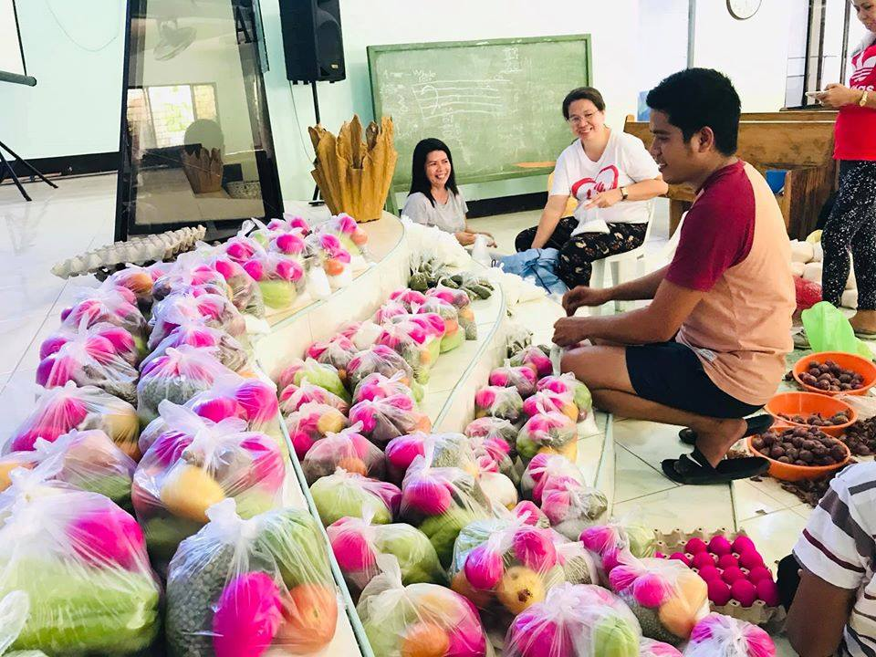
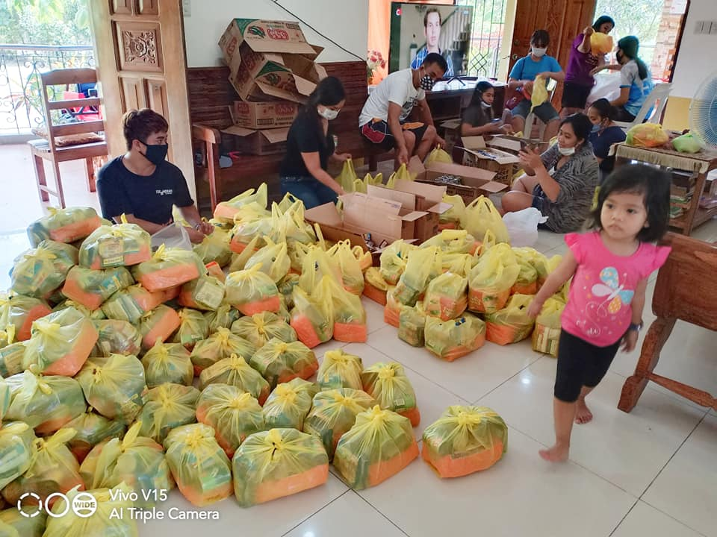
Preparation of Food Packages

Slide 4
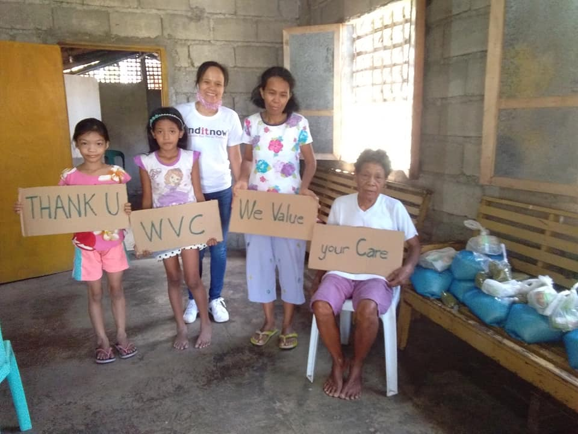
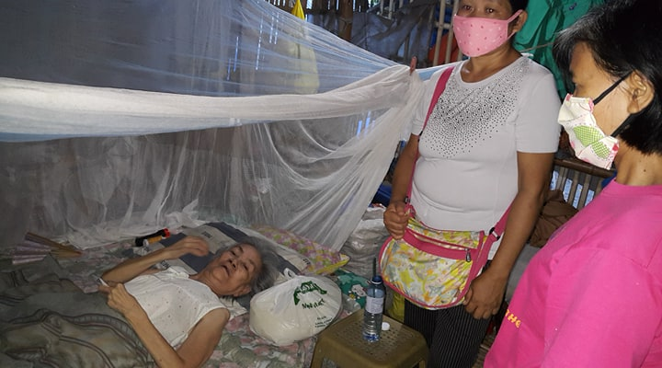
Giving of Food Packages

Slide 5
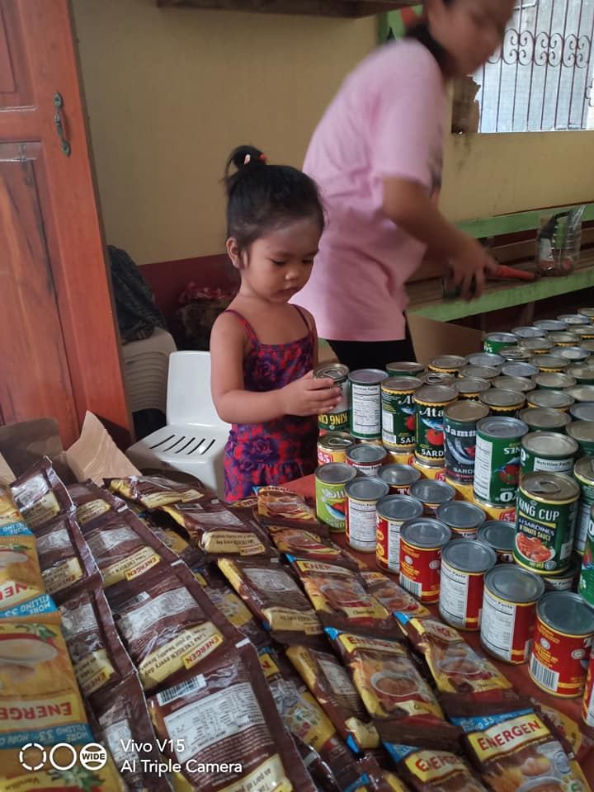
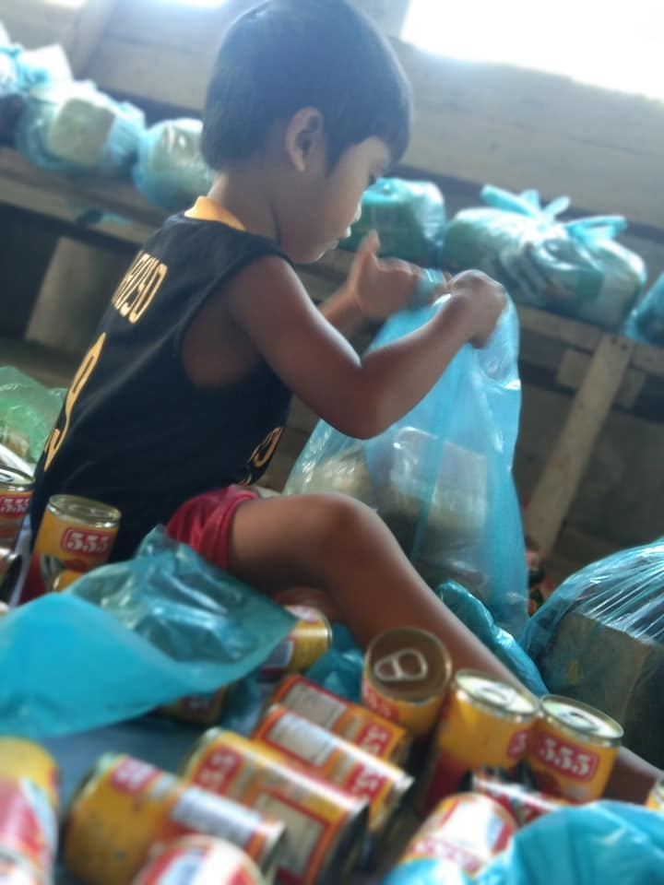
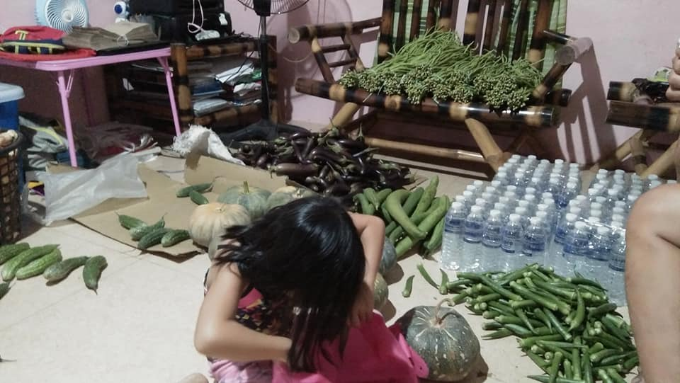
Pastors’ Kids in Action

Slide 6
Ministry to the Frontliners

Slide 7
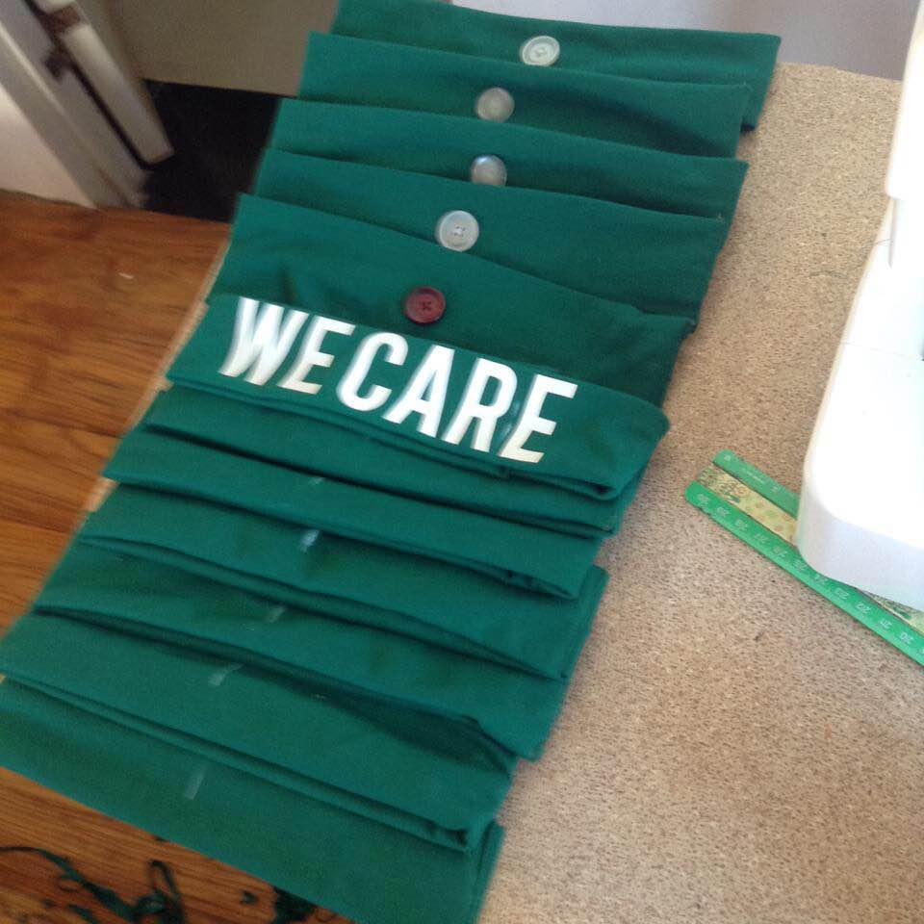
Face Mask Ministry

Slide 8
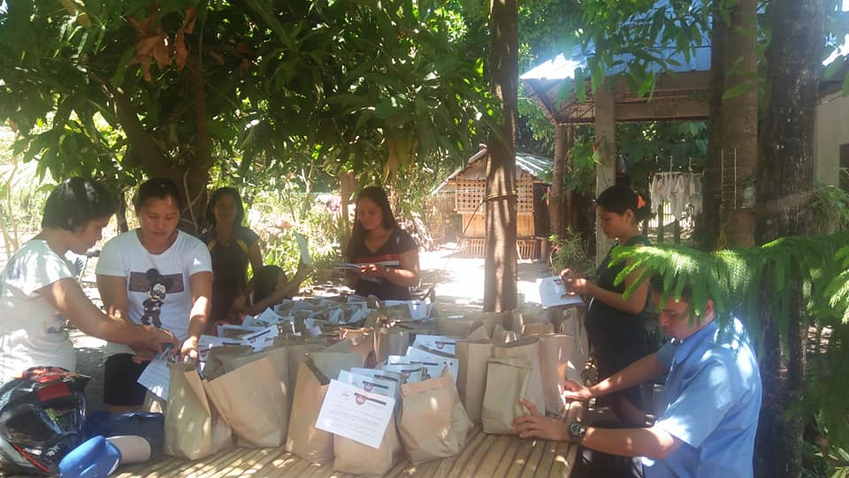
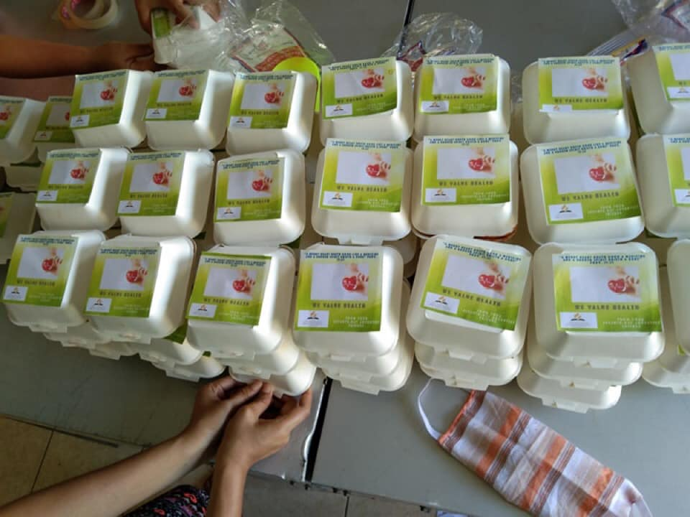
Snacks for the Frontliners

Slide 9
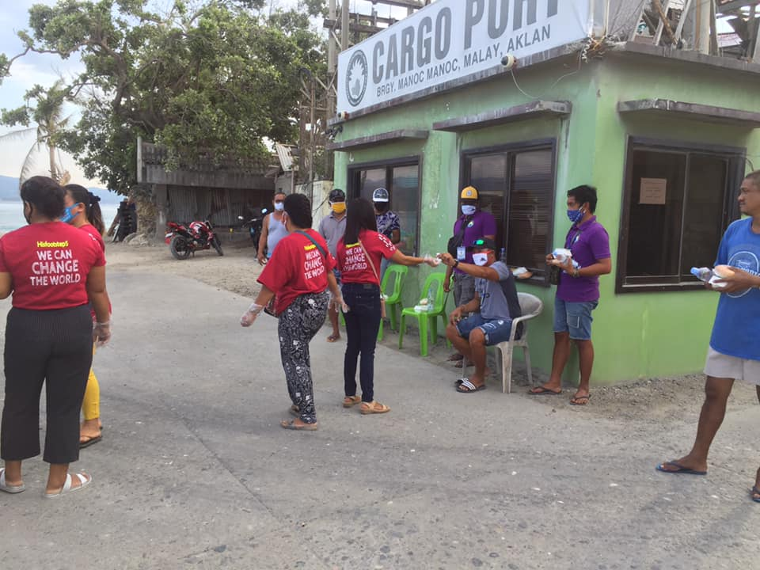
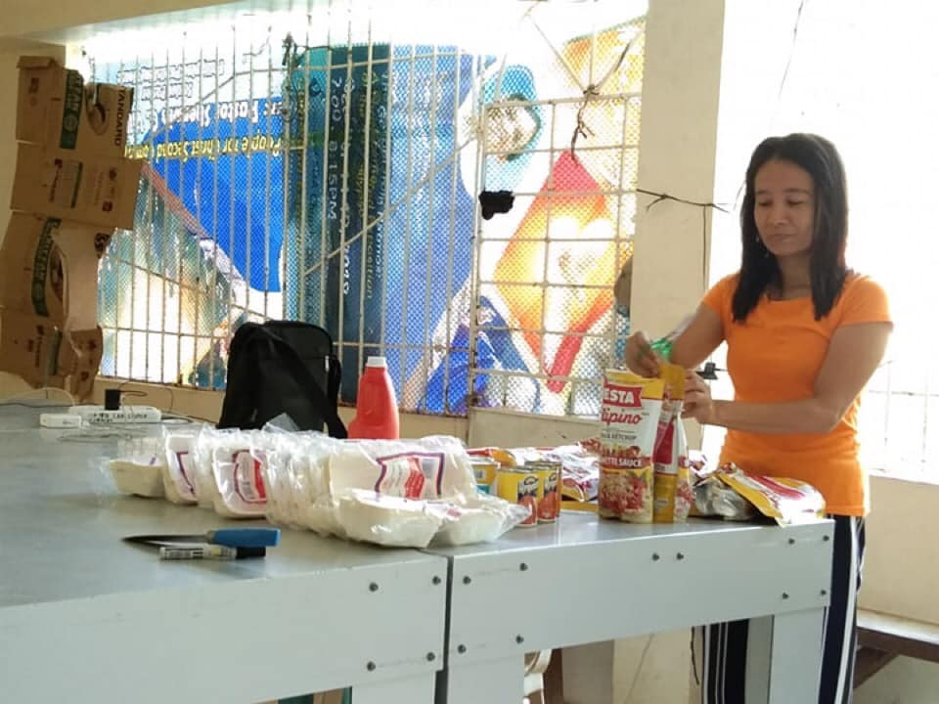
SI’s Kitchen Ministry

